Slide 1
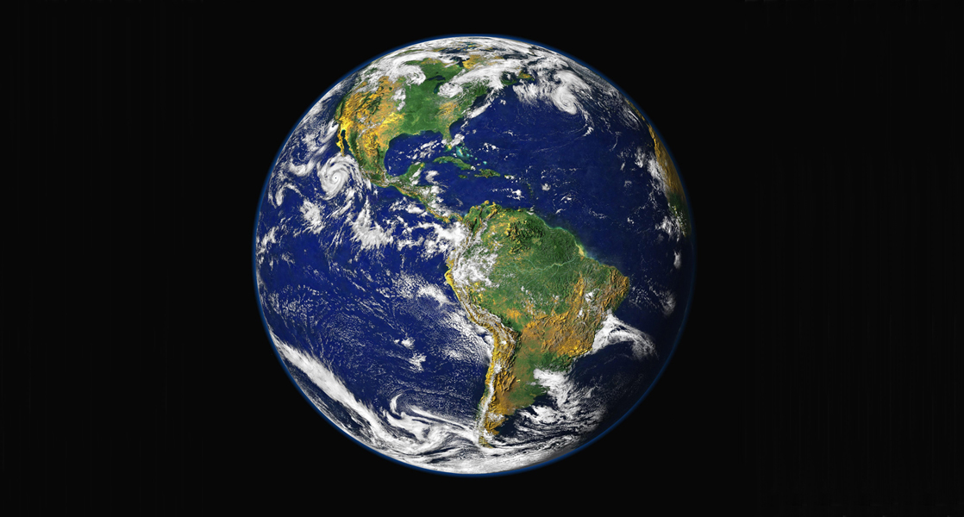

What is sustainability?
Jeff McKinnon, Professor, Department of Biology
Faculty Workshop on Integrating Sustainability into the Curriculum
12-13 May 2025
Notes:
Think about definitions and explore related issues, topics, to help us kick off

Slide 2
SUSTAINABILITY
Opening Activity: (can discuss with neighbors first)
Define the term sustainable
Give examples of “sustainable” and “sustainability” based on your knowledge:
  Personal, professional, family/friends
  Social
  Economic
  Natural Environment
Consider sustainability at different scales - local, state, regional, federal, international. Decision-makers Problems Solutions

Slide 3
SUSTAINABILITY
Bruntland 1987: "meets the needs of the present without compromising the ability of future generations to meet their own needs”
Typically most emphasizes the natural environment with societal and economic aspects also considered key
Various indices proposed
Global warming and biodiversity loss (extinction) widely viewed as especially critical issues
Biology perspective: extinction as a key indicator?
Notes:
In 1987, the World Commission on Environment and Development (WCED), which had been set up in 1983, published a report entitled «Our common future». The document came to be known as the «Brundtland Report» after the Commission's chairwoman, Gro Harlem Brundtland. It developed guiding principles for sustainable development as it is generally understood today. UN affiliated.

Slide 4
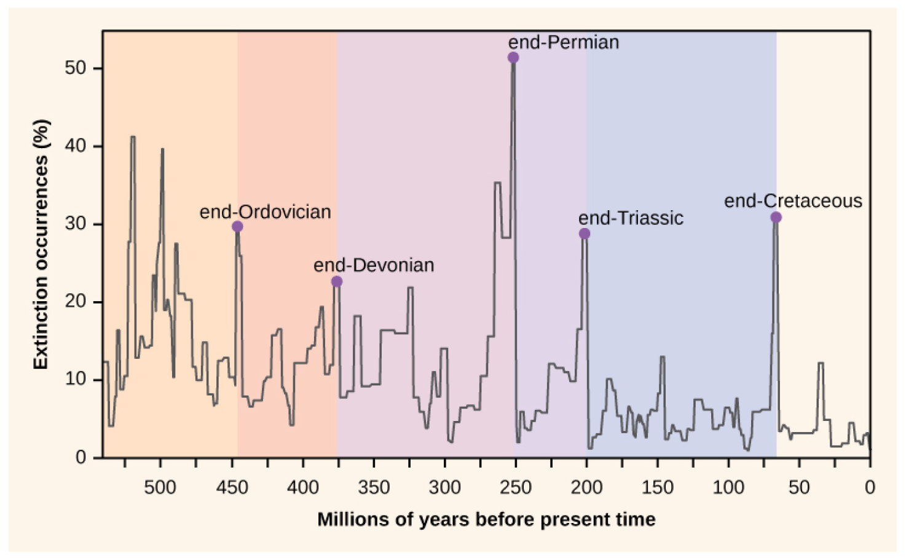
The diversity of life
Notes:
538.8mya Phanerozoic EOn

Slide 5
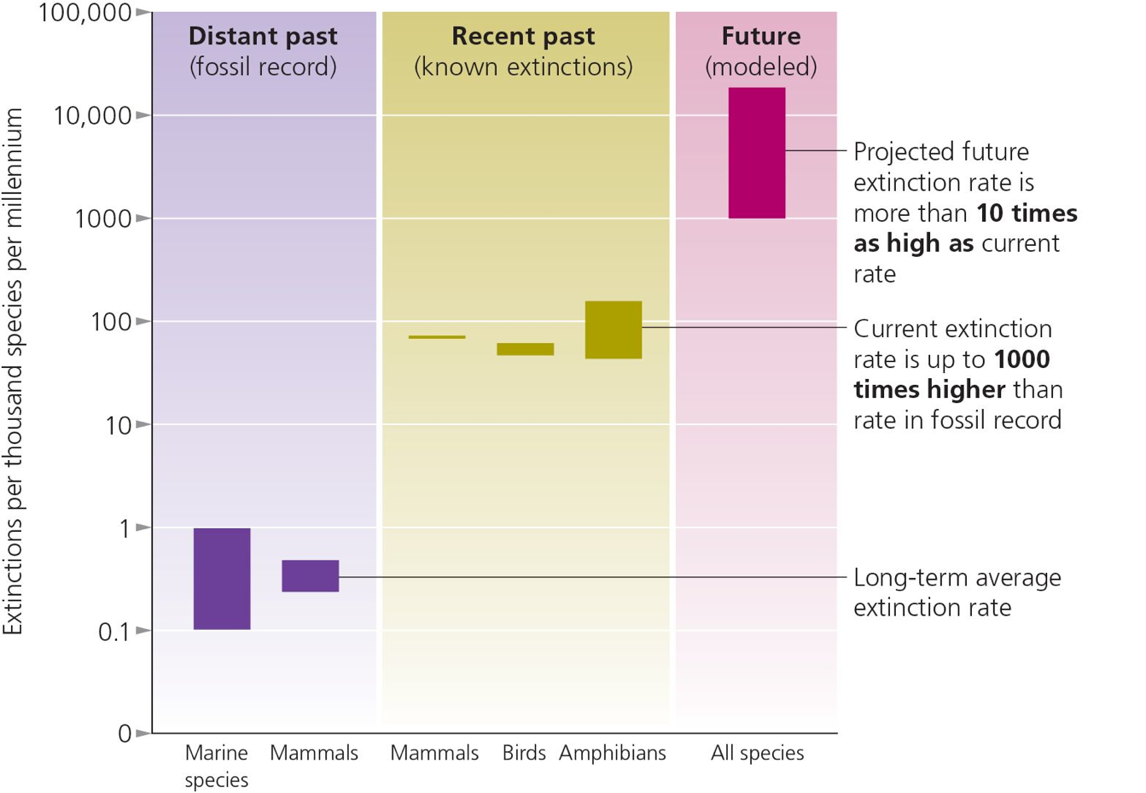
Entering a sixth mass extinction?
Emlen and Zimmer 2015
Notes:
History may help us better interpret the present

Slide 6
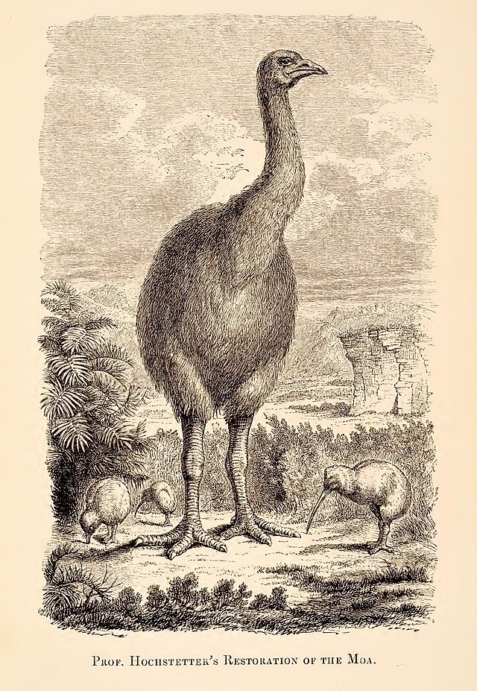
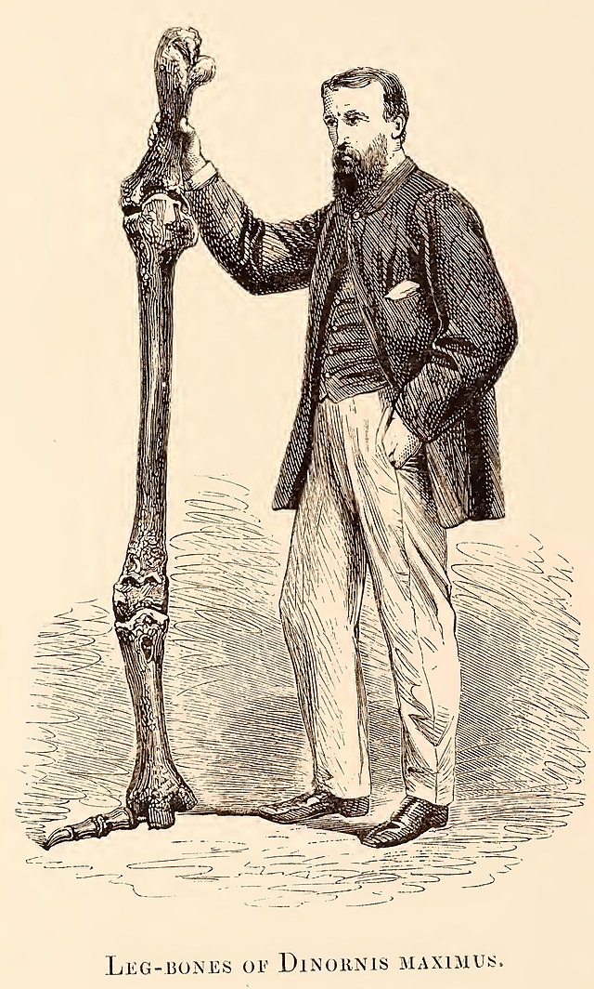
Shifting Baselines!
Each generation considers its own experience normal and change is overlooked
When did current mass extinction start?
Pacific Islands: extinctions of New Zealand’s moas, others generally viewed as result of first human arrivals <1000ya
Many other birds, especially flightless, also disappeared across the Pacific, elsewhere
Suggest human arrival consistently associated with extinctions

Slide 7
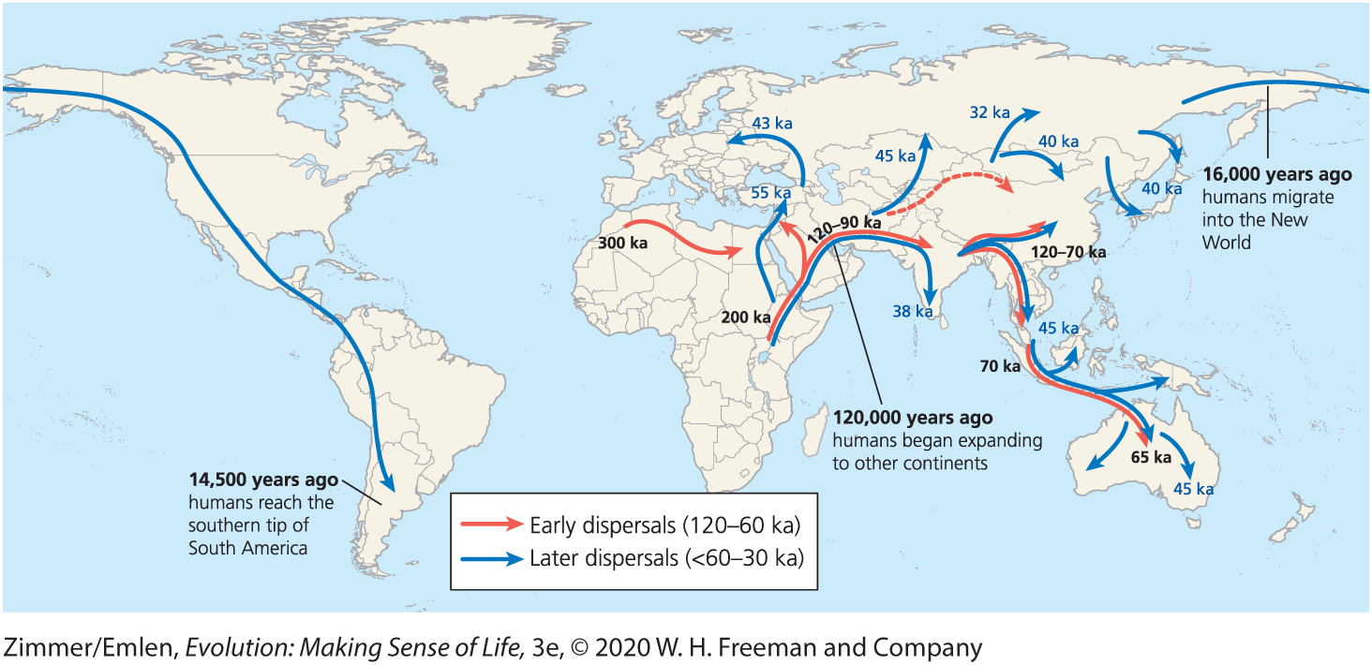
Modern humans radiate from Africa starting about 120,000 years bp (other Homo already in Eurasia)
Notes:
Figure 17.31 Studies on fossils and DNA indicate that humans originated in Africa and expanded throughout the continent. Starting about 120,000 years ago, humans began expanding to other continents. (Data from Bae et al. 2017)
The genes of living people outside of Africa suggest that they belong to one main lineage, which arose from a small population of East Africans who expanded into the Near East. This history is reflected in the genetic diversity of living people: Africans today have much more genetic diversity than all other people on Earth combined because their populations have accumulated variation in their DNA for much longer.

Slide 8
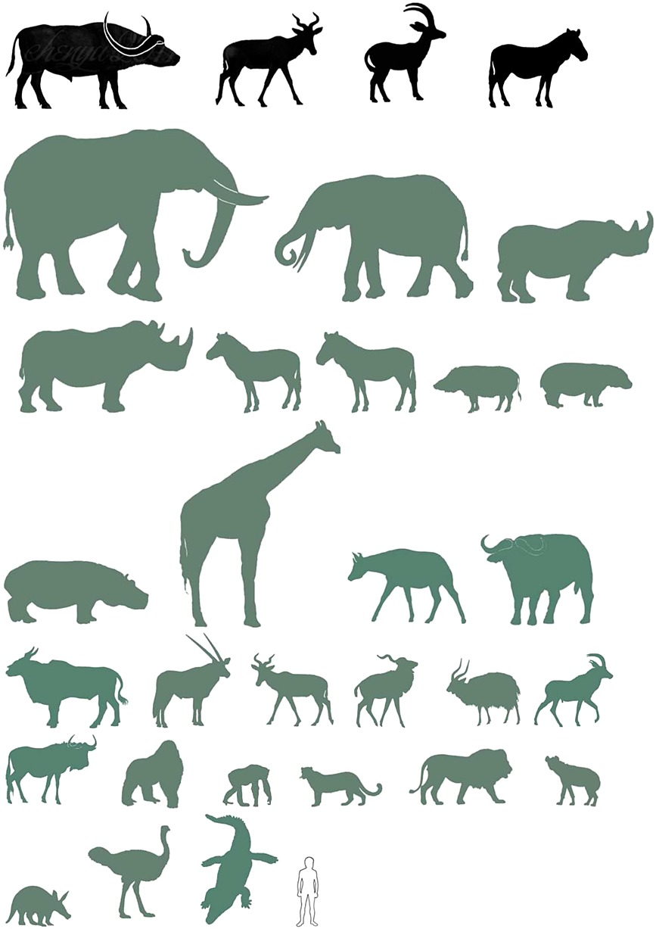
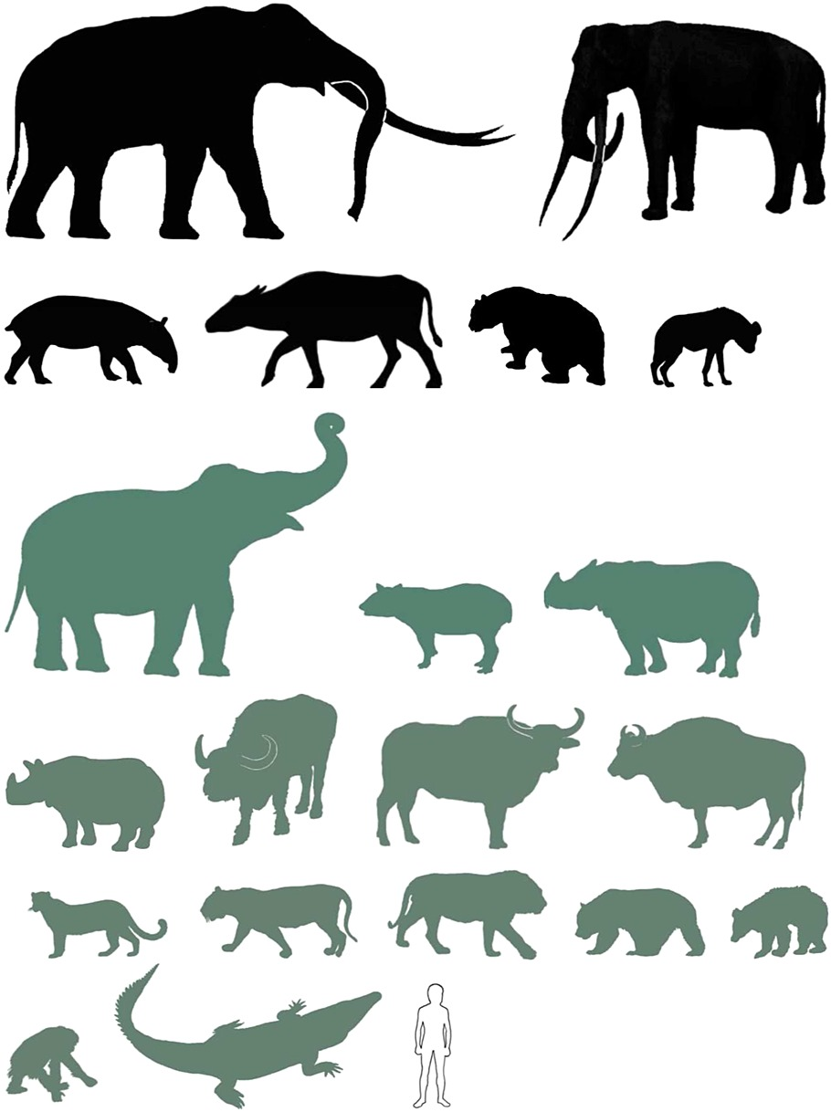
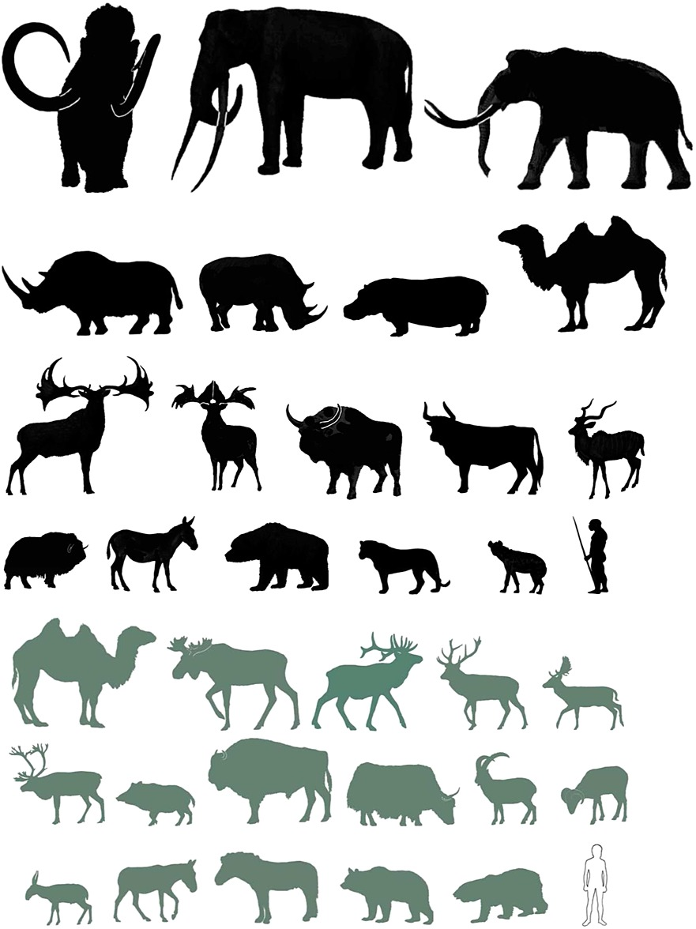
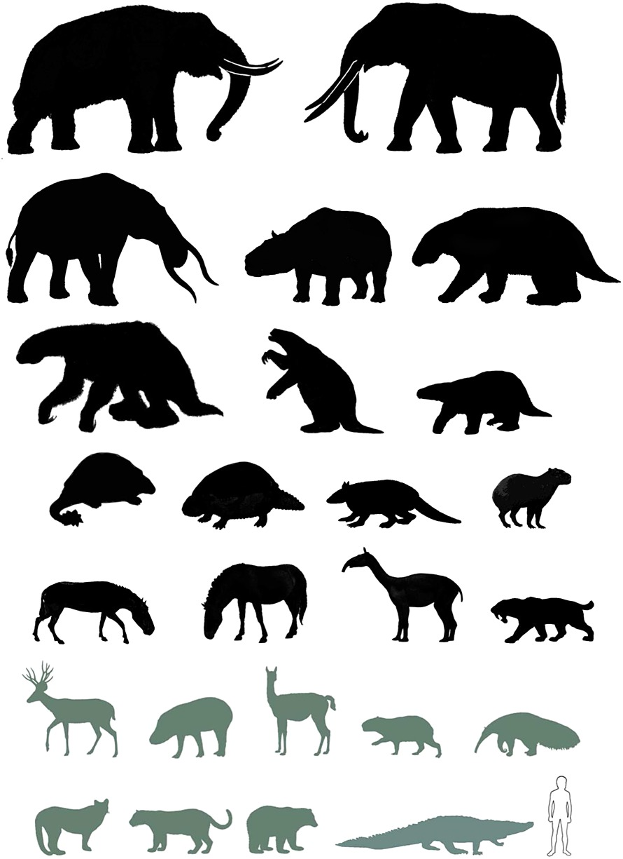
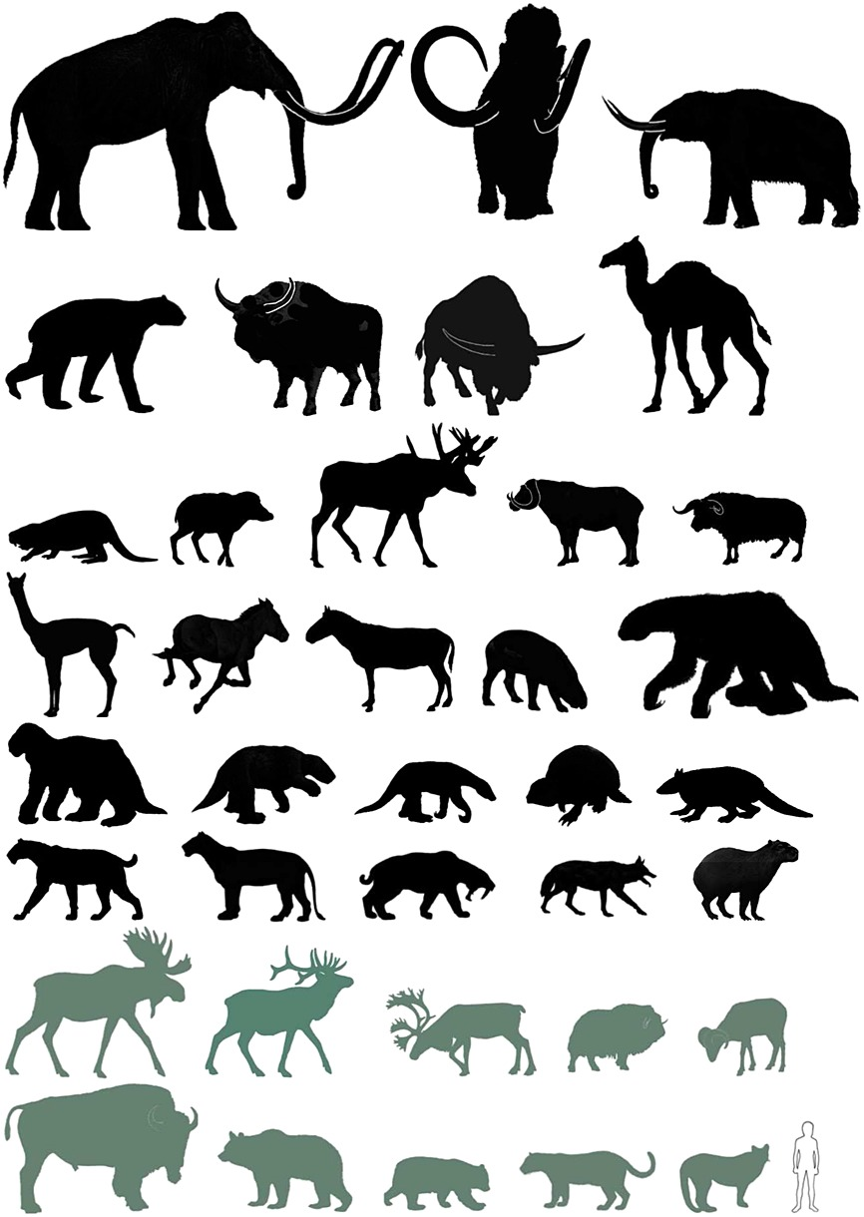
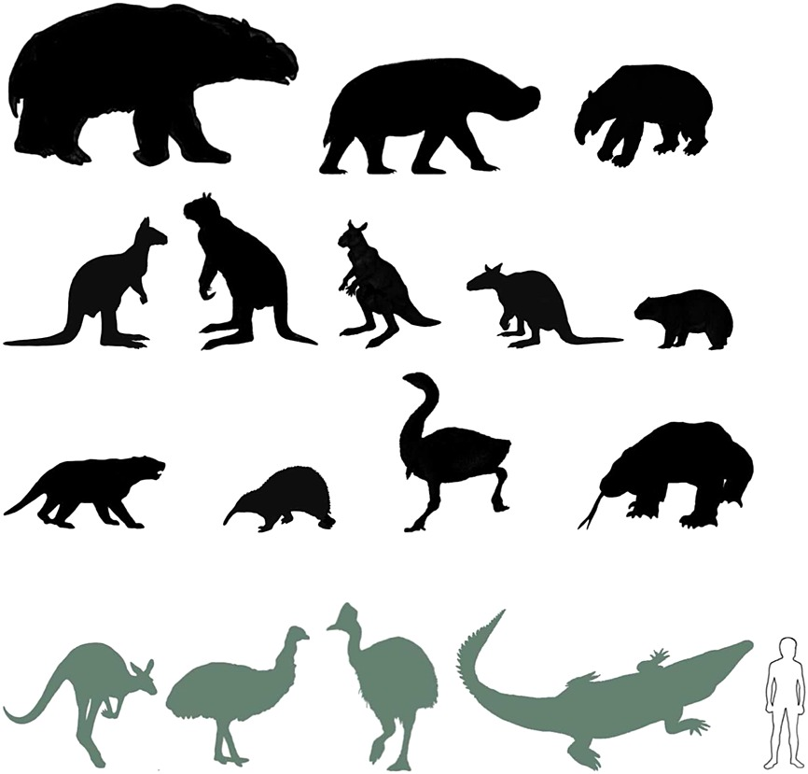
Megafauna extinctions (>~100lbs)
(though not in oceans, rivers)
Sub-Saharan Africa
S Asia
N Eurasia
S America
Austrasia
N America (low latitudes; higher similar)
Geological Journal, Volume: 50, Issue: 3, Pages: 338-363, First published: 20 December 2014, DOI: (10.1002/gj.2633)
Notes:
Southern Asia (Indo‐Malay Ecoregion). Selected extinct species (black): Stegodon orientalis, Palaeoloxodon namadicus, Megatapirus augustus, Bubalus mephistopheles, Ailuropoda baconi, Crocuta (crocuta) ultima. Selected living species: Elephas maximus, Rhinoceros unicornis, Rhinoceros sondaicus, Tapirus indicus, Bubalus arnee, Bos javanicus, Bos gaurus, Panthera pardus, Panthera tigris, Panthera leo, Ailuropoda melanoleuca, Melursus ursinus, Pongo pygmaeus, Crocodylus porosus. Outline Homo sapiens gives approximate scale.
IF THIS IMAGE HAS BEEN PROVIDED BY OR IS OWNED BY A THIRD PARTY, AS INDICATED IN THE CAPTION LINE, THEN FURTHER PERMISSION MAY BE NEEDED BEFORE ANY FURTHER USE. PLEASE CONTACT WILEY'S PERMISSIONS DEPARTMENT ON PERMISSIONS@WILEY.COM OR USE THE RIGHTSLINK SERVICE BY CLICKING ON THE 'REQUEST PERMISSIONS' LINK ACCOMPANYING THIS ARTICLE. WILEY OR AUTHOR OWNED IMAGES MAY BE USED FOR NON-COMMERCIAL PURPOSES, SUBJECT TO PROPER CITATION OF THE ARTICLE, AUTHOR, AND PUBLISHER.

Slide 9
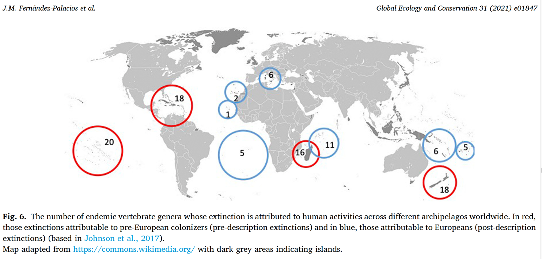
Continued on islands, later
Started well before the wave of European colonizations—islands (especially Pacific—others less definitive)
-hunting, introductions, habitat change; often large species, flightless birds
Red: pre-European
Blue: European

Slide 10
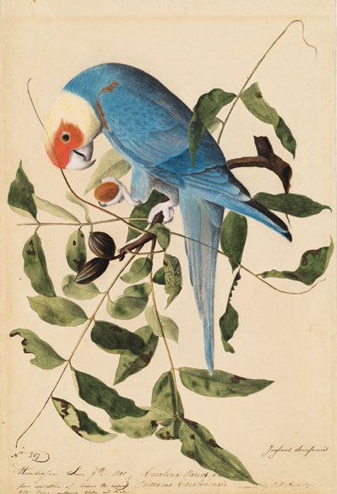
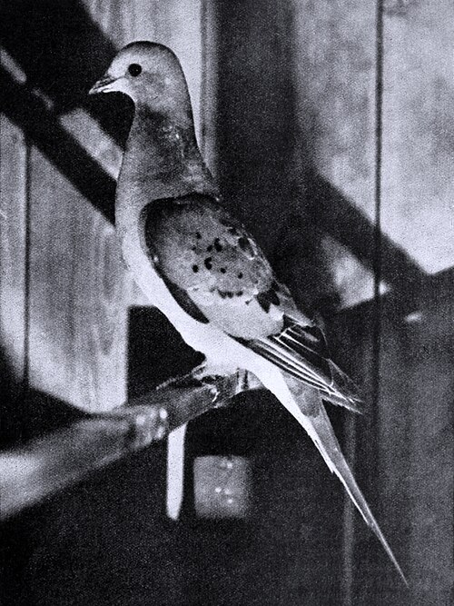
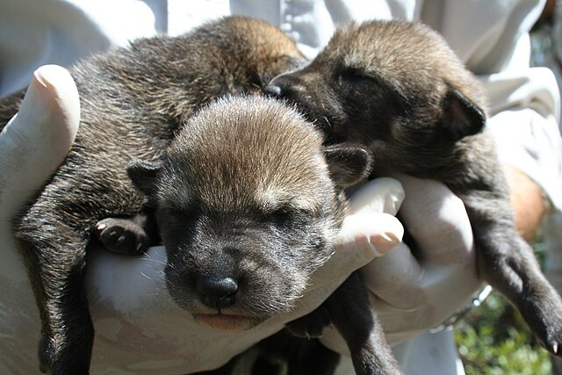
Red Wolf (Ryan Nordsven/ USFWS ccby 2.0)
Still extant, only in NC
Passenger Pigeon(Wikipedia 1898)
Extinct 1914
Carolina Parakeet (Audobon)
Extinct 1918
Extinct (or nearly) NC Species
(hunting key)

Slide 11
Extinction story so far …
Our species has authored major (mass?) extinction of mainly megafauna over the last 60,000 years, largely through hunting (introductions)
Situation much better in the oceans
21st century causes of extinction different … soluble?

Slide 12
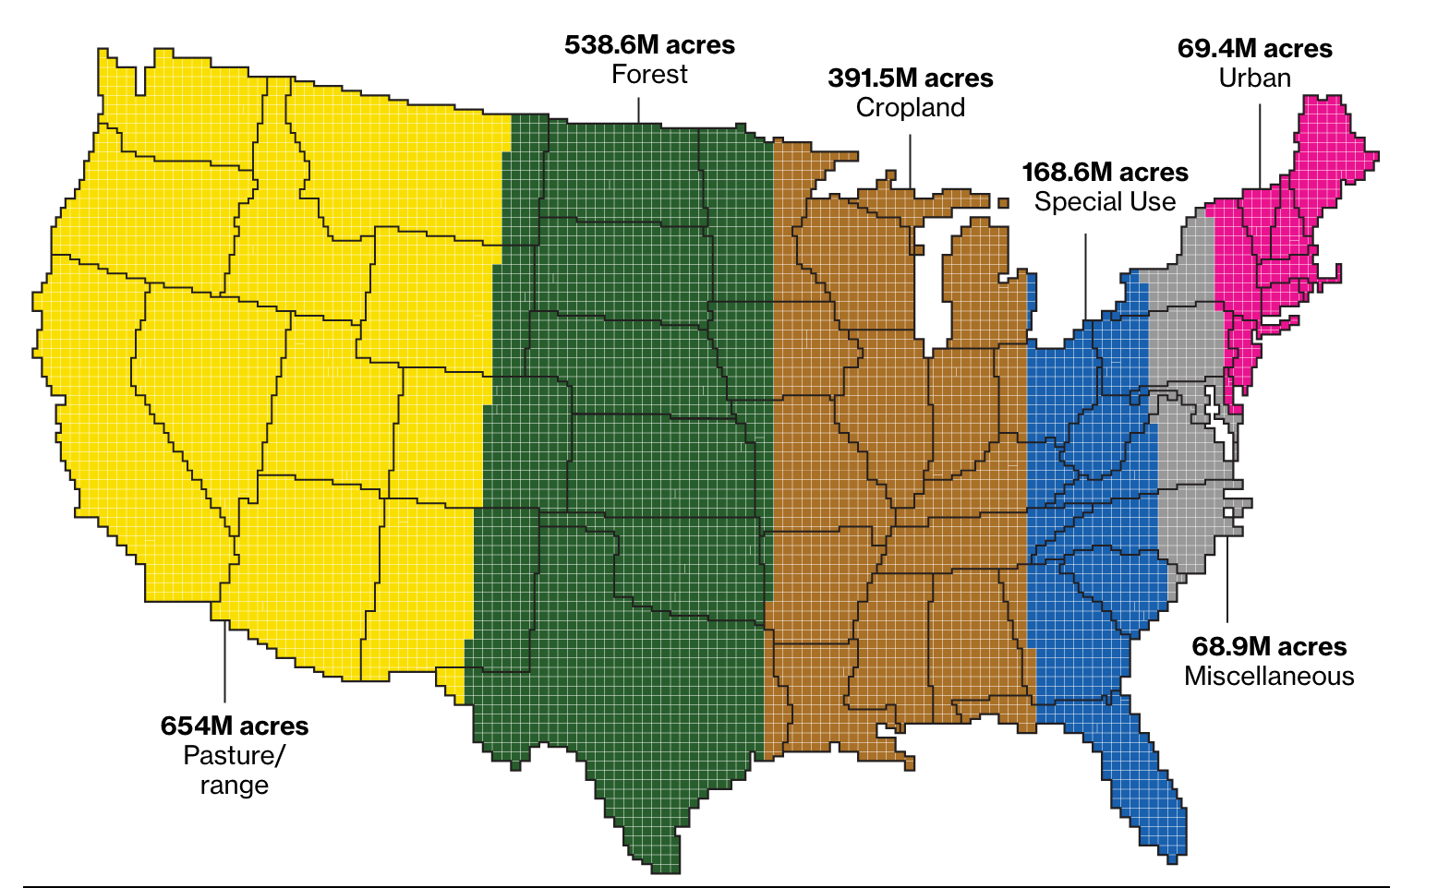
21st Century
Problem 1
Space
Merrill and Leatherby, Bloomberg 2018 (USDA data)
https://www.bloomberg.com/graphics/2018-us-land-use/?sref=B3uFyqJT
Notes:
bioconcentration

Slide 13
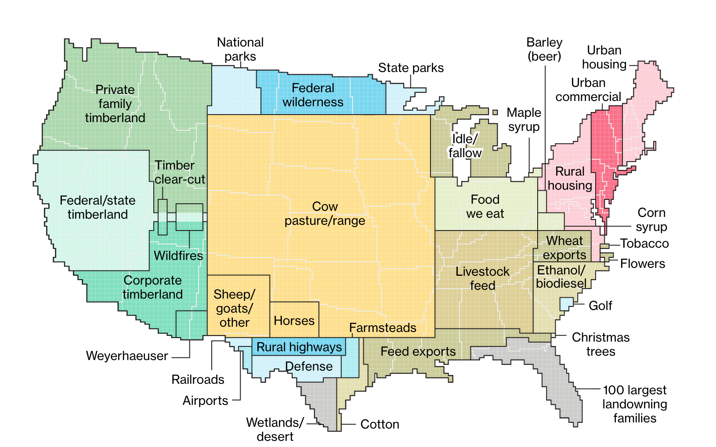
Merrill and Leatherby, Bloomberg 2018
https://www.bloomberg.com/graphics/2018-us-land-use/?sref=B3uFyqJT
Notes:
bioconcentration

Slide 14
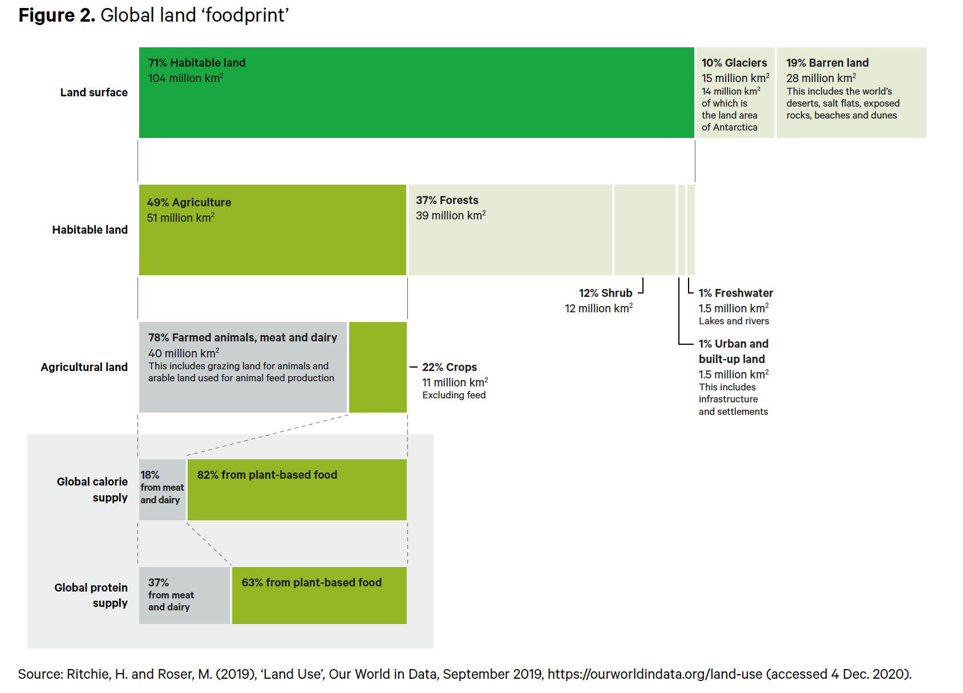
Benton et al. 2021, Fig. 2
Notes:
Could free up land for wilderness and conservation, carbon capture, etc

Slide 15
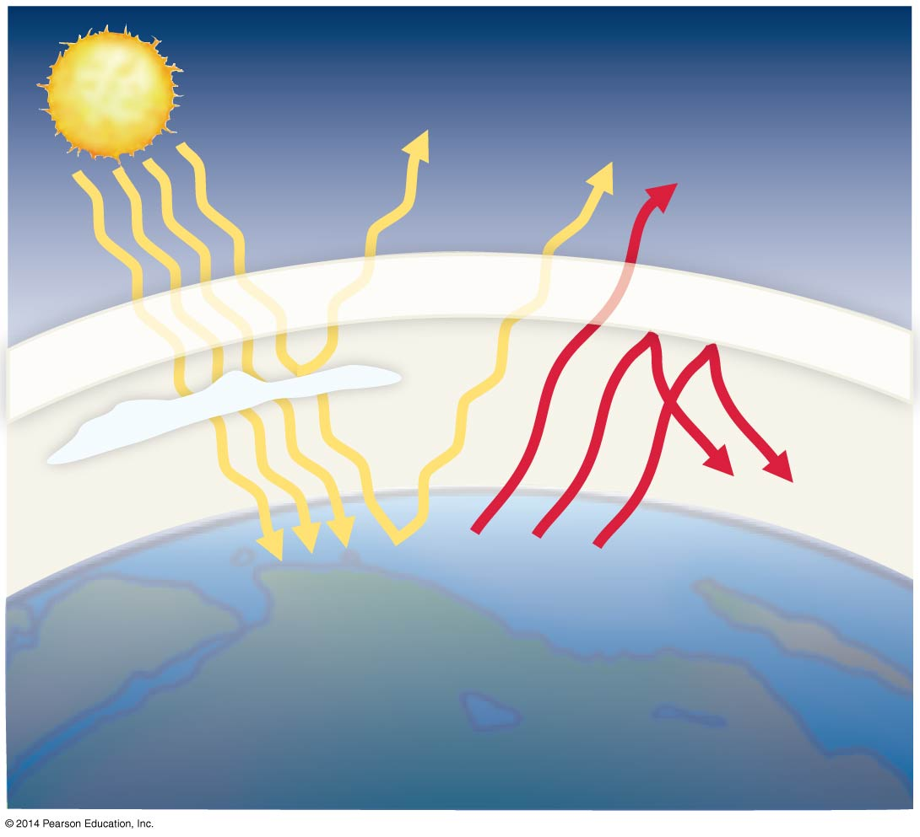

21st Century
Problem 2
Heat
The culprits:
CO2 (oil, coal, natural gas);
methane (aka natural gas)
Clouds
Heat
High-energy solar radiation
enters the atmosphere.
Some is reflected, and some
is absorbed by the Earth’s
surface, warming it.
Heat is emitted as infrared
radiation. Some is lost in
space, but much is trapped
by greenhouse gases and
retained in the atmosphere,
increasing the temperature.
Notes:
15
Figure 56.21 The Greenhouse Effect.

Slide 16
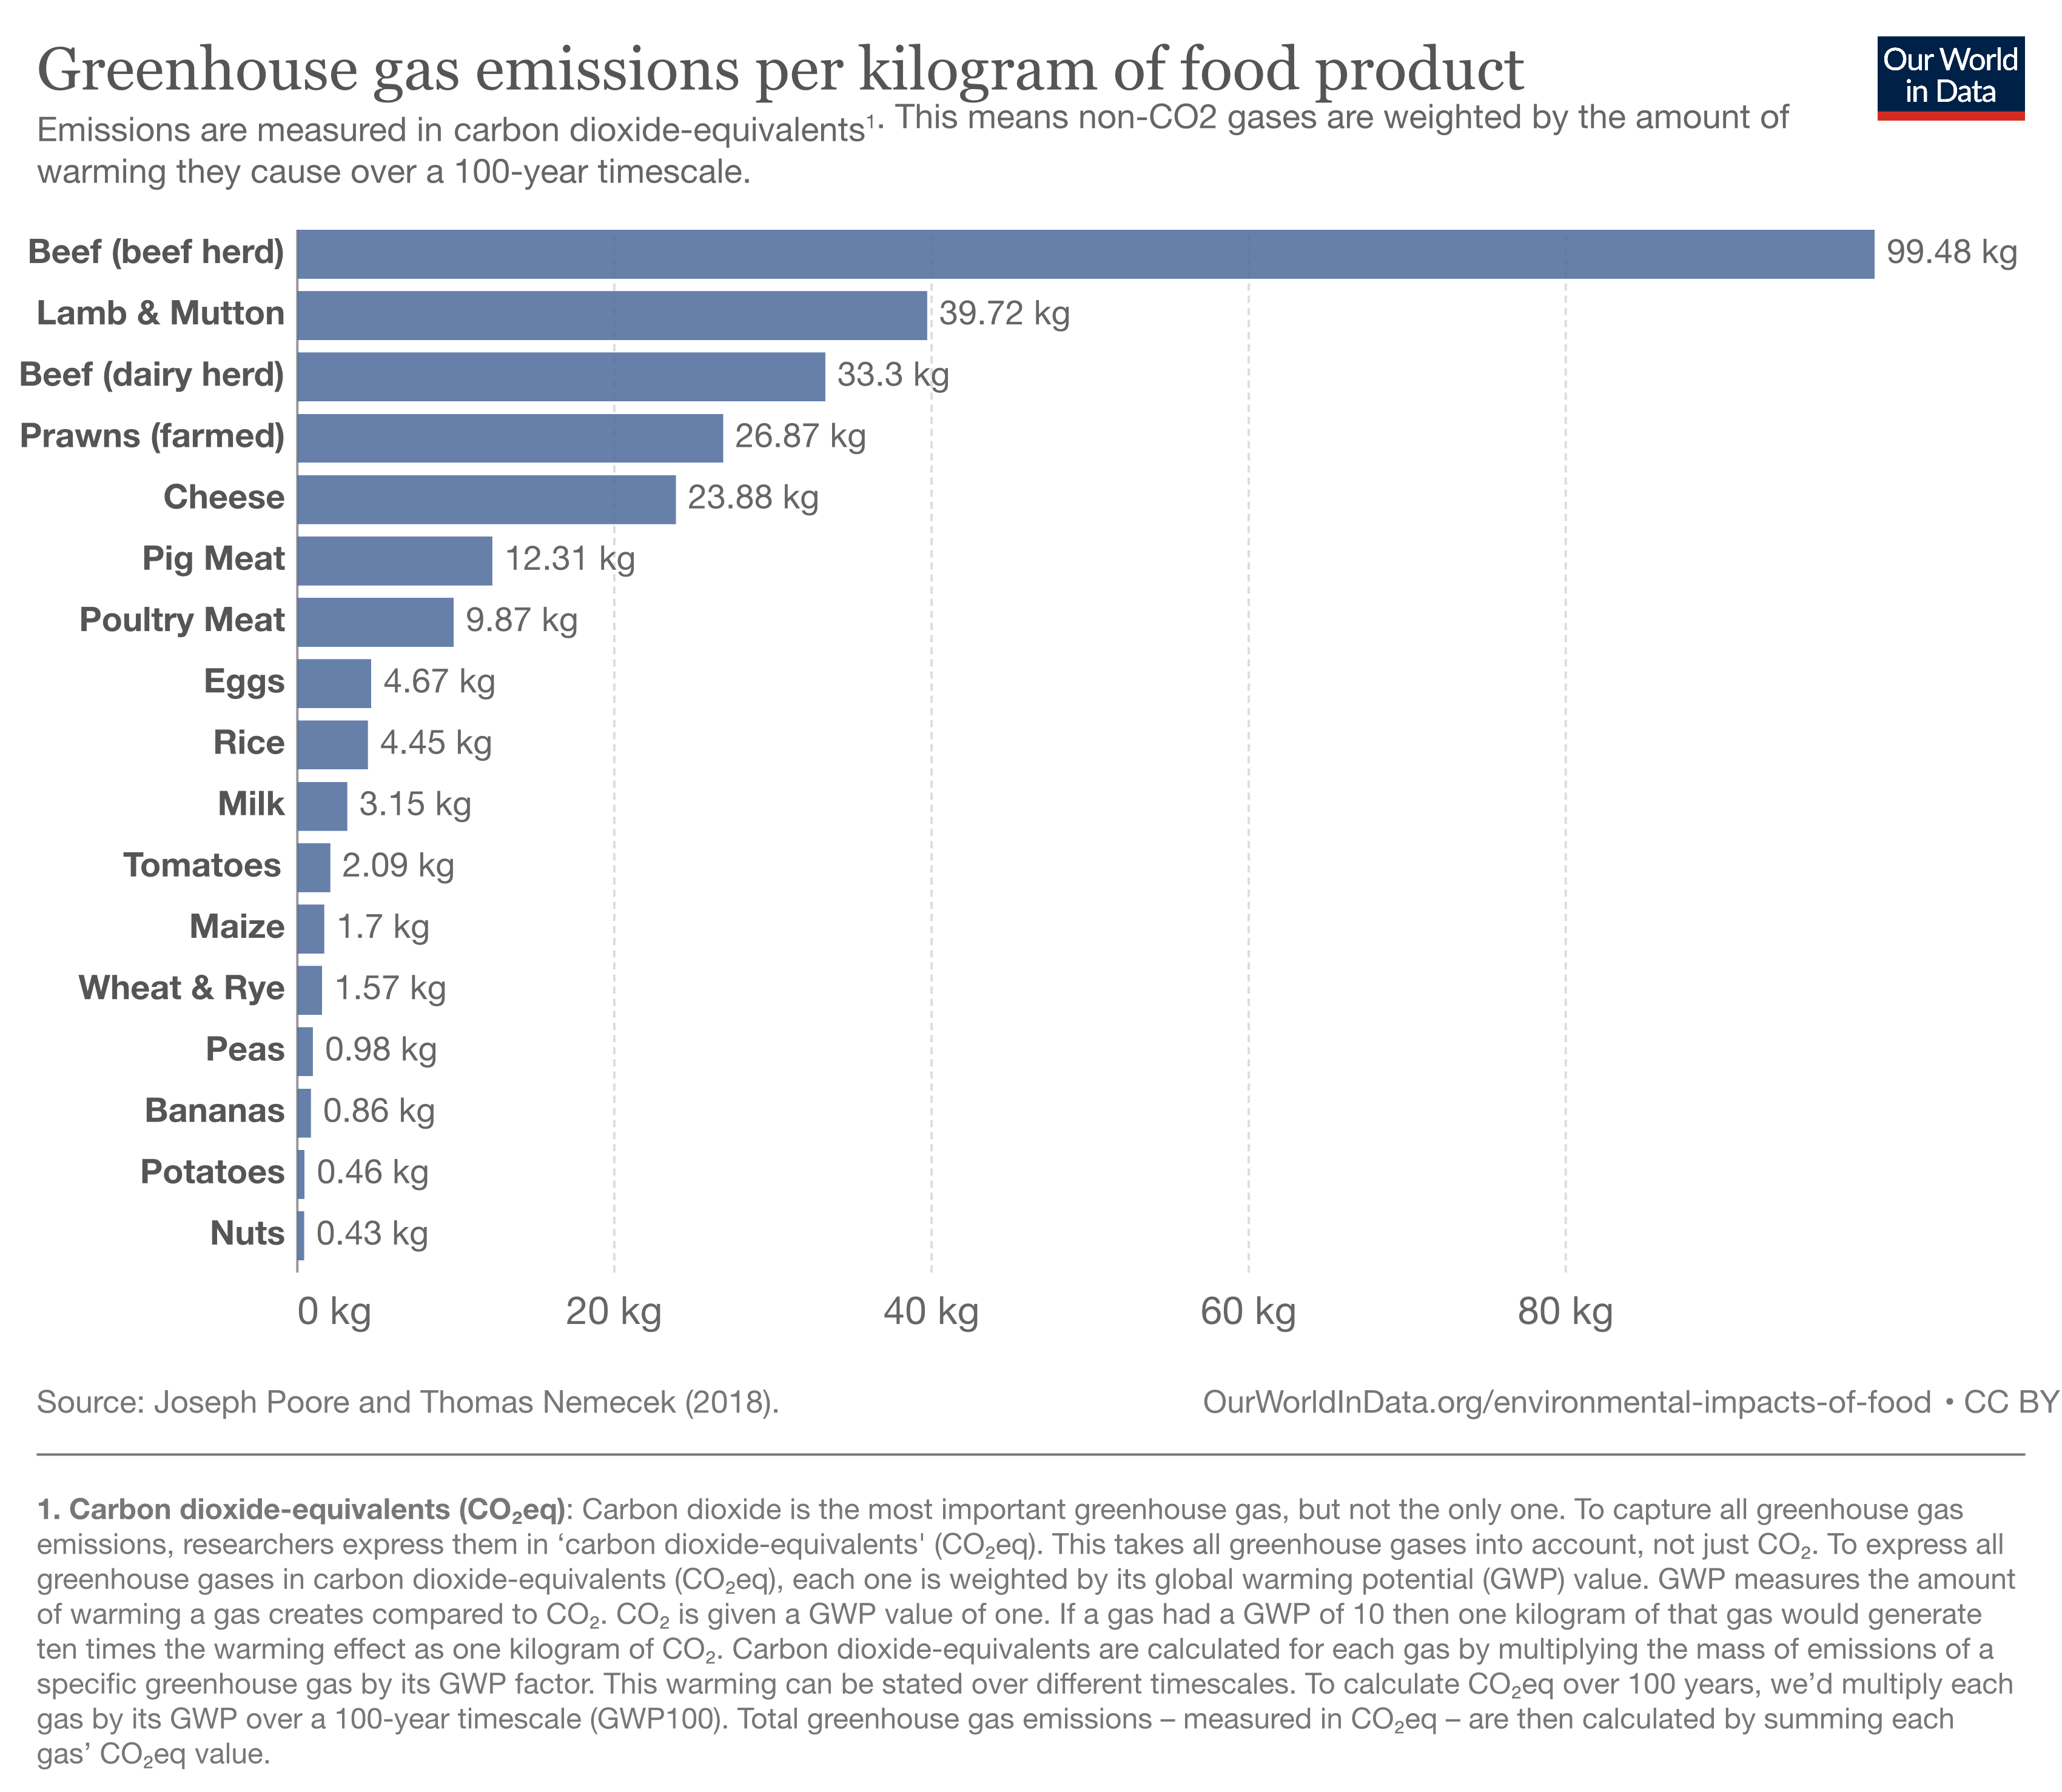
Notes:
Could free up land for wilderness and conservation, carbon capture, etc

Slide 17
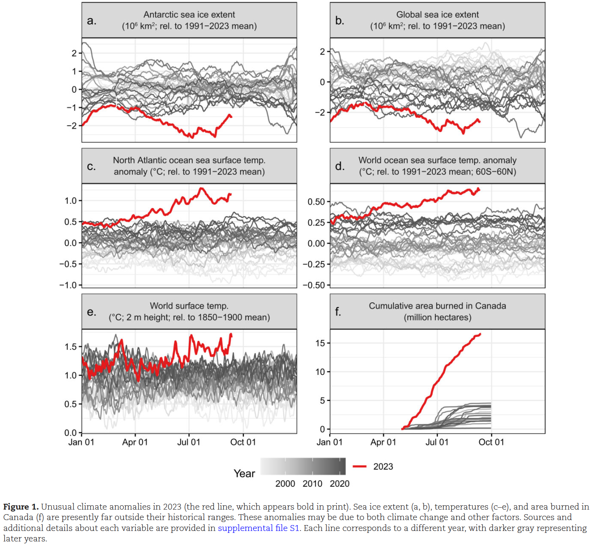
The 2023 state of the climate report: Entering uncharted territory
Ripple et al. 2023
Have aerosols been protecting us?
First climate extinction:
Florida plant
Notes:
Figure 14.27 A: Human activity has already dramatically raised the concentration of carbon dioxide in the atmosphere. B: As a result, the average temperature of the planet has shown a warming trend for the past century. C: Computer projections consistently show that the planet will warm much more in the next century if the concentration of atmospheric carbon dioxide continues to increase. This graph shows three scenarios. In RCP 2.6, greenhouse gas emissions peak by 2020 and then substantially drop after that. In RCP 4.5, emissions peak around 2040 before declining. And in RCP 8.5, emissions rise throughout the twenty-first century. Rapid climate change may raise the extinction rate by reducing suitable habitat for species.
I am more optimistic in general because folks your age often seem to view this as an urgent matter, and with technological changes moving to low carbon is probably relatively painless, and some economists think it could be very positive.

Slide 18
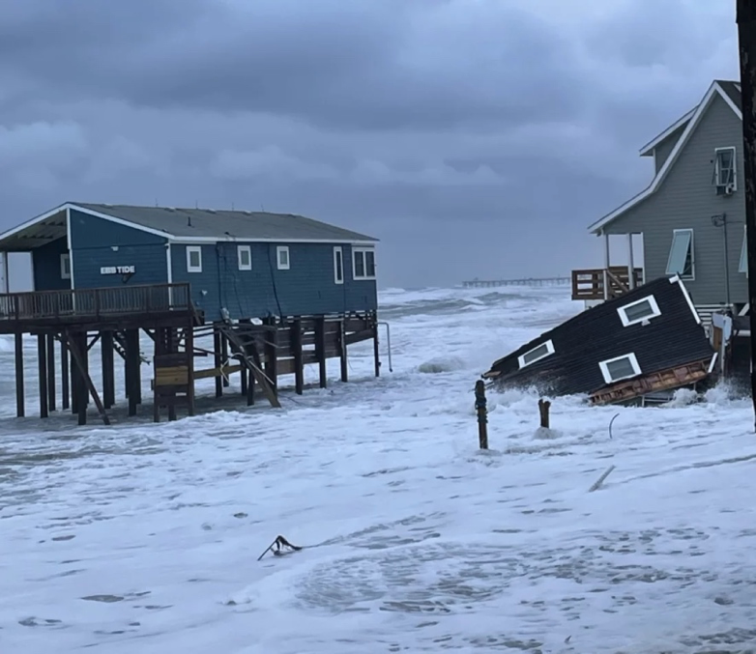
Current Global Warming Effects in E NC
Sea level rise is contributing to the loss of coastal homes

Slide 19
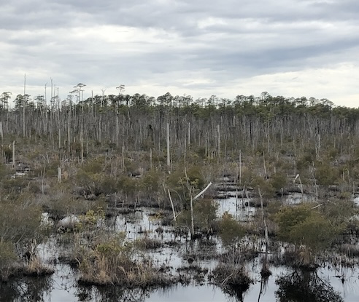
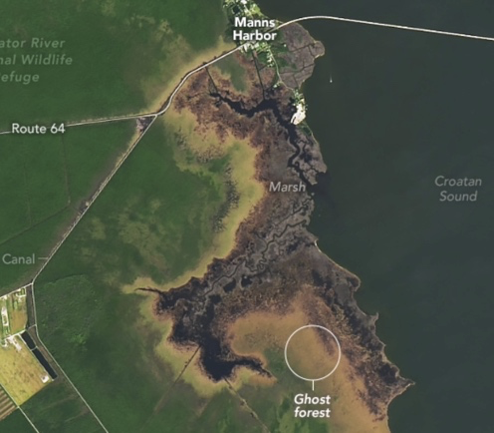
Current Global Warming Effects in E NC
Sea level rise is enabling sea water penetration inland, killing trees and creating “ghost forests”

Slide 20
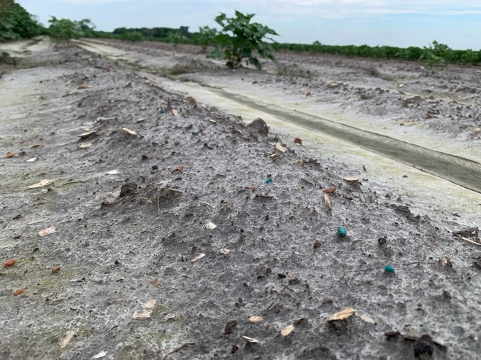
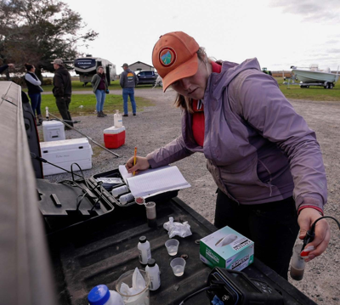
Current Global Warming Effects in E NC
Sea level rise is enabling salt water intrusion inland, damaging farmland
Images: Matt Ricker, PBS, CALS Magazine

Slide 21
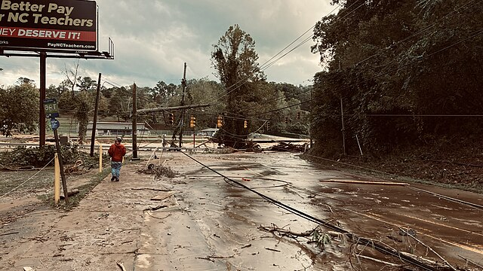
Current Global Warming Effects in E NC
Hurricane Helene:
~10% more rainfall owing to warming

Slide 22
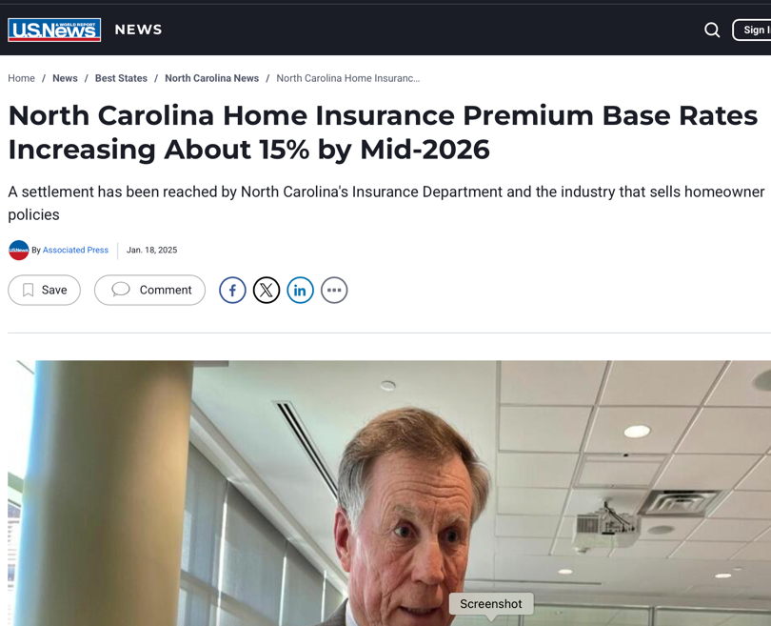
Current Global Warming Effects in E NC
Insurance costs up
Some insurance
cancelled
https://www.usnews.com/news/business/articles/2025-01-18/north-carolina-home-insurance-premium-base-rates-increasing-about-15-by-mid-2026#google_vignette

Slide 23
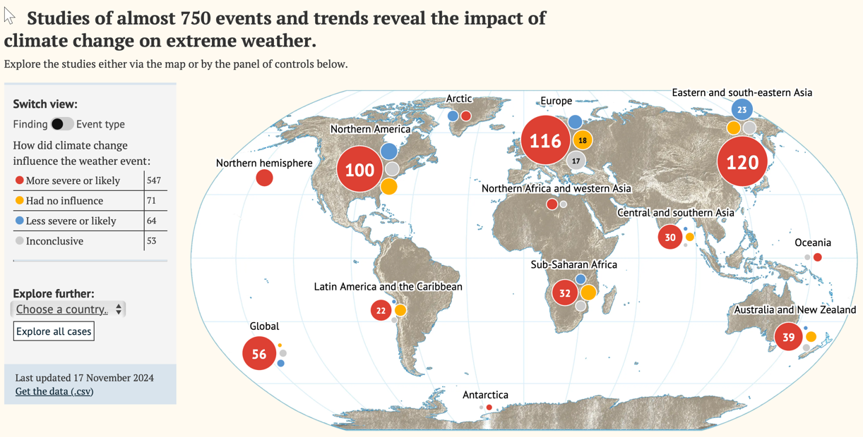
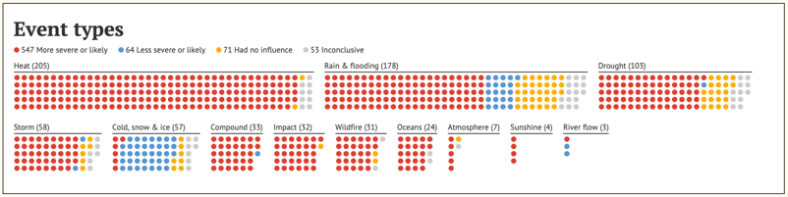
Global Warming Worldwide, 2024
https://interactive.carbonbrief.org/attribution-studies/index.html
This will get worse

Slide 24

Fossil fuel burning causes direct health harms
Release of other compounds, e.g. carbon monoxide, nitrous oxide, sulfur dioxide, often cause:
Respiratory illness, e.g. asthma
Cardiovascular illness
All fossil fuels harmful,
(natural gas)
coal generally worst
Notes:
Fossil fuels have provided cheap, convenient energy but with a major downside

Slide 25
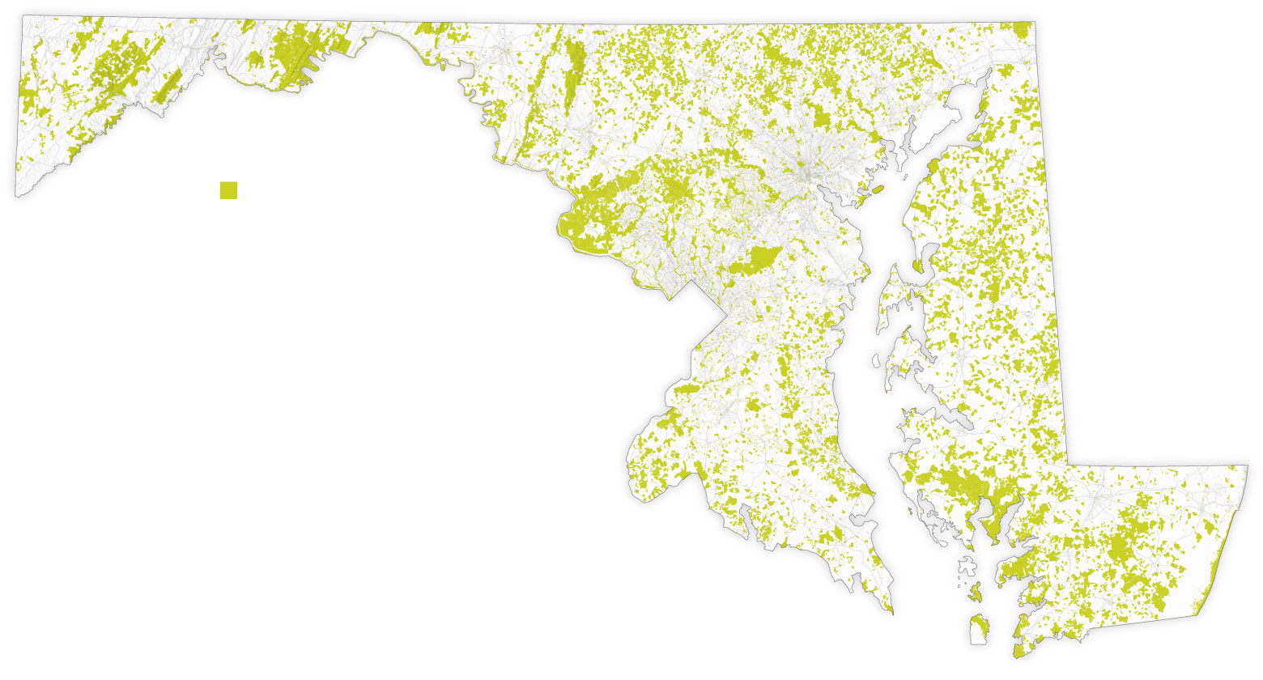
HISTORY OF ENVIRONMENTAL ACCORDS
Brundtland Commission (1987): Defined Sustainability as “meeting the needs of the present without compromising the ability of future generations to meet their own needs.”
Montreal Protocol (1987) – Ozone Layer Protection
IPCC (1988) – Intergovernmental Panel on Climate Change
Basel Convention (1989) – Transboundary movement of hazardous wastes
UN Framework on Climate Change (1992) – foundational treaty for climate action
Kyoto Protocol (1997) – international treaty that set targets for reducing GHGs
Rio+20 (2012) – UN Conference that built on the 1992 Earth Summit
Paris Agreement (2015) – Sustainable Development Goals (SDGs)
Kunming-Montreal Biodiversity Framework (2022) - 30*30
https://www.unep.org/multilateral-actions-safeguard-environment-timeline
State of Maryland
has achieved it!
(protected green)
NY Times April 21, 2025

Slide 26
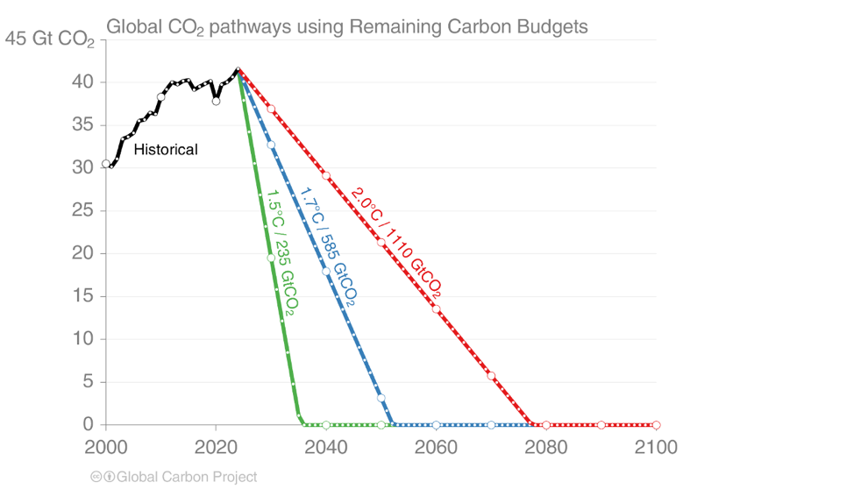
Global Warming Worldwide, 2024
Paris agreement 2016 (UN):
Max 2.0 C increase
Goal: 1.5 C
Substantial decisive actions are needed: different levels of government, NGOs, individuals, etc.

Slide 27
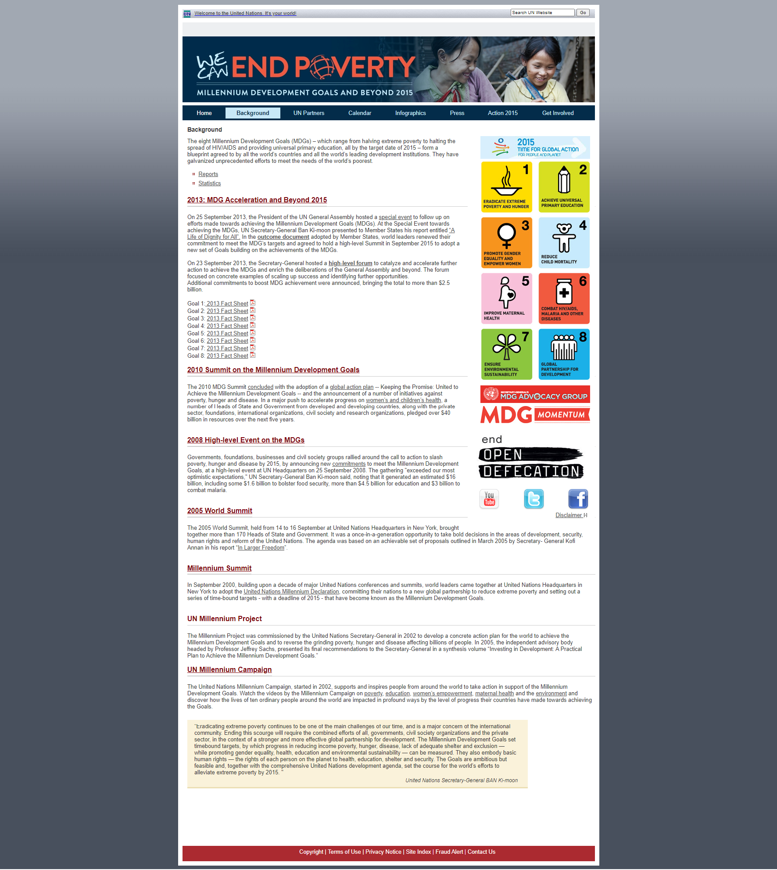

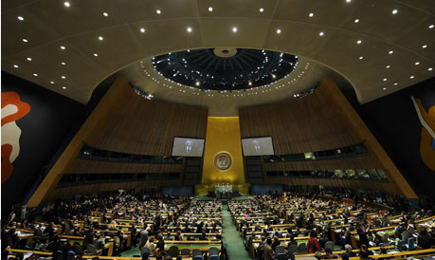
International focus on sustainability
accelerated with the
Millennium Development Goals (MDGs)
United Nations, 2002-2015

Slide 28
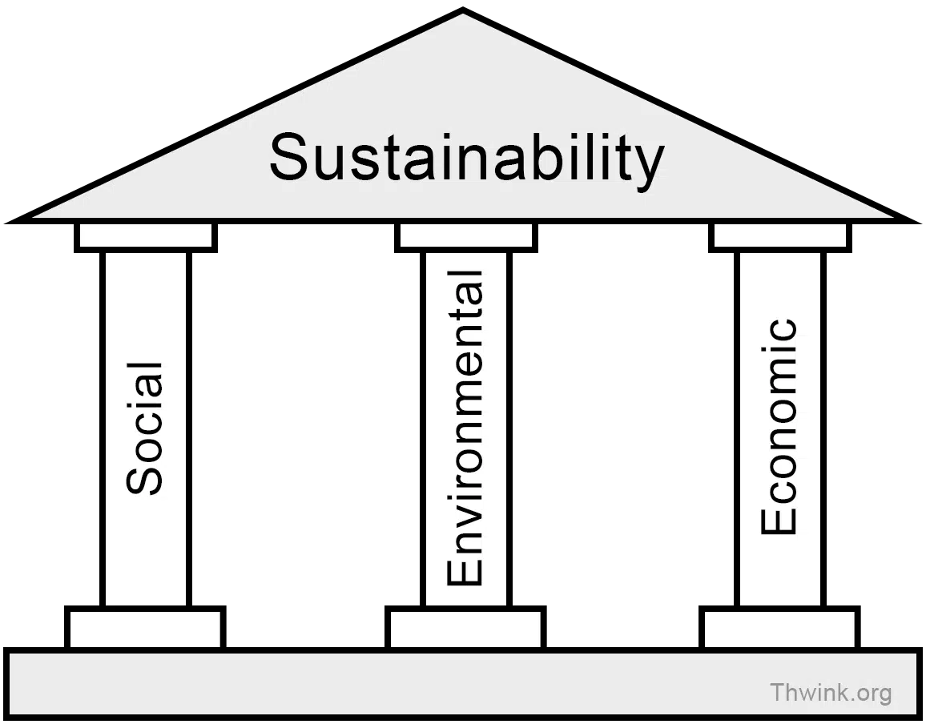
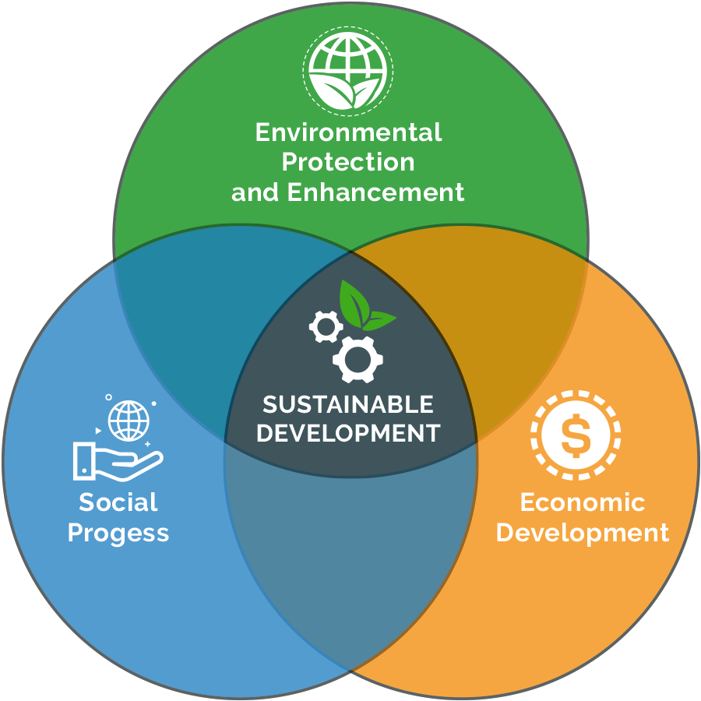
3 Pillars of Sustainability fostering Sustainable Development

Slide 29
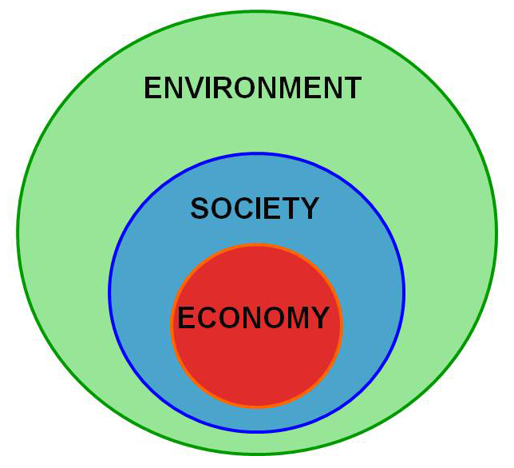
3-Nested Dependencies Model: Bob Doppelt, The Power of Sustainable Thinking (2010)

Slide 30
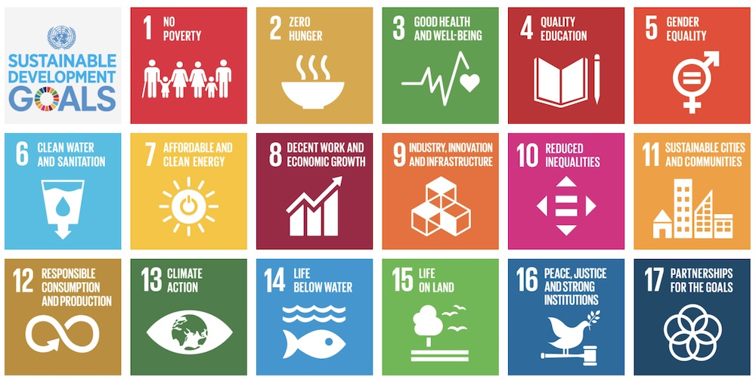
Ranking the 17 Goals…
If you had to choose, what comes first? Pick top 3, in pairs (different fields)

Slide 31
Can we slow extinctions, warming, avoid catastrophe?
  YES!!
  International efforts have prevented global pollution disaster before: ozone depletion (1973) stopped, reversed by 1987 Montreal protocol on CFCs;
  Endangered species rescued from extinction (e.g. gray whale, alligator, bald eagle (417 nests 1963 to 71,467 2021)
  Human population growing less quickly
  Renewable energies, electric vehicles much cheaper, better
  Awareness elevated, societal consensus stronger
  Need societal, individual actions
Notes:
Saying we can, not that we will
The ozone layer or ozone shield is a region of Earth's stratosphere that absorbs most of the Sun's ultraviolet radiation.

Slide 32
What Can I Do?
  Eat lower on the food chain, more efficiently (beef worst)
  Electrify everything … (transport, heating, cooking … renewably if possible)
  Talk about sustainability to others
  Good news: often, healthy nature = healthy people = healthy economy

Slide 33
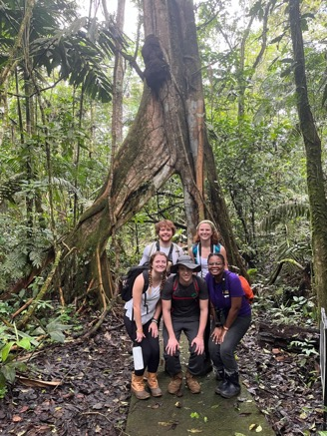
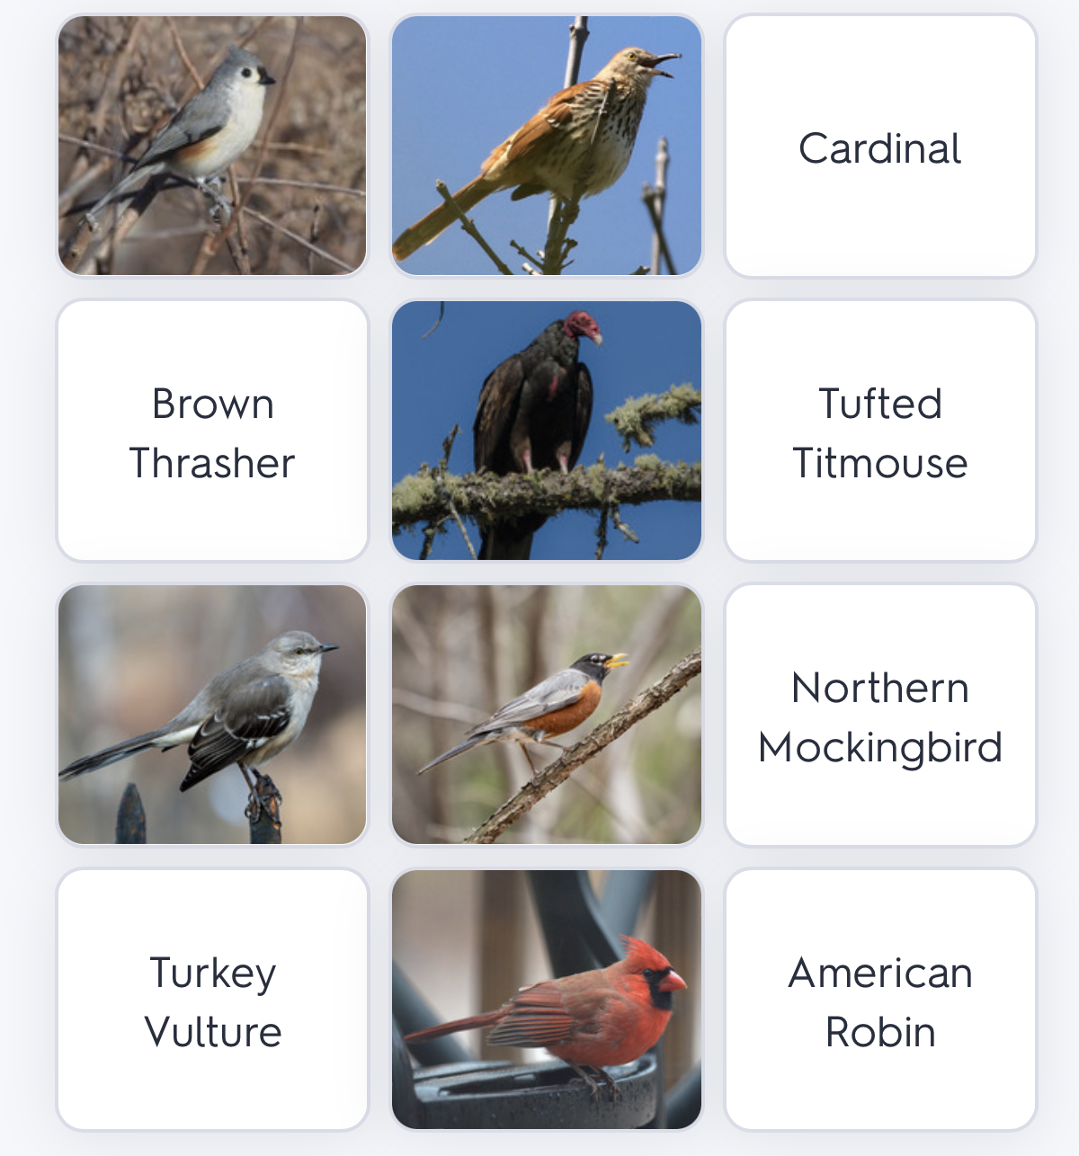
What to do at ECU, in E NC?
Explain the issues (many misconceptions still)
Give students experience of the issues
Give students knowledge, experience of possible solutions; opportunity to work on solutions
Two of my approaches: field biology in
Costa Rica as Intro Bio lab
Learning animal IDs through quizlet games

Slide 34
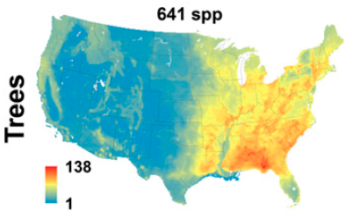
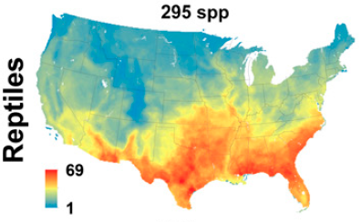
Our region matters:
SE Biodiversity!
Jenkins et al. 2015, PNAS

Slide 35
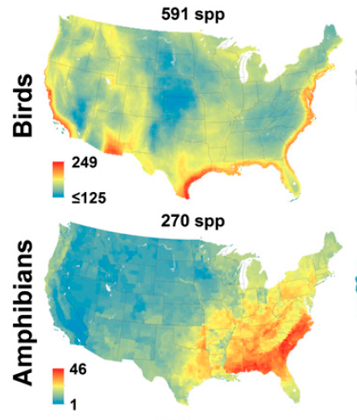
High SE Biodiversity!
Jenkins et al. 2015, PNAS

Slide 36
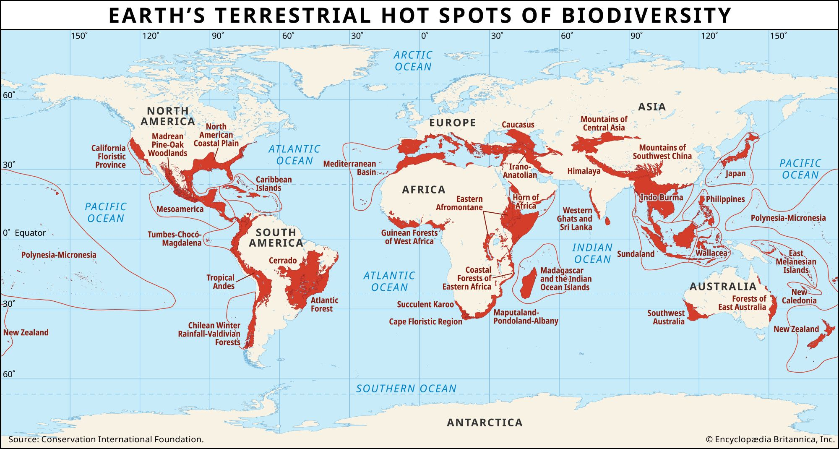
Global Biodiversity Hotspot #36 – North American Coastal Plain
Notes:
“Systems thinking is a discipline for seeing wholes rather than parts, for seeing patterns of change rather than static snapshots, and for understanding the subtle interconnectedness that gives living systems their unique character.” - Peter Senge, author of The Fifth Discipline: The Art and Practice of the Learning Organization.

Slide 37
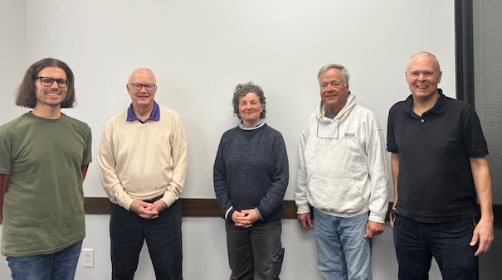


Greenville Environmental Advisory Commission
Current EAC Members :
Jeff McKinnon, 2025 Chair
Yoshi Newman, 2025 Vice Chair
Khristi Dixon
Josh Gardner
Robert Shaw
Tom Trevathan
Karin Zipf
Notes:
[Please adjust the text to be centered vertically if title and date create line breaks; turn on the static guides to help with placement.]

Slide 38
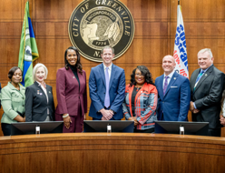
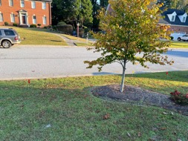
2024 Accomplishments
Recommended, successfully, creation of sustainabililty coordinator position
UDO (initial) adoption of some EAC tree subcommittee recommendations, e.g. planting at least 50% native species
Earlier, worked with GUC toward better financial incentives of residential solar in Greenville

Slide 39
Sustainability: multifaceted issue
But achievable
Notes:
“Systems thinking is a discipline for seeing wholes rather than parts, for seeing patterns of change rather than static snapshots, and for understanding the subtle interconnectedness that gives living systems their unique character.” - Peter Senge, author of The Fifth Discipline: The Art and Practice of the Learning Organization.

Slide 40
Questions?
Comments?
Notes:
“Systems thinking is a discipline for seeing wholes rather than parts, for seeing patterns of change rather than static snapshots, and for understanding the subtle interconnectedness that gives living systems their unique character.” - Peter Senge, author of The Fifth Discipline: The Art and Practice of the Learning Organization.

Slide 41
Notes:
“Systems thinking is a discipline for seeing wholes rather than parts, for seeing patterns of change rather than static snapshots, and for understanding the subtle interconnectedness that gives living systems their unique character.” - Peter Senge, author of The Fifth Discipline: The Art and Practice of the Learning Organization.

Slide 42
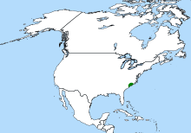
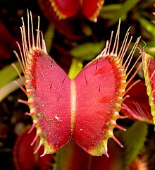

Wikipedia 2020
Wikipedia 2021
Venus fly trap … within 90km of Wilmington
Waccamaw (Phelps?) Killifish
The N.C. Wildlife Action Plan list of evaluated taxa needs, knowledge gaps, management concerns (2017 NC N.C. Wildlife Resources Commission planning tool); 12-60% SGCN.
Notes:
https://www.ncwildlife.org/Portals/0/Conserving/documents/ActionPlan/Web%20page%20documents/2017_Workshops_WAP_Data_sets_CindySimpsonCarr.pdf

Slide 43


Systems-Thinking Approach to Sustainable Solutions:
Notes:
“Systems thinking is a discipline for seeing wholes rather than parts, for seeing patterns of change rather than static snapshots, and for understanding the subtle interconnectedness that gives living systems their unique character.” - Peter Senge, author of The Fifth Discipline: The Art and Practice of the Learning Organization.

Slide 44



2023 - Breaking records - 1.5⁰ C to 2⁰C - A World That’s Hot and Getting Hotter

Slide 45


Climate Change Feedback Loops:

Slide 46
Notes:
Could free up land for wilderness and conservation, carbon capture, etc

Slide 47

Biomass mammals, birds
Guardian May 21, 2018, Bar-One et al. 2018
Notes:
Could free up land for wilderness and conservation, carbon capture, etc

Slide 48

Impact of Climate Change on Human Health

Slide 49

Changes in climate, air/water chemistry often implicated in mass extinctions
Permian (vulcanism), Cretaceous (asteroid) most important
--ignition of fossil fuels may have been important in end-Permian (Siberia)
--also new results suggest oxygen depletion, ocean acidification, rising temperatures

Slide 50




Triple Bottom Line Approach to Sustainable Business:

Slide 51



Overharvesting
Bison, alligator – but protected in time
Passenger pigeon, Great Auk, Steller’s Sea Cow … too late
Lwolfartist, Wikimedia, ccby 2.0
wikimedia image, NMNH
Keulemans, pre 1903
Notes:
51
Steller sea cow extinct 18th century
Great Auk extinct 19th century

Slide 52

Healthy Ecosystems

Slide 53

Sustainable Development Goals at scale
Notes:
Emphasize that cannot address environmental issues in isolation; need to work with society within an economy

Slide 54

Planetary Boundary Model: Johan Rockstrom, Stockholm Resilience Centre (2009)

Slide 55

Donut Economics Model: Kate Raworth, Oxfam Report (2012)

Slide 56
From the MDGs to the SDGs (Sustainable Development Goals )
The Sustainable Development Goals (SDGs) aim to transform our world. They are a call to action to end poverty and inequality, protect the planet, and ensure that all people enjoy health, justice and prosperity.
What are the differences?
The new Goals are universal and apply to all countries, whereas the MDGs were intended for action in developing countries only. SDGs added:
Integration of Environmental Sustainability
Emphasis on Partnerships
Data-Driven Monitoring and Accountability
Adaptability and Long-Term Vision

