Slide 1
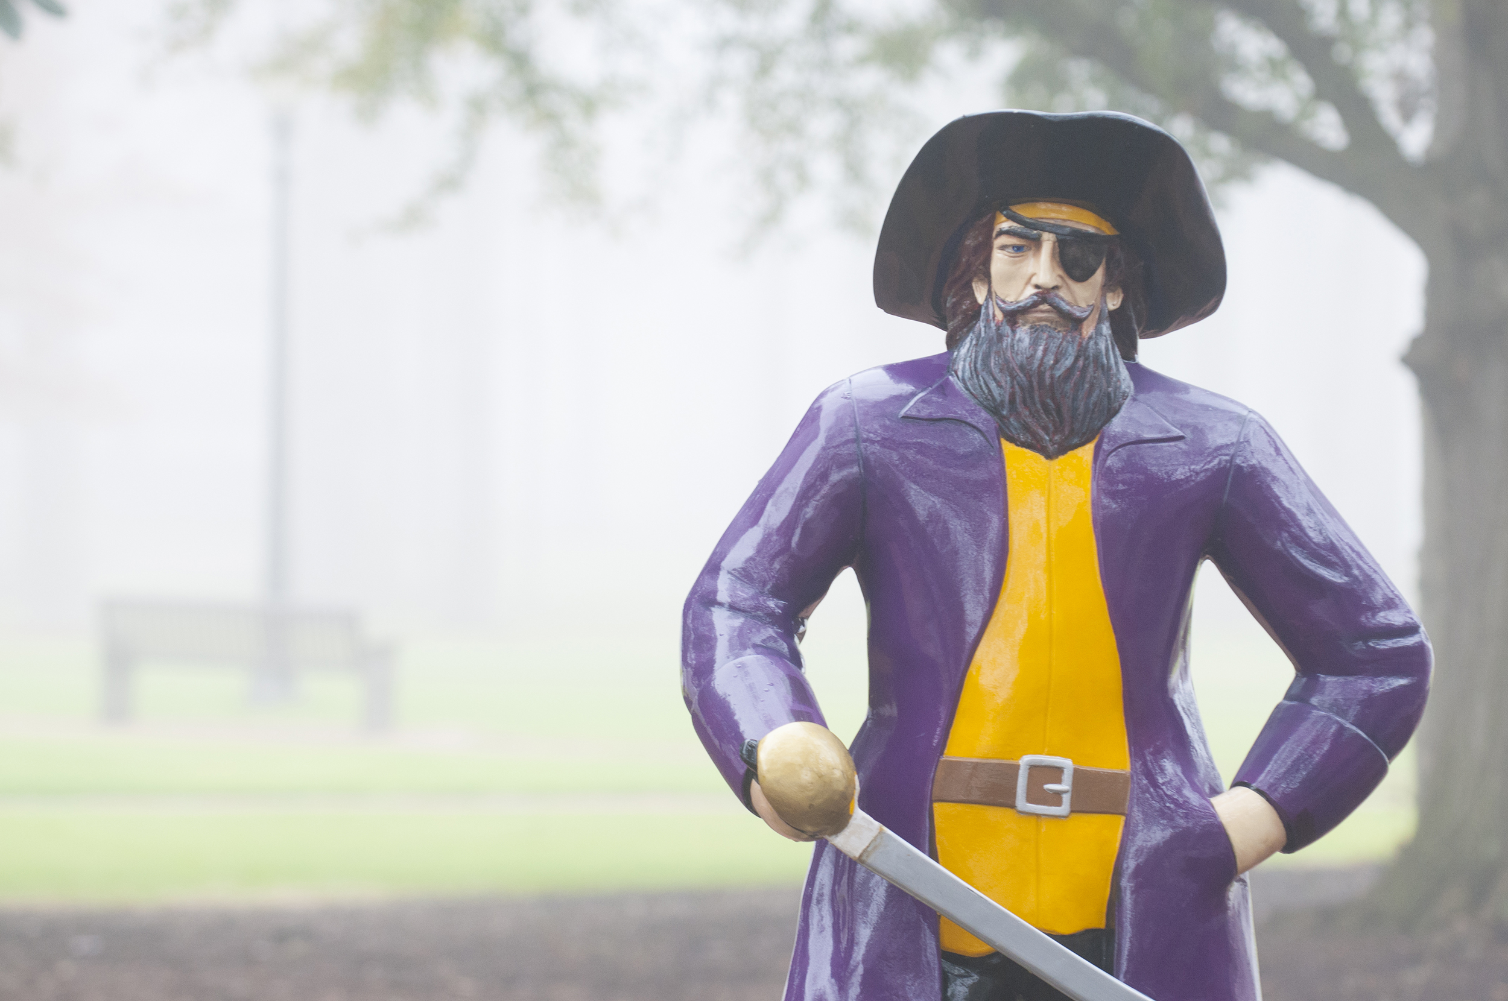

Kim Fox
Sustainability Outreach Specialist
foxki23@ecu.edu

Slide 2
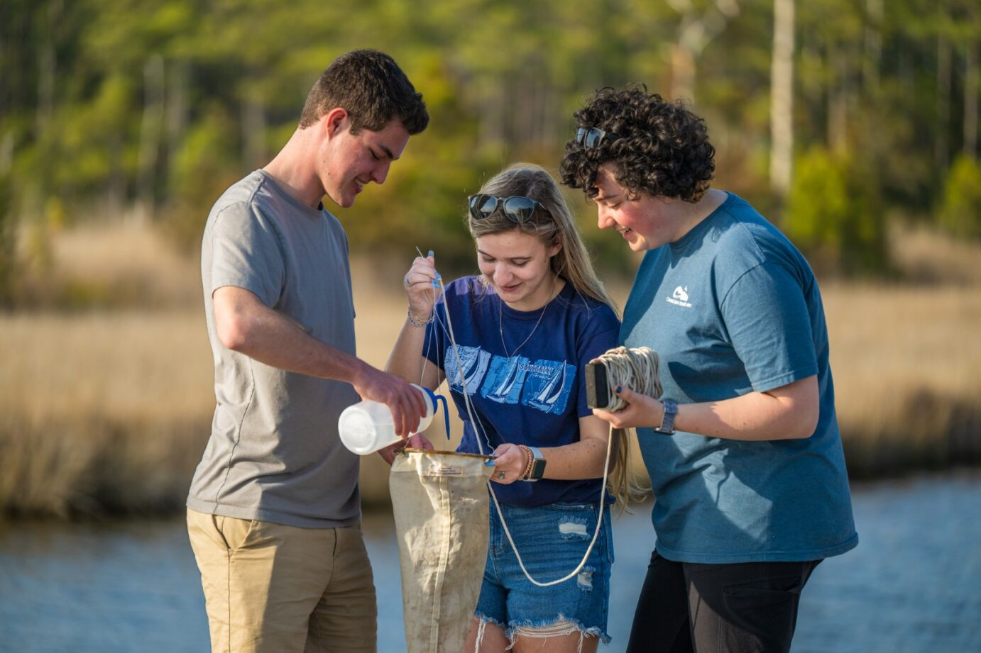
Academics
Notes:
Course offerings
Faculty research
Degree programs
Student projects

Slide 3
Course Offerings
BIO 1060 – Environmental Biology
ECON 3855 – Environmental Economics
EHST 4200 – Environmental Health Management and Law
EHST 5020 – Environment Toxicology
CMGT 4320 – Construction Sustainability
CMGT 6655 – Residential Sustainability
DESN 3038 – Sustainable Design
GEOG 1250 – The Water Planet
GEOG 1000 – People, Places, and Environments
GEOG 2350 – Climate Change: Science and Society
GEOG 2300 – Geography of Environmental Resources
GEOL 1700 – Environmental Geology
GEOL 3209 – Environmental Forensics
GEOL 3500 – Hydrogeology and the Environment
GEOL 3800 – Earth’s Climate: A Geological Perspective
GEOL 6350 – Environmental and Global Change
MKTG 6772 – Sustainability Marketing
PADM 6162 – Environmental Administration
PADM 6163 – Environmental Policy Analysis
PADM 6164 – State and Local Environmental Policy
PADM 7009 – Coastal, Maritime, and Environmental Law
PLAN 1900 – Sustainable Cities
PLAN 3020 – Environmental Planning
PLAN 4015 – Emergency Management Planning
PLAN 4250 – Environmental Impact Analysis
PLAN 6003 – Design for the Built Environment
PLAN 4045 – Environmental Resources Planning and Management
POLS 3255 – Environmental Politics
SAFT 6282 – Design for Safety and the Environment
SCIE 6200 – Environmental Education
SOCI 3010 – Environmental Sociology
SUTO 6100 – Environmental Systems and Sustainability
SUTO 6300 – Policy and Planning for Sustainable Tourism
Notes:
REMEMBER "They," not "you!"

Slide 4
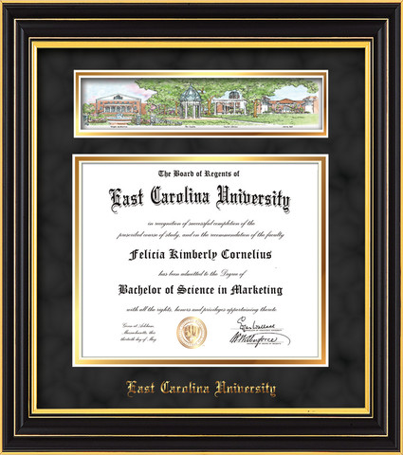
Degree Programs
Majors
  Environmental Health
  Urban and Regional Planning
  Recreation and Park Management
Concentrations
  Geography (BA) Environmental
  Applied Geography (BS) Environmental
Certificates
  North Carolina Environmental Educator
  Registered Environmental Health Specialist
Graduate
  Master of Science in Sustainable Tourism
  Master of Science in Environmental Health
Doctorate
  PhD in Coastal Resources Management
Your Name Here

Slide 5


Notes:
Dr. Beth Bee
Earth and Environment: focus on natural sciences (climate, ecology, geomorphology, etc)
Environment and Society: focus on social, political, economic, and cultural aspects of environment and sustainability

Slide 6
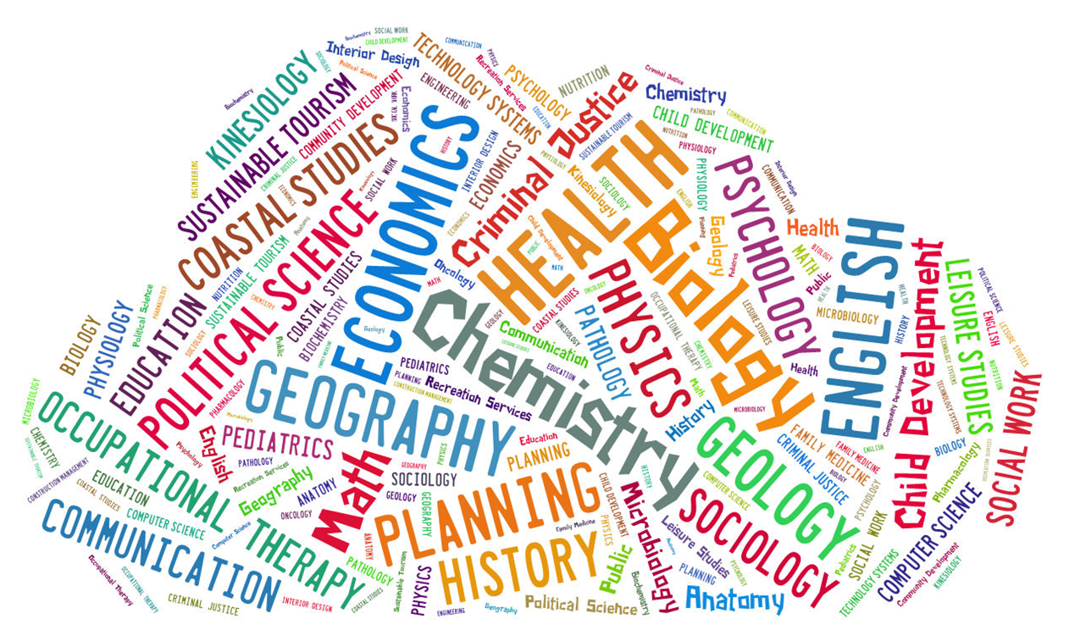
Faculty Research
Notes:
Over 100 Faculty doing research in sustainability
Biology
Dr. Rebecca Asch in Biology Department: How climate change affects fisheries
Dr. April Blakeslee in Biology Department: Conservation biologist who focuses on aquatic systems
Dr. Jim Morley in Biology Department: Impacts of human-based stressors on marine ecosystems
Social Sci
Dr. Eric Wade in Coastal studies: Environmental social scientist who studies human-environment interactions, using behavioral economics as well as social and conservation psychology
Engineering
Dr. Randall Etheridge in Engineering: Engineering solutions to water quantity and quality issues in ENC
Geography
Dr. Yoo Min Park in Geography, Planning, & Environment: The effect of environmental/social stressors on human health and social disparities in health risks
Dr. Sid Mitra in Geological Sciences: Coastal plain wildfires and climate change
History
Dr. Nathan Richards in History Department, Director of Maritime Studies: How climate change affects underwater archaeological sites
Health
Dr. Guy Iverson in Health Education and Promotion: wastewater management and water quality (surface and shallow ground water)
Dr. Suzanne Lea in Public Health: How environmental quality impacts human health
Economics
Dr. Jonathan Lee on water demand & energy and the environment
English
Dr. Helena Feder: environmental humanities, ecofeminism, American nature writing

Slide 7
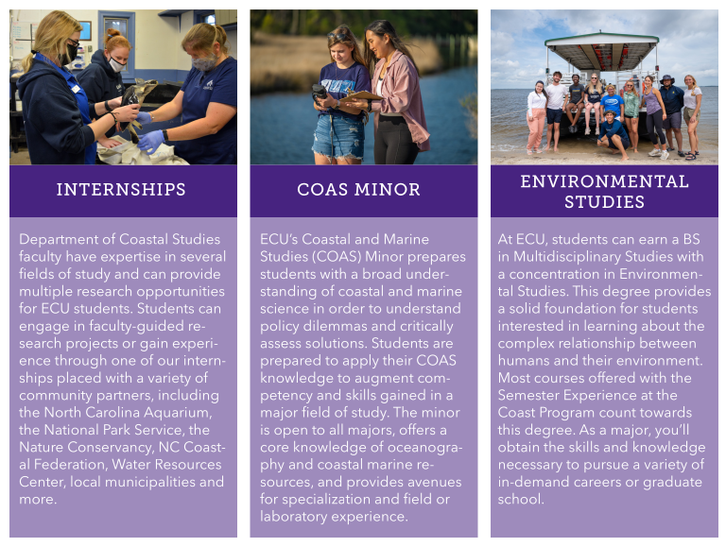

Semester Experience at the Coast
Notes:
The Undergraduate Semester Experience at the Coast is a structured residential program (housing available) located on ECU’s Outer Banks Campus for students with an interest in coastal studies. This semester-long program provides students interested in coastal resources, science, and management to immerse themselves in an environment where courses are hands-on with field and lab-based experiences.
Program benefits include:
Smaller classes (approx. 20 students) and strong faculty and student interaction
Classroom learning connected with active learning opportunities at the coast with real-world applications
A remarkable coastal setting surrounded by diverse freshwater, estuarine, and marine ecosystems
Cutting-edge coastal research labs
Credits count toward COAS minor
Program aspects:
Faculty-guided undergraduate research projects
Apply skills to real-world coastal issues
Tuition and the Student Health Insurance Plan (SHIP) costs are the same as for students on the main campus.

Slide 8
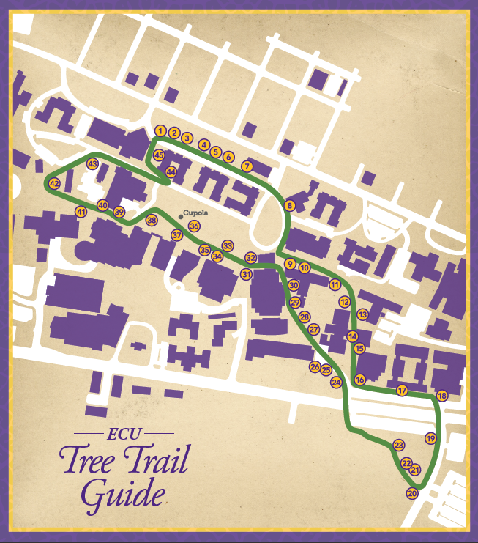

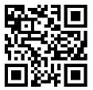
Student Projects
Capstone Projects
  Energy Audits on Residence Halls
  Waste Audits on Campus Buildings
  Modeling buildings’ solar energy potential
Notes:
This semester: GIS mapping of green spaces

Slide 9
Notes:
Status & Recognition
Goals
Progress
Green House Gas Profile

Slide 10







Status & Recognition
Notes:
Tree Campus USA
Bee Campus USA
Bicycle Friendly University
AASHE STARS Silver Rating
Clean Air Carolina Partner of the Year
Princeton Review Green Schools: 75% of prospective students and family are looking for university environmental stewardship in determining whether to apply to or attend a school. Sustainability is a powerful recruiting tool

Slide 11

Goals
  ECU must reduce energy consumption 40% by 2025
  ECU must reduce greenhouse gas emissions 50% by 2030
The UNC System must be “climate neutral” by 2050
Notes:
State mandate!
Climate Neutral:
The AUCPCC defines climate neutrality as having no net carbon (greenhouse gas) emissions. This is to be achieved by reduction of energy consumption, followed by conversion to low or no impact energy sources, and finally through purchase of carbon offset credits.

Slide 12
Progress
Landfill Diversion rate = 34%
  Dual-Stream Recycling rate is only at about 18%
Water consumption has dropped 53% (per gsf) since 2003
Energy consumption has dropped 30% (per gsf) since 2003
Notes:
Estimated up to 80% waste could be diverted from landfill
Motor oil, tires, electronics, furniture (surplus warehouse), construction and demolition
PLANS:
UNC System Sustainability Policy (2009)
ECU Sustainability Plan (adopted fall 2018) – 60 Students, faculty, and staff worked together to write
ECU Strategic Plan and Campus Master Plan

Slide 13
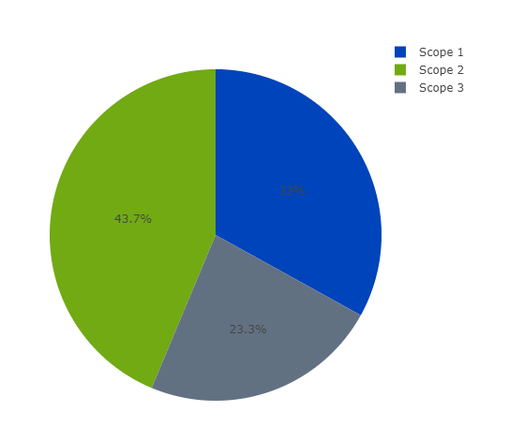
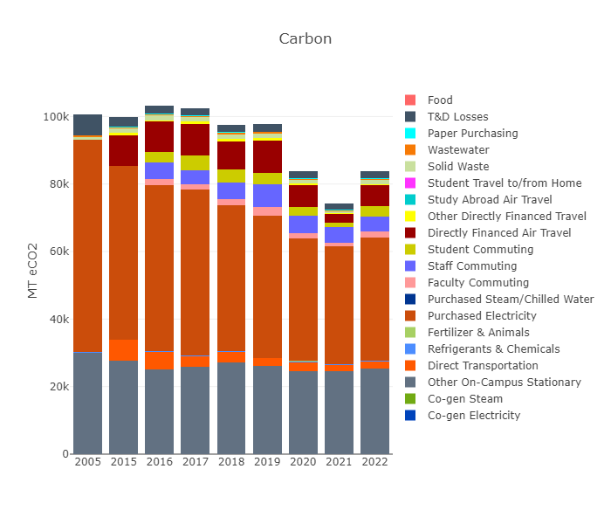
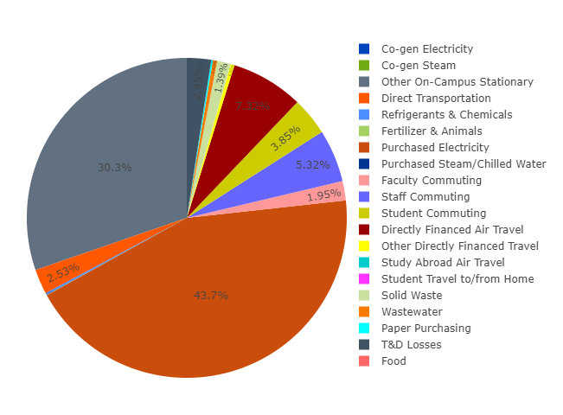
Greenhouse Gas Inventory
Notes:
Scope 1: Sources owned or controlled by a federal agency
Scope 2: Generation of electricity, steam, or heat purchased by a federal agency
Scope 3: Not owned or directly controlled by a federal agency but related to agency activities (e.g. business air travel, employee commute, waste from contractors)

Slide 14
Operations
Notes:
Energy
Water
Waste
Grounds
Habitats
Materials
Food & Dining
Transportation
Green Buildings

Slide 15
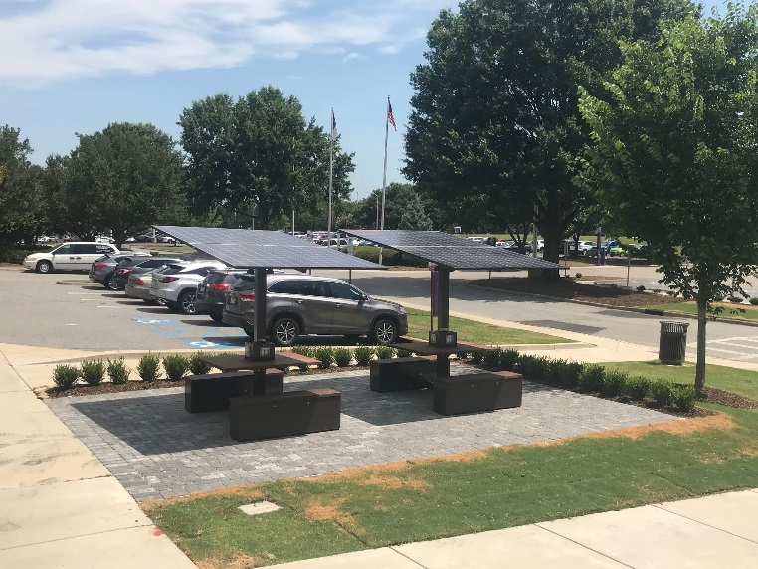


Energy and Water
Costs:
  Electricity:
  Natural Gas:
  Water:
$10.5 million
$4.3 million
$2 million
Notes:
Everyone should feel incentivized including students, staff, and faculty to reduce utility consumption because we’re all paying these bills via state taxes, because we’re a public institution
1. HVAC Automation Systems
LED Lighting Upgrades
Solar Panels
Occupancy Sensors
Sink Faucet Aerators
Water Efficient Dishwashers
Low Flow Toilets and Showerheads
Rigorous Leak Detection and Repair Program

Slide 16
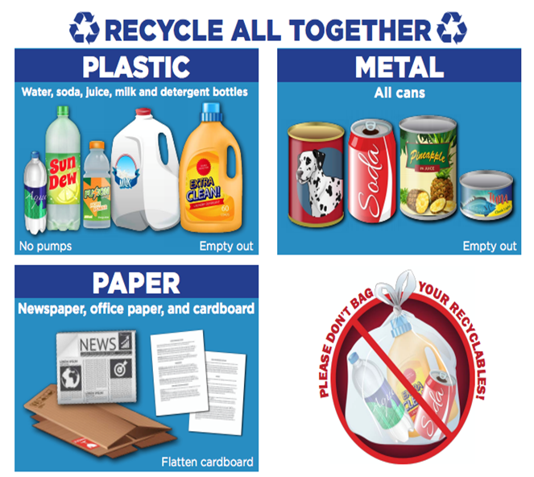
Waste
Notes:
When discussing the plastic recyclables, say “Drink Containers like water, soda, and juice bottles plus milk jugs and detergent bottles”
Emphasize the specific NO RECYCLING items like glass, to-go drink containers, aerosol cans, and plastic food containers
Recycling center off port terminal road, off 10th St. across from Lowe’s, drive past the boat ramp – large yellow dumpster
In the summer of 2021, the local recycling center ran by ECVC (Eastern Carolina Vocational Center) stopped accepting glass for recycling. This was due in part to the economics of recycling and the fact that glass is the heaviest commonly recycled material and they were having to ship it outside of Pitt County when gas prices were skyrocketing. The other reason is that when glass breaks it becomes a health hazard to the employees who first hand-sort the recyclables plus glass shards were contaminating other streams of recycled material. As such, Pitt County stepped in and placed large yellow dumpsters at all 14 of their recycling drop-off stations.

Slide 17
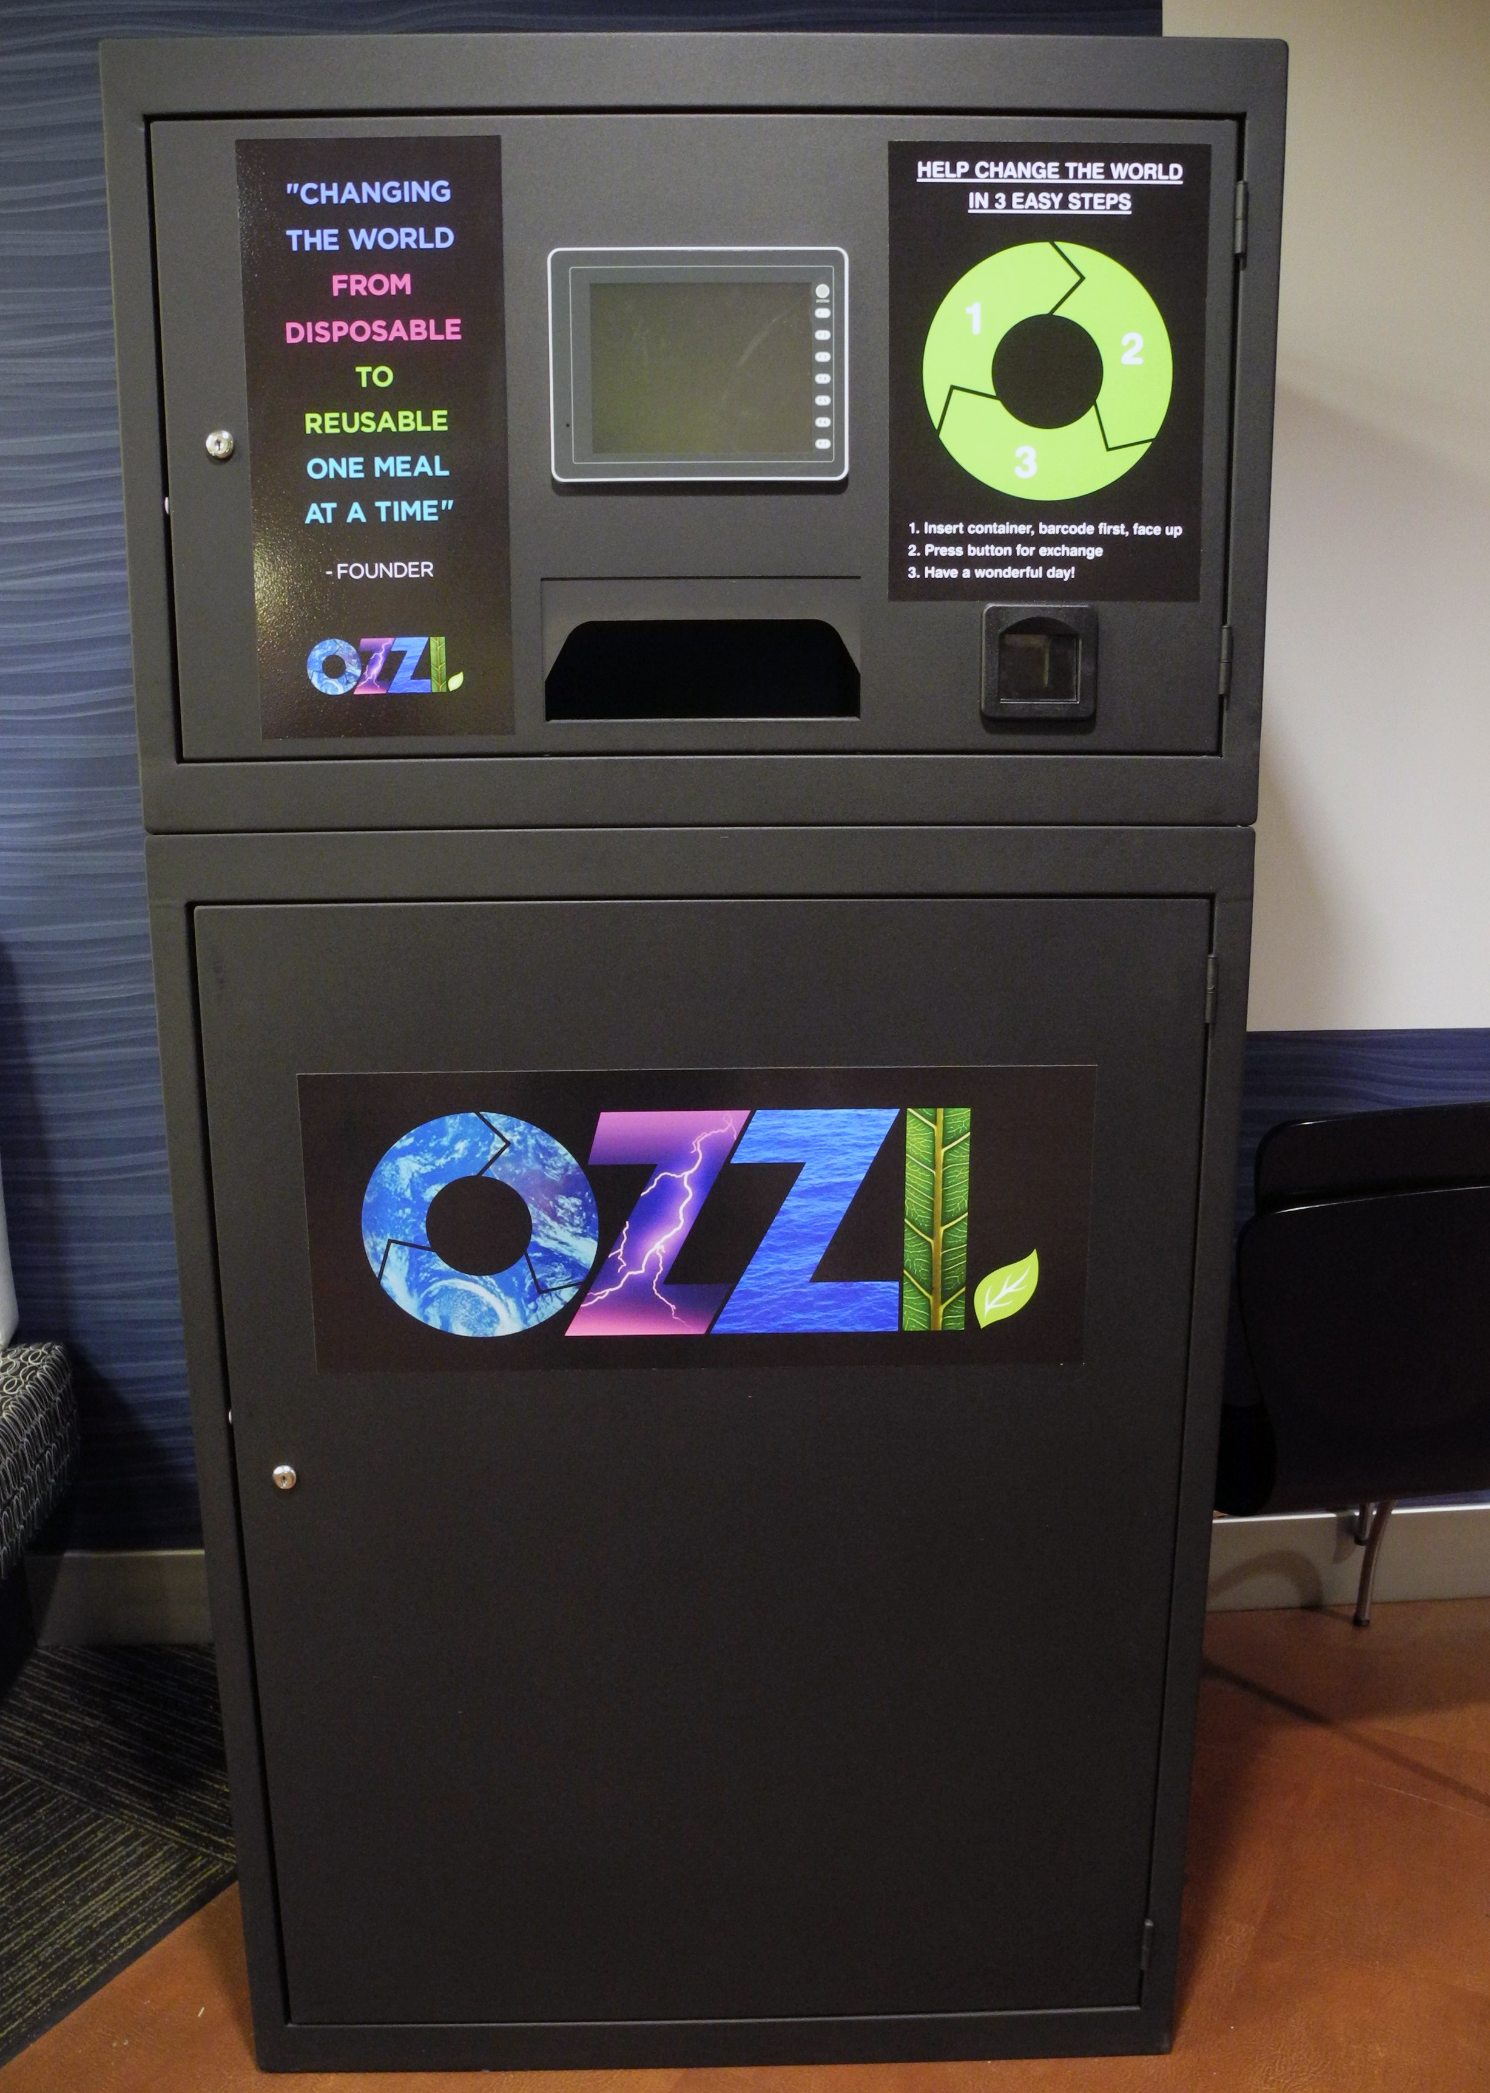
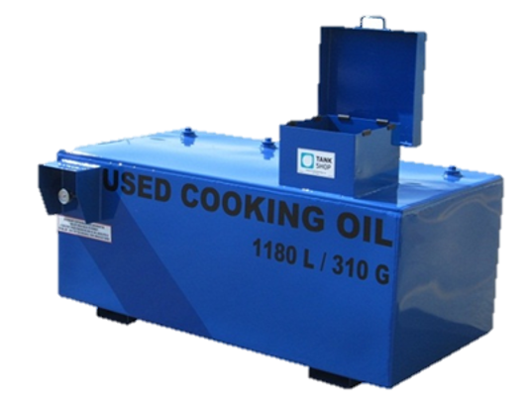
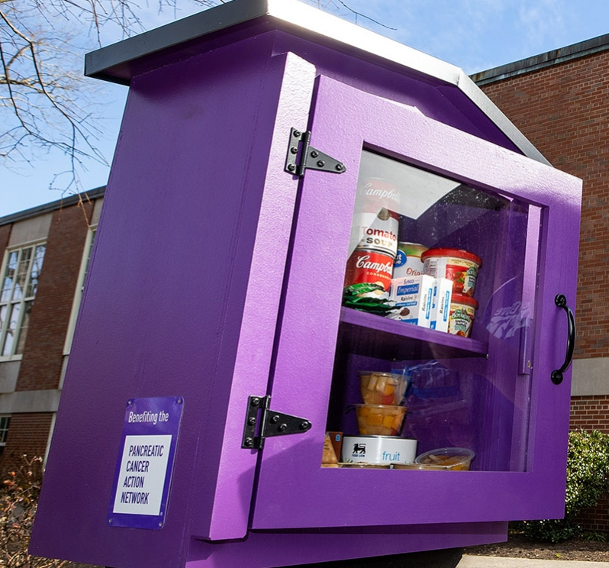

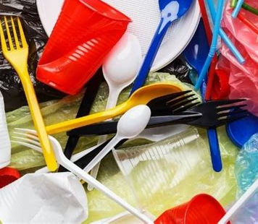
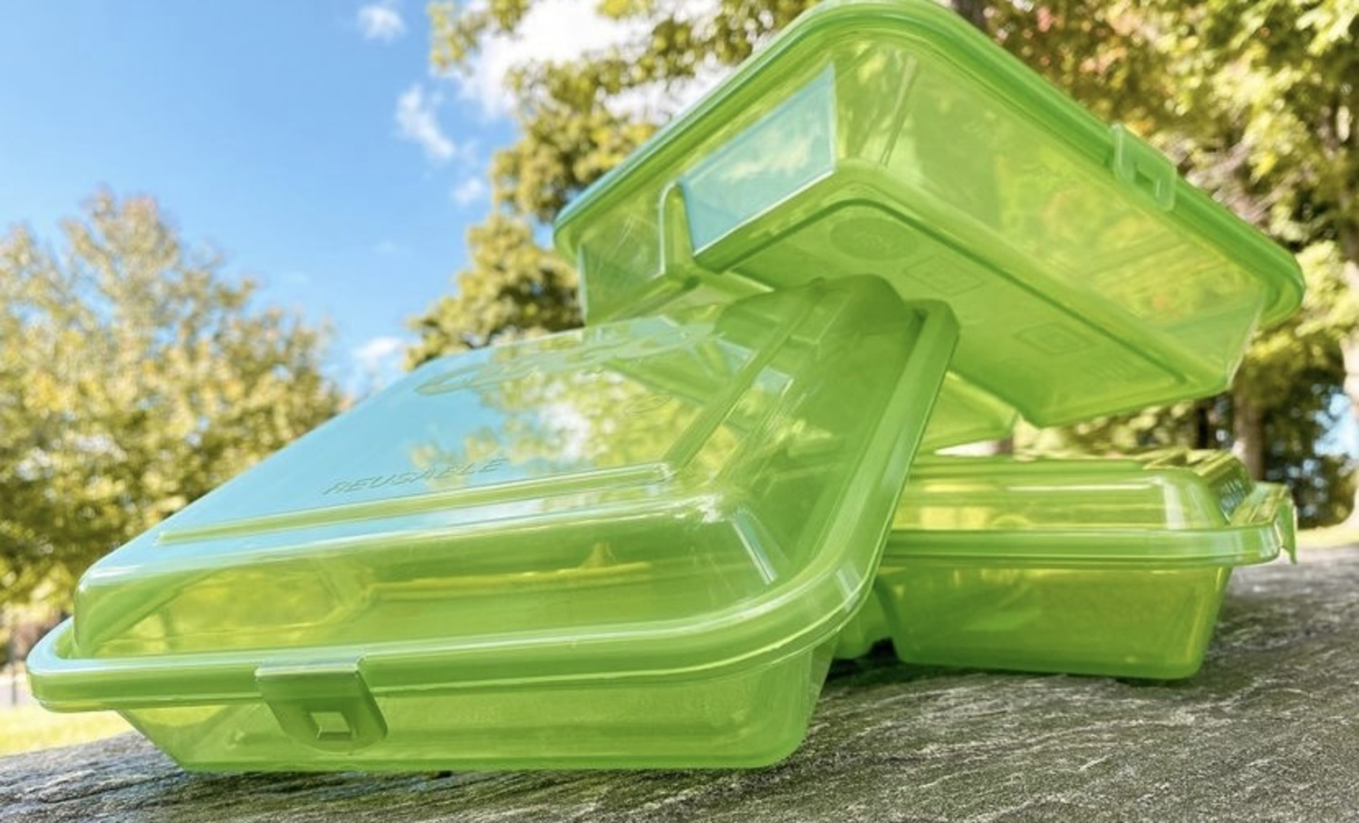
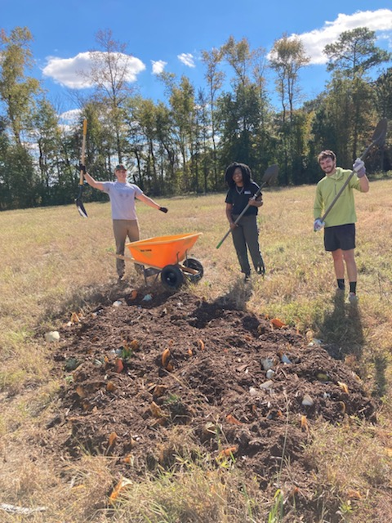
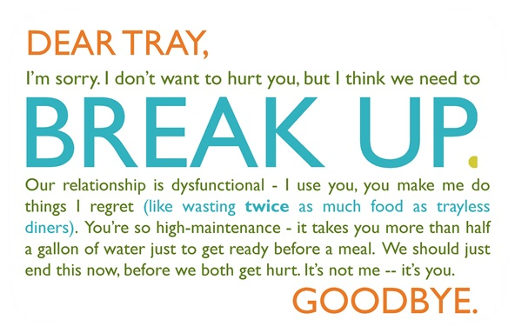
Food & Dining
Notes:
Hydroponic farming for greens
500 heads of lettuce per month, Equivalent of what we can grow on 2 acres of land, No need for pesticides
Behind Jones Residence Hall, Recycling cooking oil
trayless dining,
purchasing NC farm milk and produce,
reducing single-use plastics, working with SGA to continue in restaurants
Ozzi container and machine, onecard swipe
purple pantry food donations, helps food insecure students:
Compost pre-consumer food scraps, through alumni owned business

Slide 18
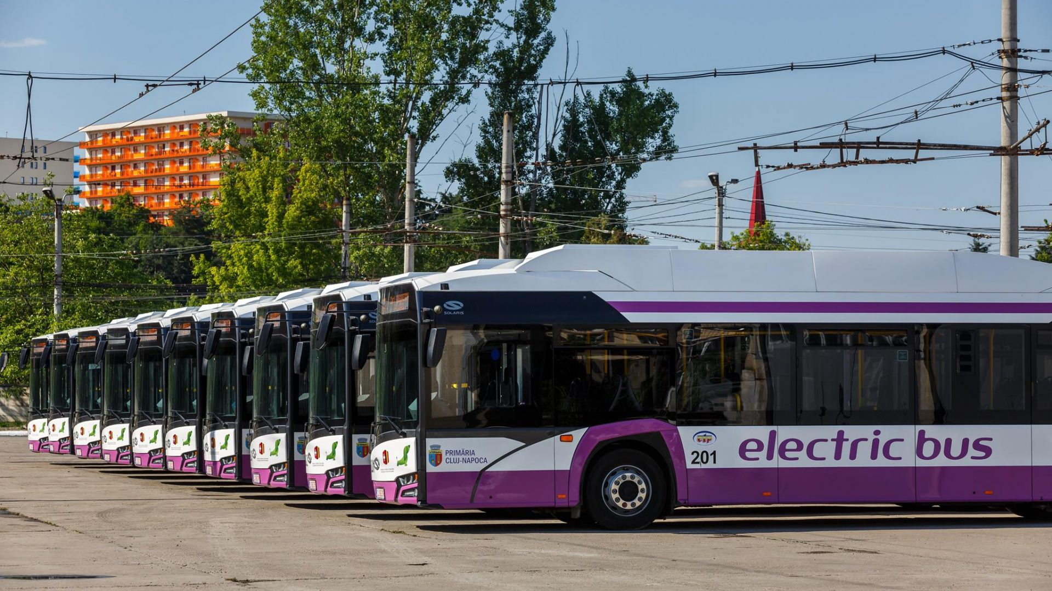
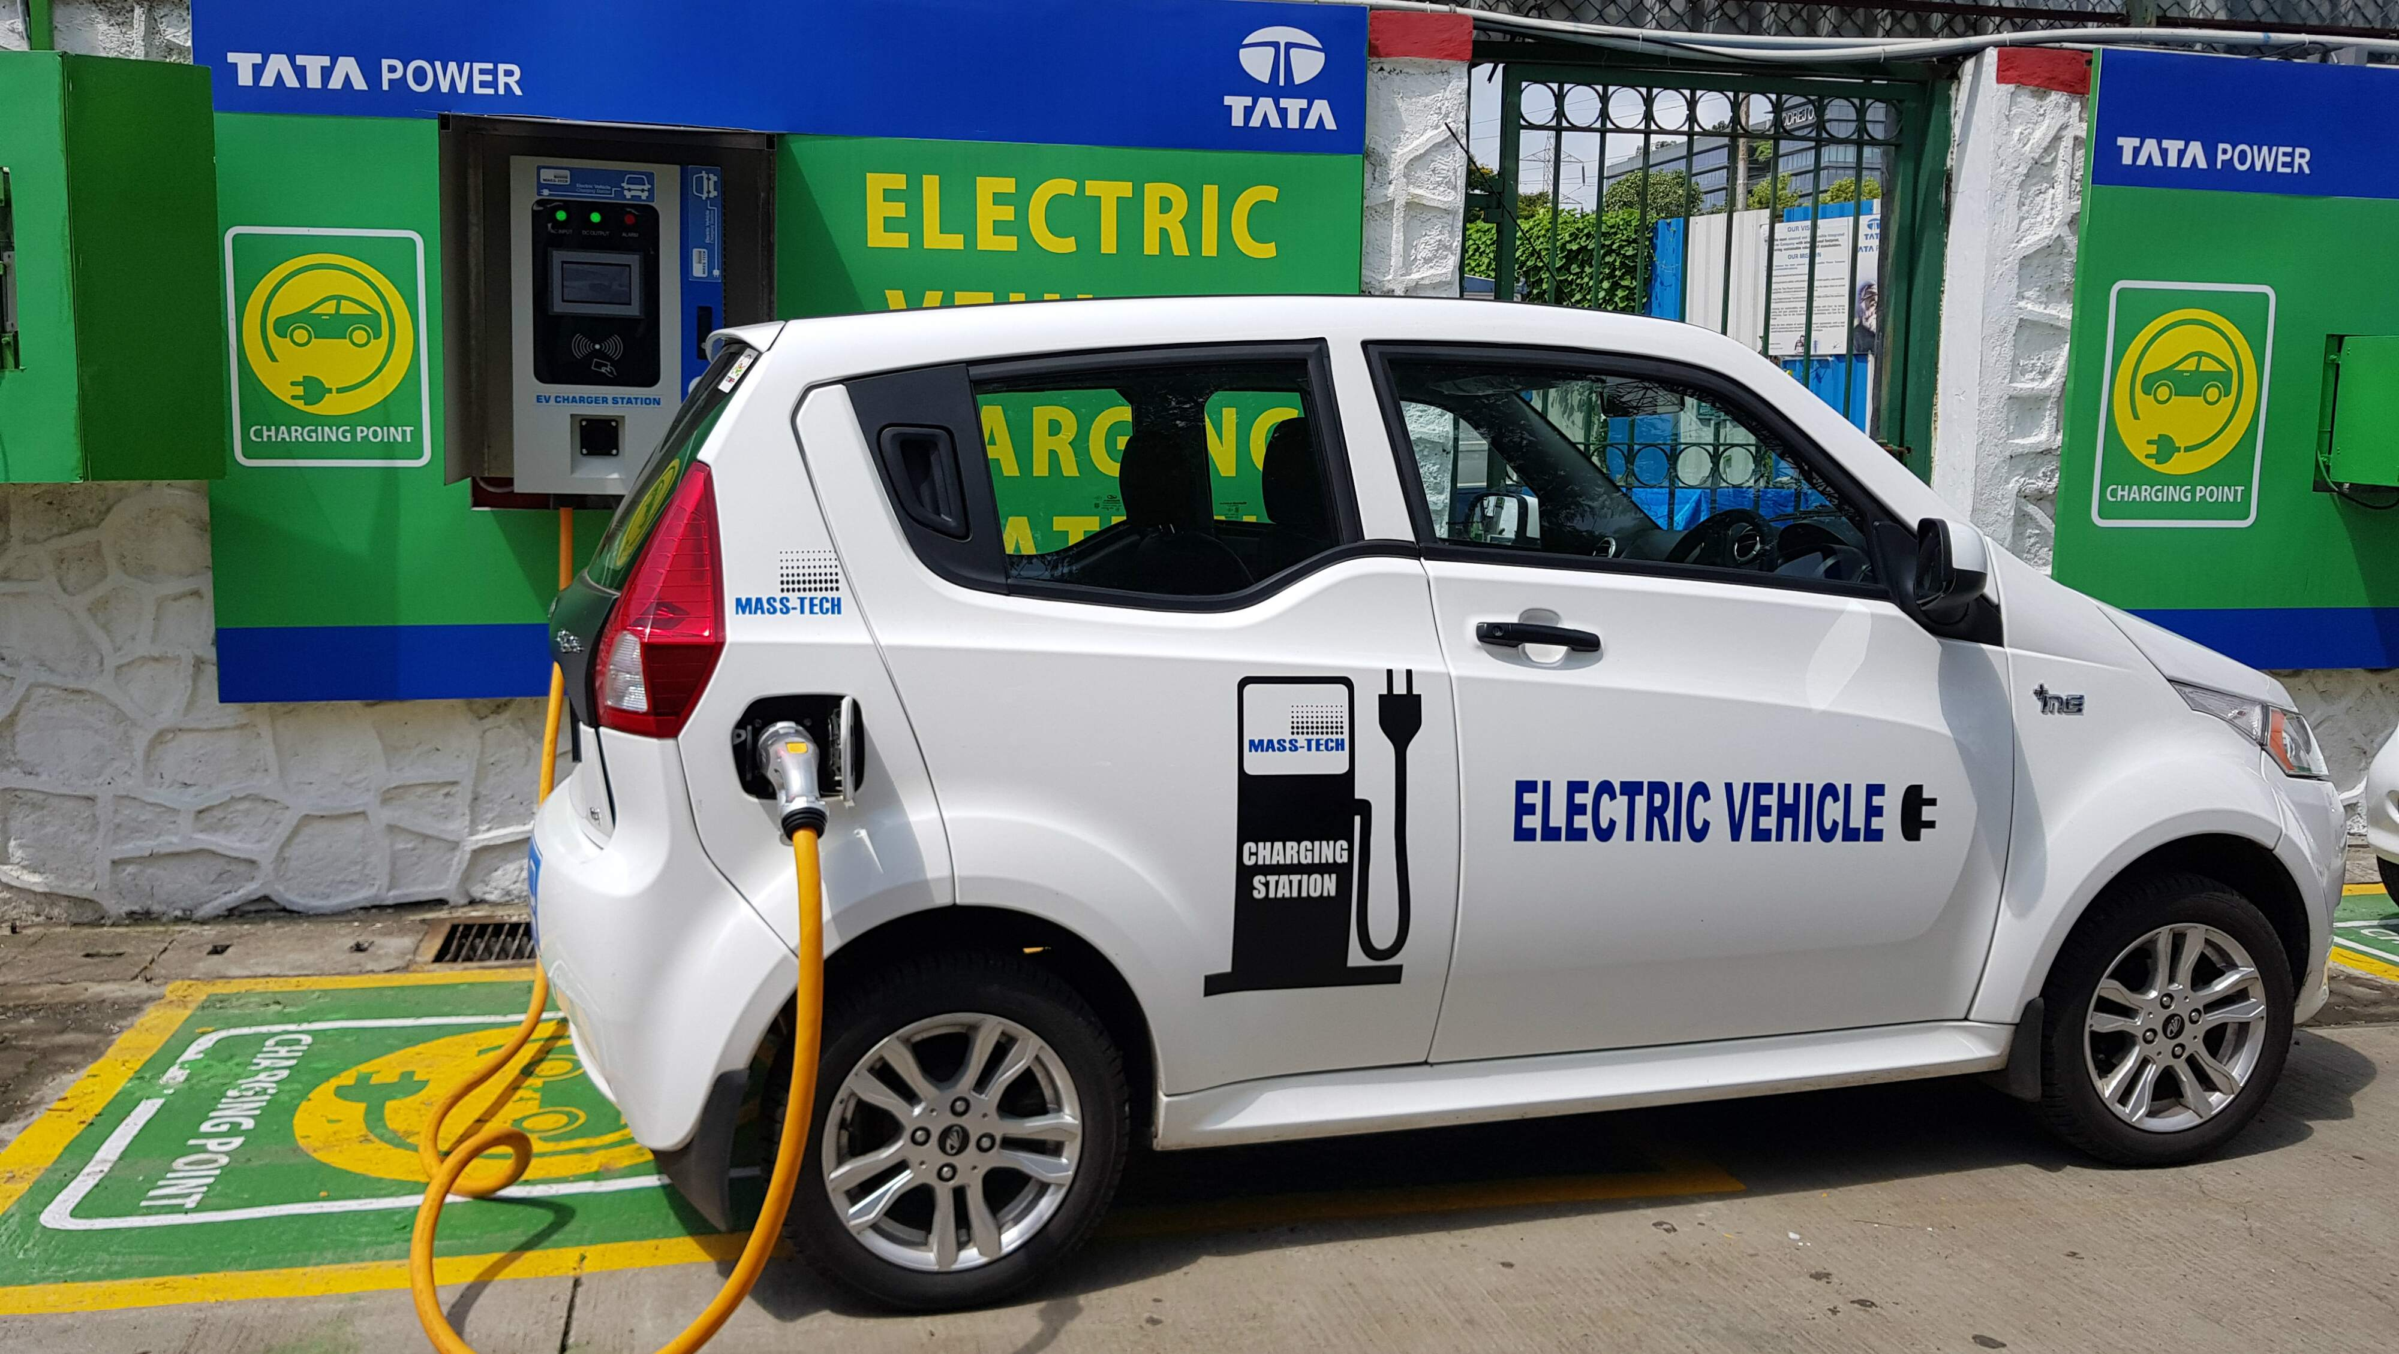


Transportation
Notes:
electric buses and buses powered by compressed natural gas (CNG) instead of diesel moving forward
Continually adding to our electric vehicle (EV) charging infrastructure (recently got a grant for 3 more)
working on developing a Fleet Electrification Transition Plan

Slide 19
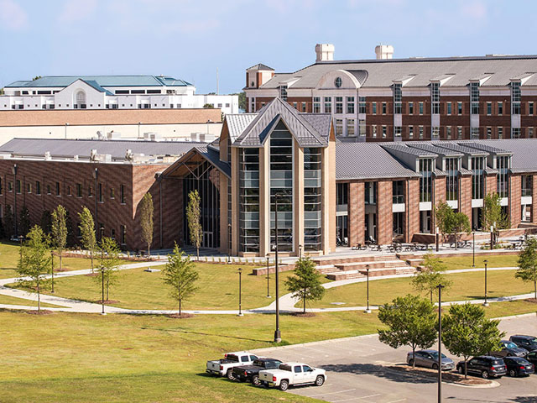
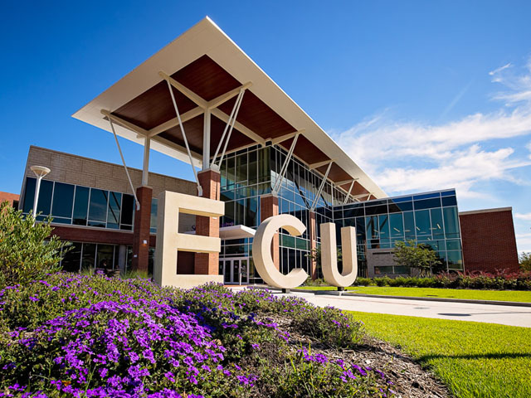
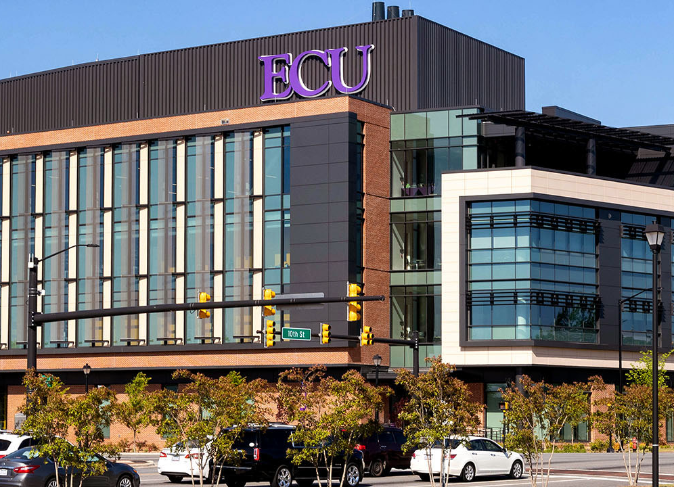
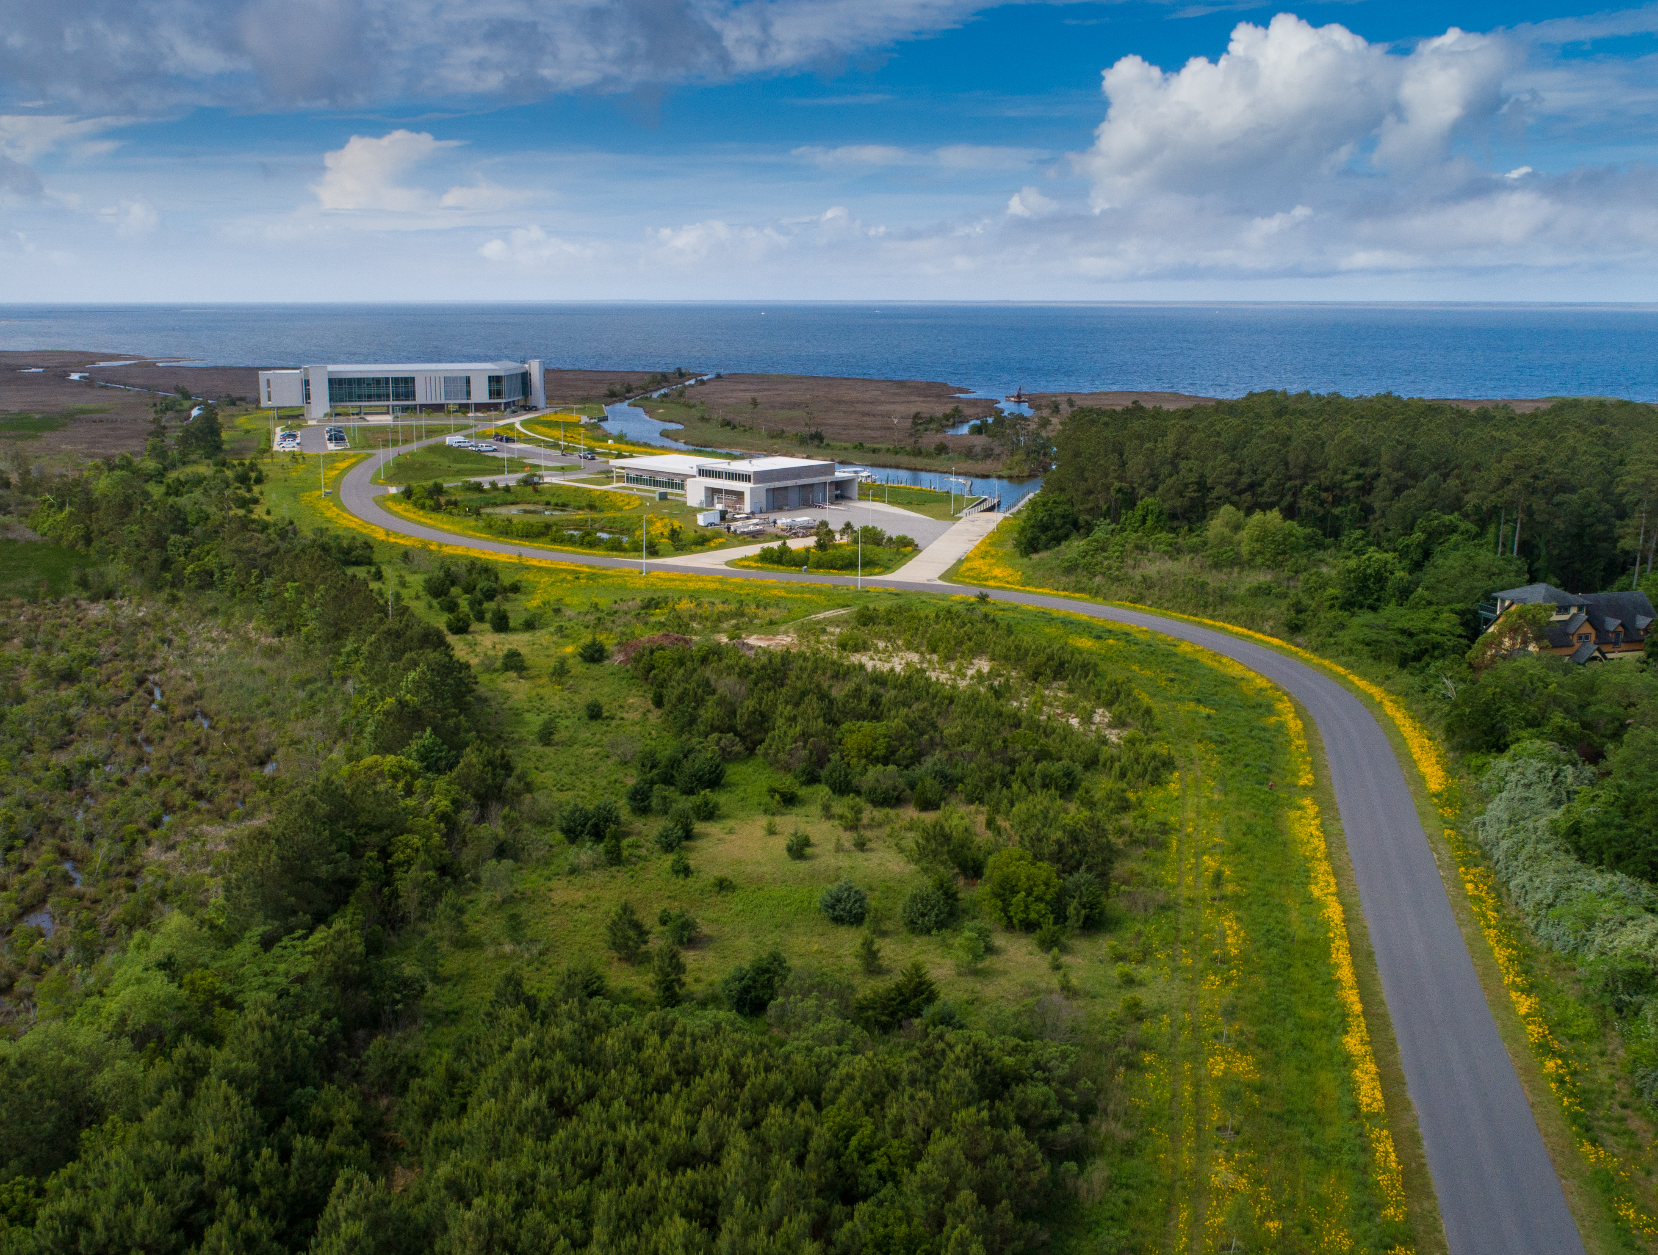
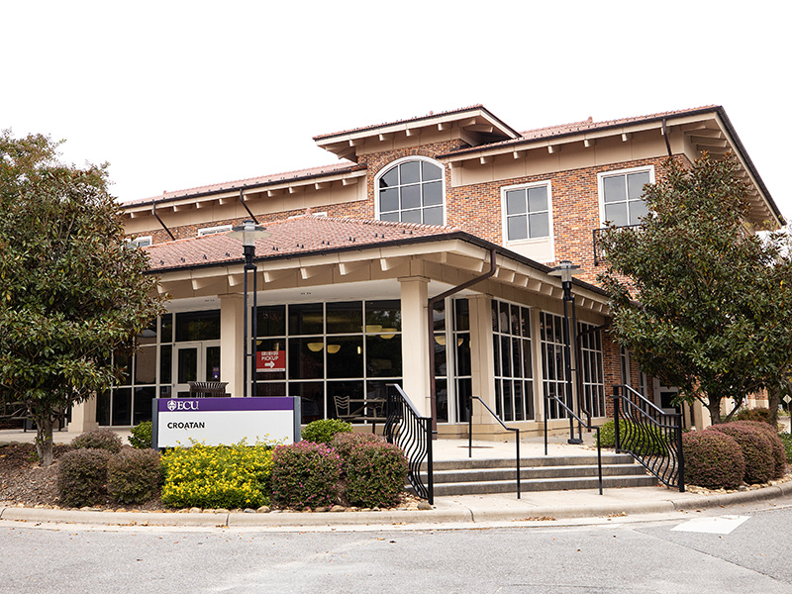
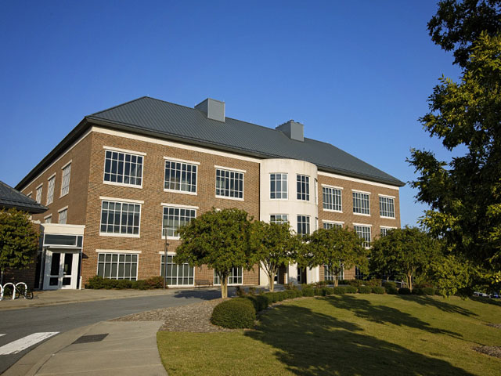
Green Buildings
Notes:
LEED: Leadership in Energy and Environmental Design
State of NC mandates future developments must be designed to meet standards of LEED Silver or higher
Croatan Dining Hall – LEED Silver
MCSC - LEED Silver
Life Sciences BioTech - LEED Silver
Ross Hall – LEED Gold
HSC Student Center – LEED Gold
Coastal Studies Institute – LEED Gold
Where semester at the coast takes place
Gives tours of the environmental aspects of the building

Slide 20
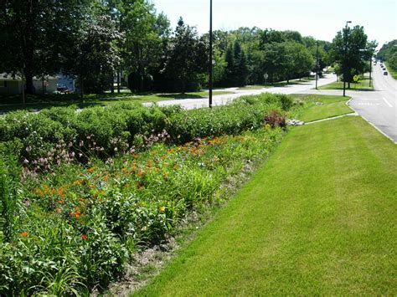
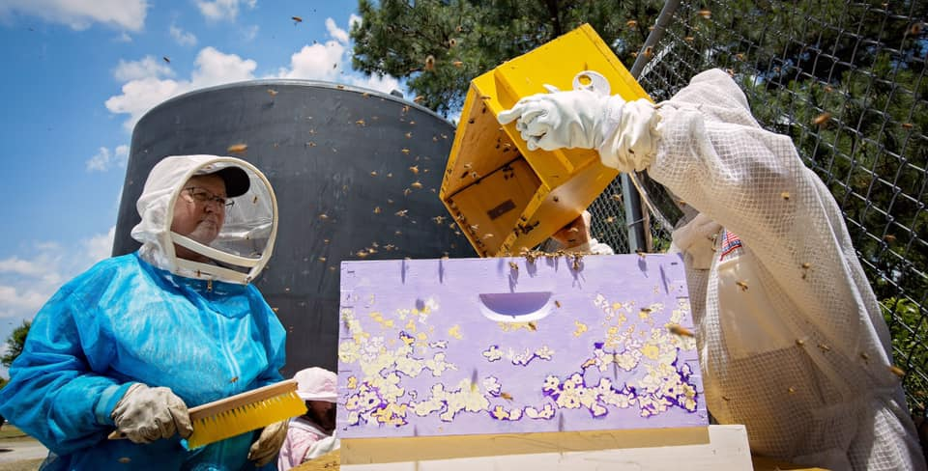
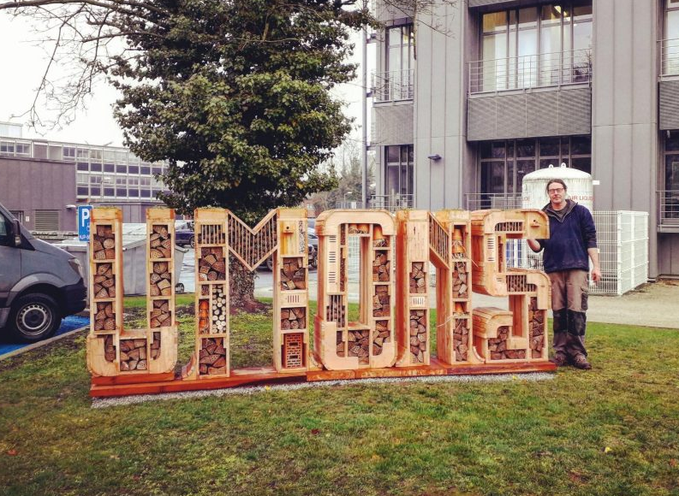
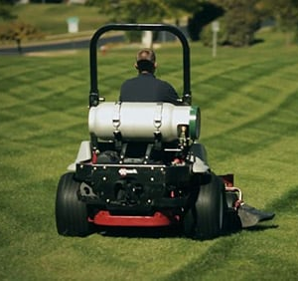
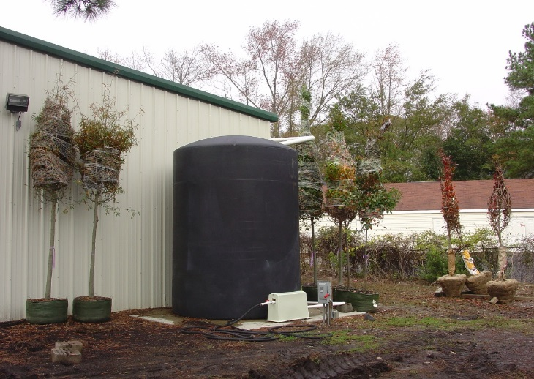
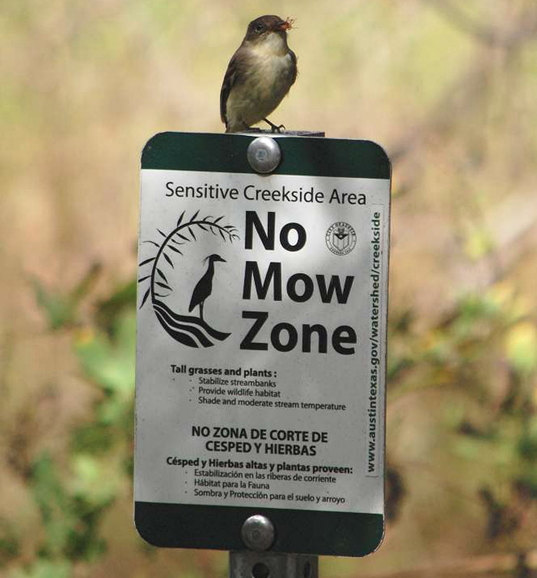
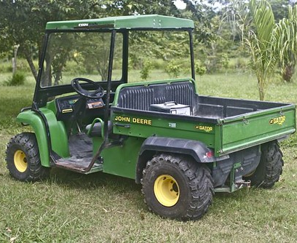
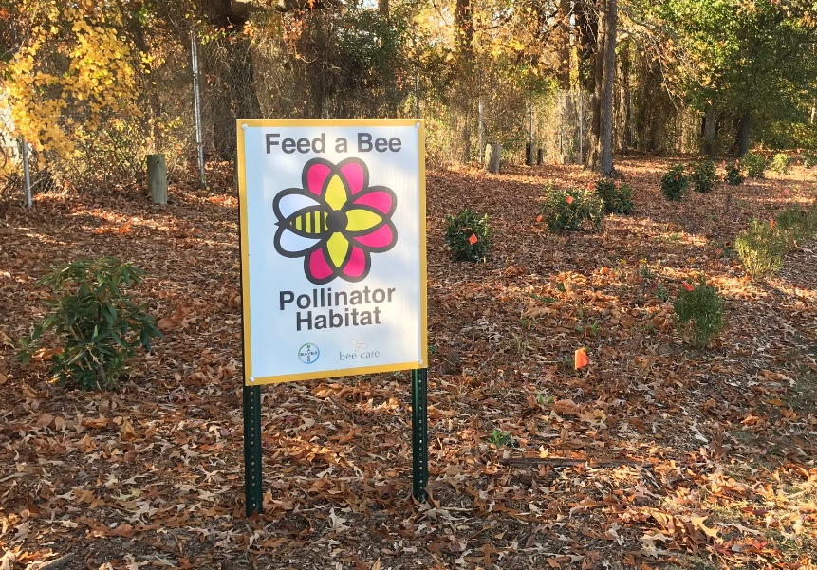
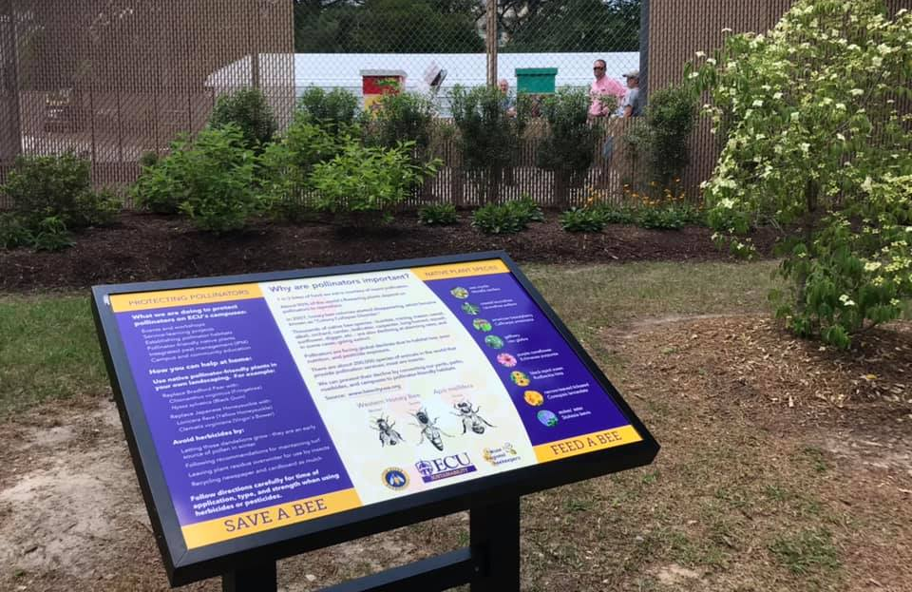
Grounds
Notes:
Cisterns to capture rainwater (15,000 gallon one behind MCSC underground)
Best Management Practice (BMP) Signage
Pollinator habitats
Propane Mowers and Electric Gators
Bioswale, rain gardens, and constructed wetlands- help with stormwater management

Slide 21
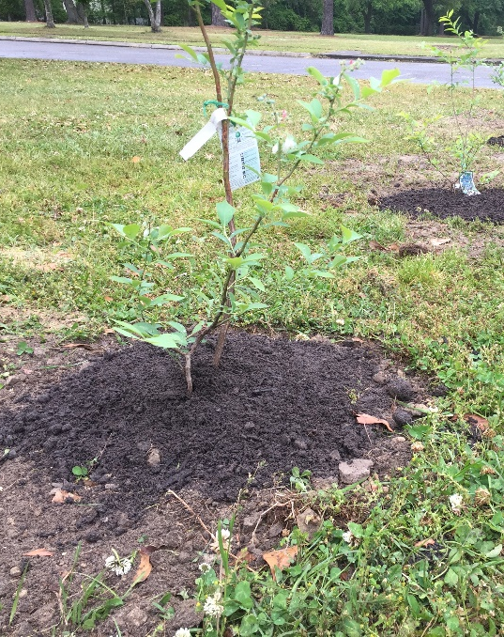
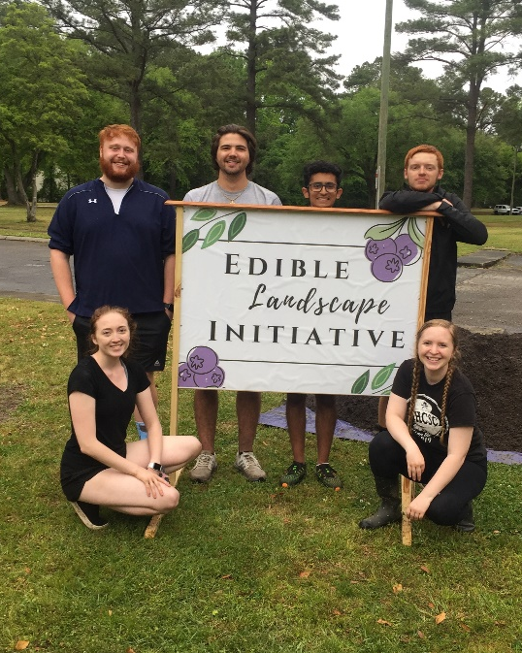
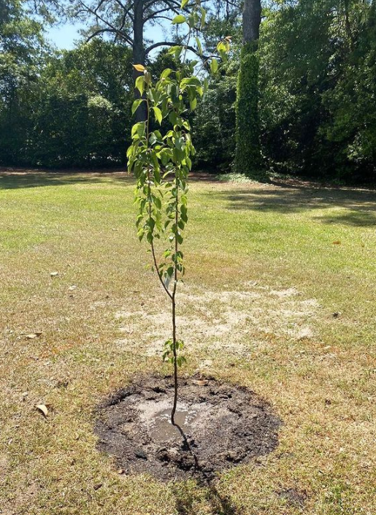
Campus Orchard
Notes:
Across from baseball stadium on Charles blvd in Stratford Arms parking lot

Slide 22
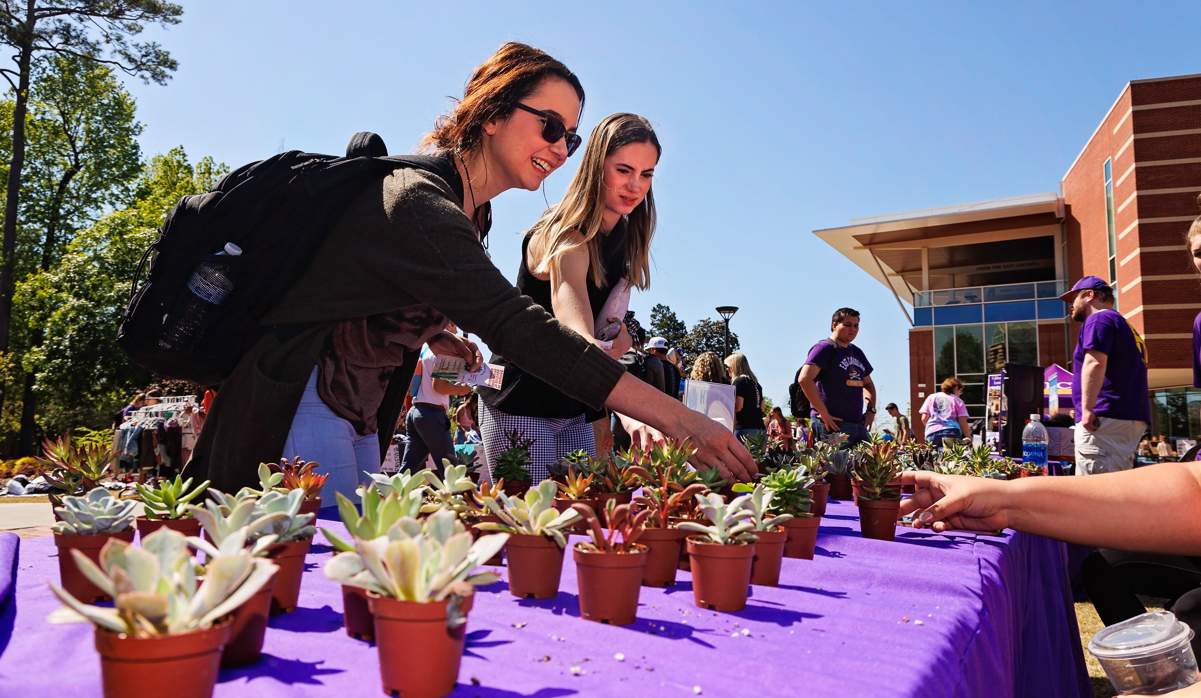
Outreach
Notes:
Events
Get Involved
Volunteer Work
Tips for Everyday
Connect with Us

Slide 23





Green Office
Green Office Training
Seed Assessment

Slide 24



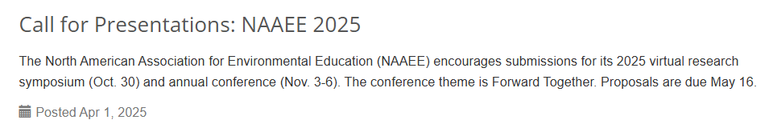
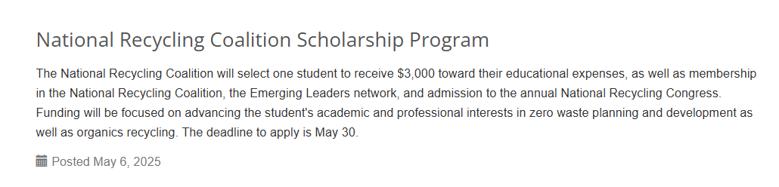
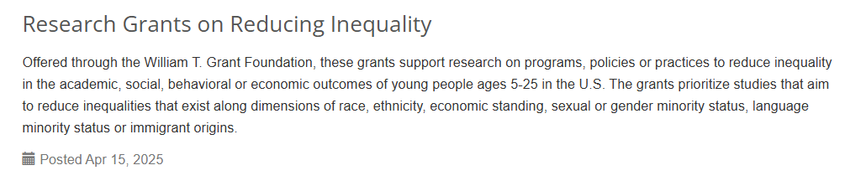
Virtual Education Programs - The Association for the Advancement of Sustainability in Higher Education
AASHE Campus Sustainability Hub

Slide 25
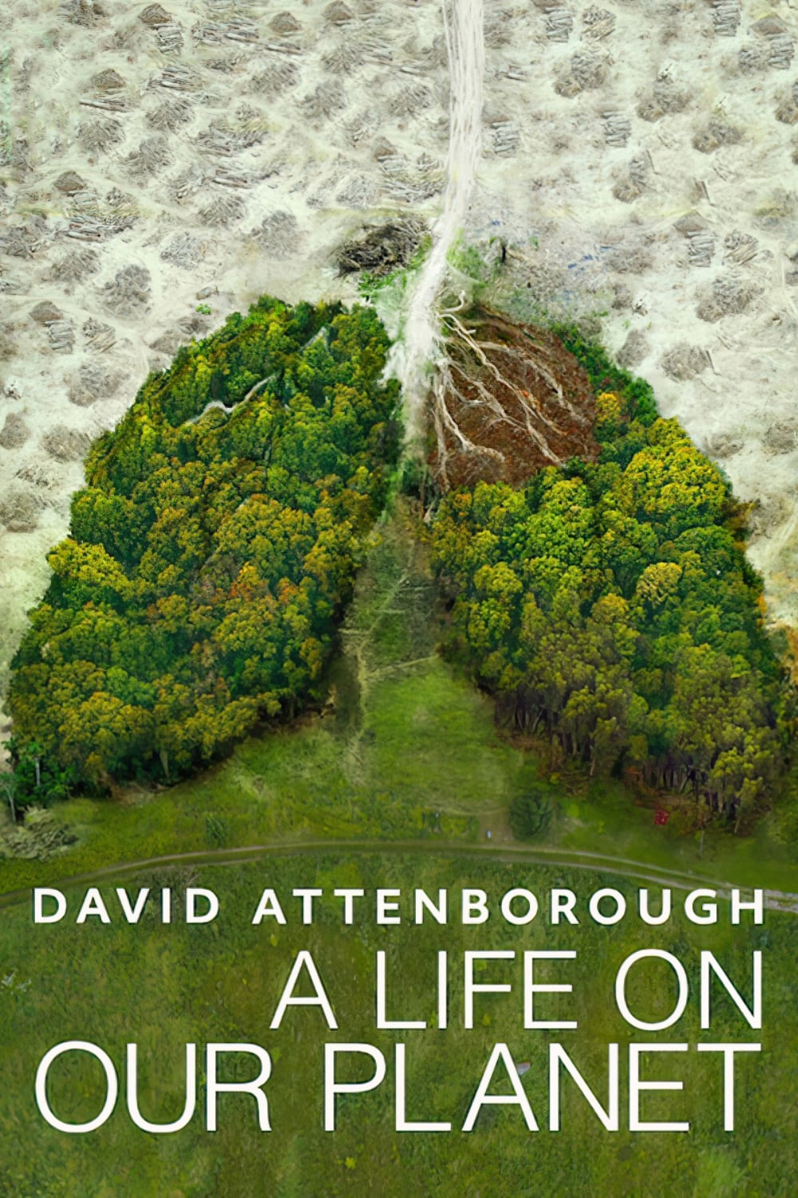
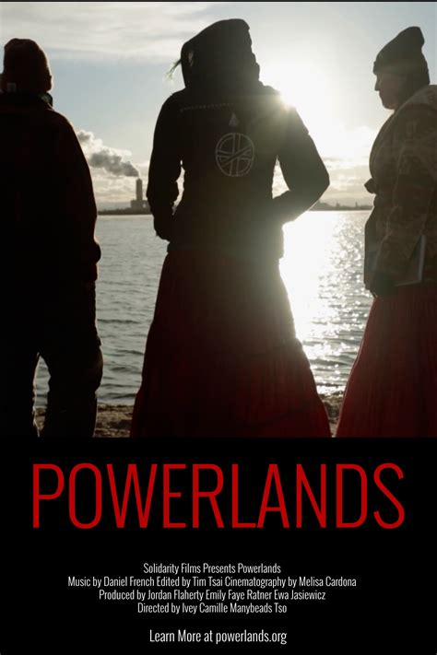




Film & Discussion Series
Notes:
We put a lot of work into these so we ask that you please incentivize students
Extra credit
Make up for missed classes
We welcome film recommendations, esp if it's something you know about and can speak on

Slide 26
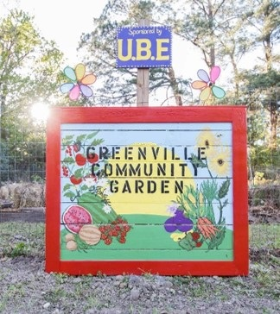

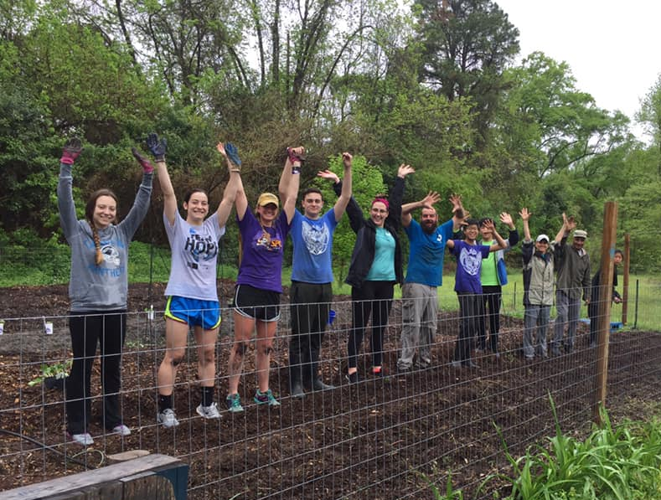
Volunteer Service Opportunities
Greenville Community Garden and Orchard
209 Stancil Drive – By the Tar River Greenway
Workdays from 10am-12pm
Notes:
Community Service Leave

Slide 27
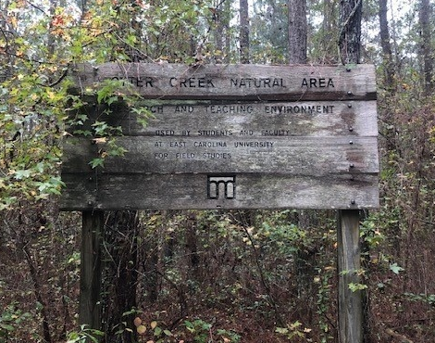
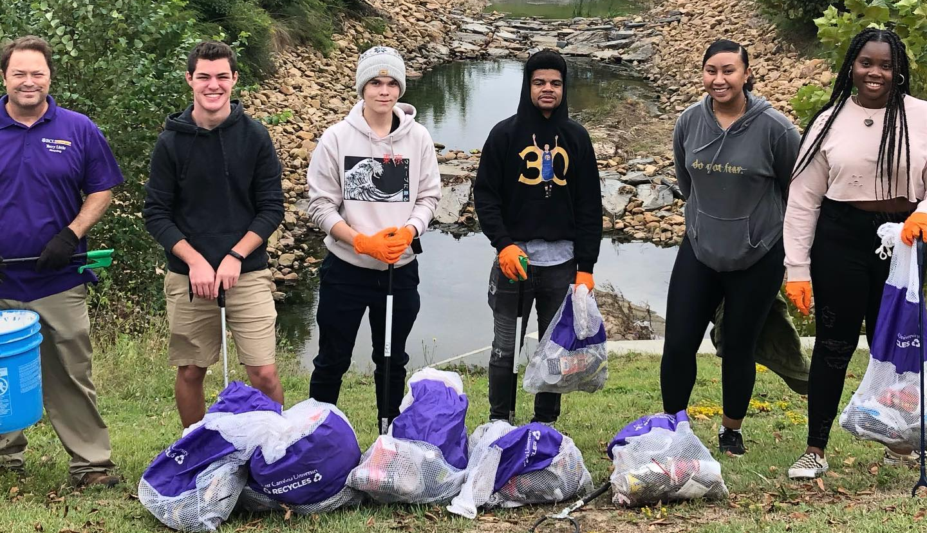
Volunteer Service Opportunities
Town Creek Culvert
Litter Cleanups
Otter Creek Natural Area Trail Maintenance Workdays
Park in the ECU lot behind the Willis Building at 1st Street and Reade Circle. Litter Cleanups will start at 3pm
Meet at the Student Center Bus Loop by 2pm to catch a ride to the site. Trail Workdays will start at 2:30pm

Slide 28

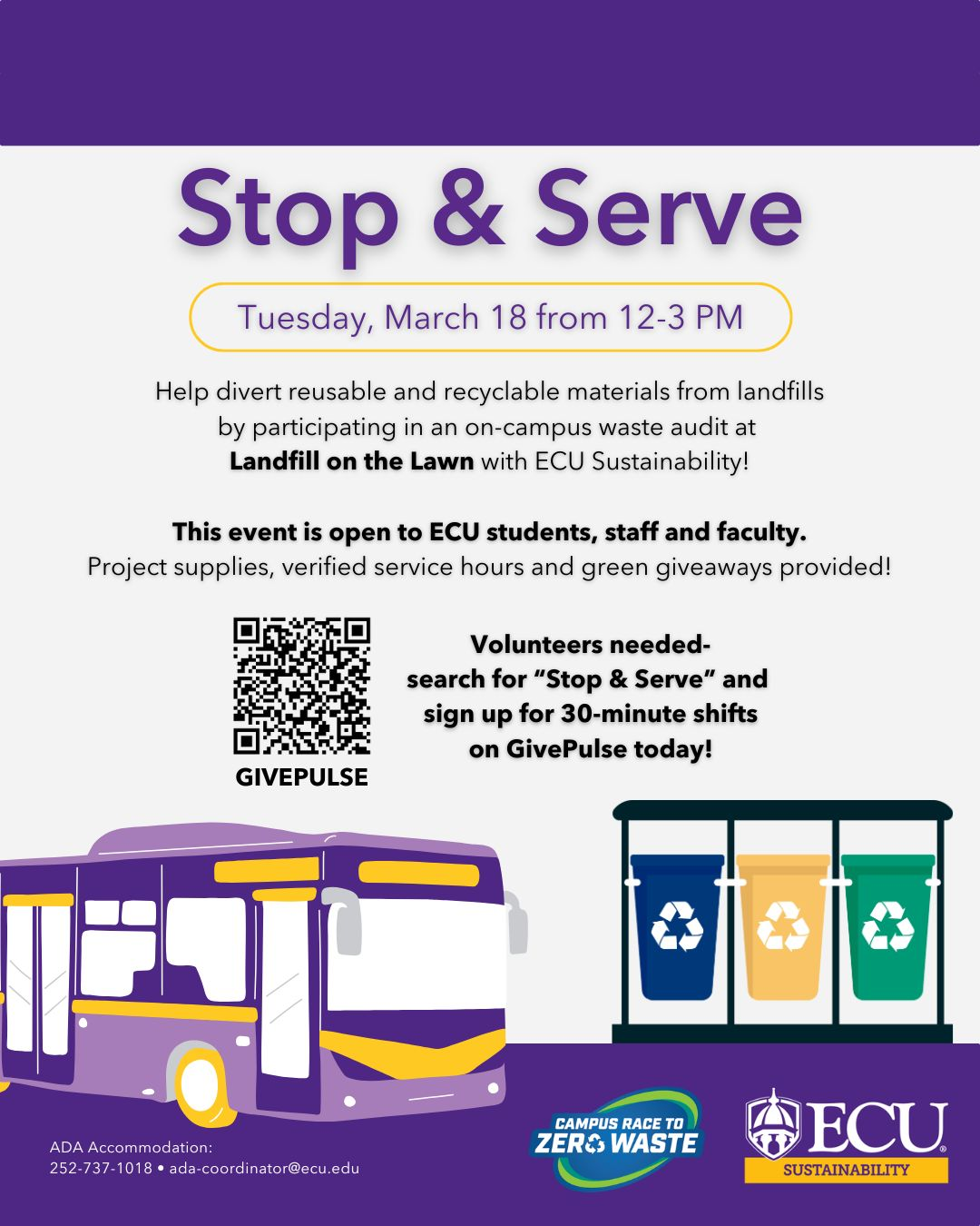




Other Events
Notes:
We put a lot of work into these so we ask that you please incentivize students
Extra credit
Make up for missed classes
We welcome film recommendations, esp if it's something you know about and can speak on

Slide 29





Student Involvement
Notes:
ECO Pirates: Waste Audits, Fundraising Events, River / Greenway Cleanups
Planet ECU: STEM-focused, Environmental, Social & Academic, Geology Club at ECU
Sustainabilibees: focused on spreading awareness, experience, and education surrounding the local pollinator population
ReLeaf: tree planting, campus orchard, Bob Ross social
UterUs: menstrual cup education
Pirates on Water: water resource management
No Confetti ECU

Slide 30





Community Opportunities
Notes:
Always looking for more experts to serve on boards

Slide 31



Health Benefits of Sustainability
Active transportation
Natural cleaning supplies and
  personal care products
Fresh, less processed food
Plant-forward diet
Unplugging from electronics
Natural lighting
Indoors plants

Slide 32




Tips to Live Greener
Eat less meat: Try Meatless Monday or a few days a week
Unplug chargers and other appliances when not in use
Set thermostat to 68 in the winter and 76 in the summer
Only run the dishwasher and washing machine on full loads

Slide 33



Tips to Live Greener
Don’t buy bottled water because it costs about $10 per gallon!!
Bus, bike, walk or carpool as much as possible
Rethink, Reduce, Reuse, Recycle
Educate yourself and spread the word about environmental issues to friends and family
Notes:
350.Org → FIND GREEN TIPS SITE

Slide 34




Connect With Us!
Website:
sustain.ecu.edu
@SustainECU
Monthly Newsletter:
@SustainECU

