Slide 1


Integrating Sustainability into the Curriculum
Susan W. Lally
Clinical Associate Professor
College of Nursing

Slide 2
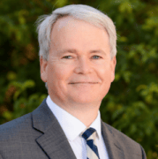
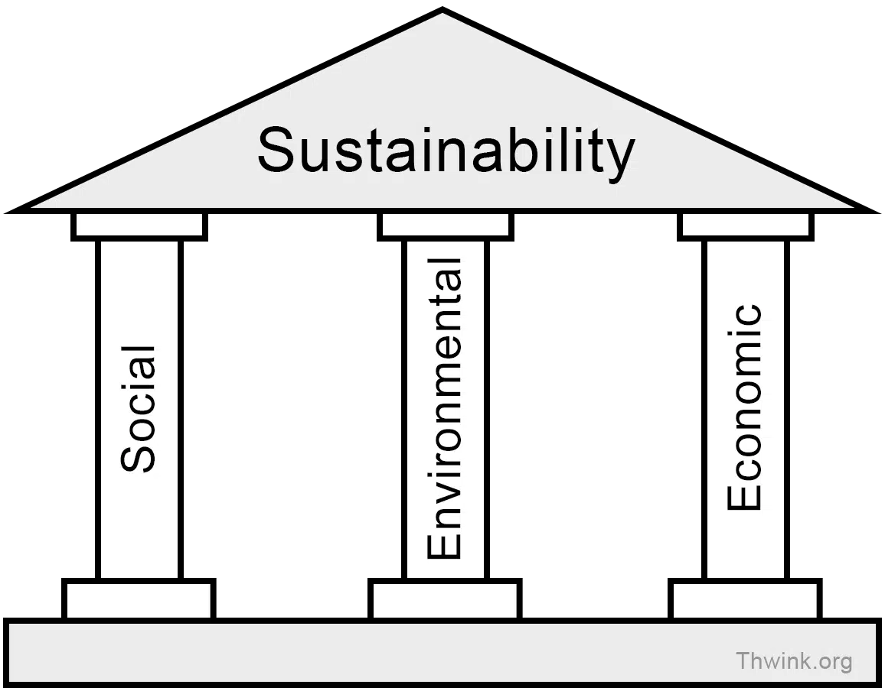
  Sustainability - meeting the needs of the present without compromising the ability of future generations to meet their own needs - Brundtland Commission (1987)
“Sustainability is improving human well-being and ensuring social equity for present and future generations while safeguarding the planet’s life-supporting ecosystems.” - Chris Boone
Notes:
Dean, College of Global Futures – Arizona State University

Slide 3

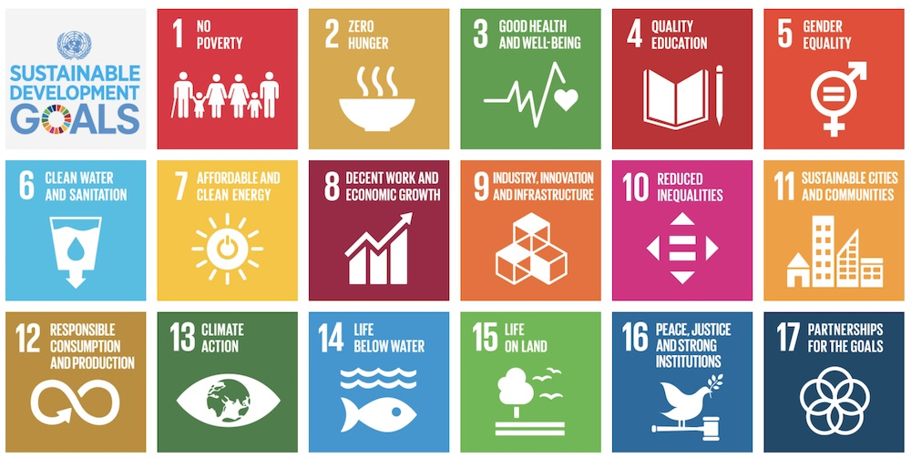
“Given what academics know about the current ecological condition of the planet, there is an obligation for universities to become leaders in the movement to prevent global ecological collapse”
Moore J. 2005. Int J Sust Higher Ed 6: 326-339.
Notes:
Janet Moore

Slide 4
Integrating Sustainability into a Psychiatric/Mental Health Nursing course
My journey…

Slide 5
NURS 3220/3221: Mental Health Care and Promotion
Course Outcomes:
Upon completion of this course, the student will be able to:
Identify mental health nursing principles, issues, evidence-based practice, and concepts as a basis for holistic nursing care of clients with mental health alterations. (SU-1, 2)
Apply clinical reasoning in comprehensive, holistic mental health assessments that prioritize concerns in patients across the lifespan and in diverse care settings, utilizing a team-based approach. (SU-4)
Analyze personal therapeutic communication styles, values, and emotional responses that employ active listening to continually improve empathetic interactions with patients.
Model healthy self-care practices that enhance personal wellness and resiliency.
Engage in advocacy efforts that influence and support health policies and promote equitable access to mental health services. (SU-1)
Demonstrate compassionate care that supports healing, dignity, and well-being through collaboration with interdisciplinary teams, utilizing an approach that develops and implements holistic mental health care plans. (SU-3)

Slide 6
American Nurses Association & American Association of Colleges of Nursing
ANA’s Code of Ethics- Provision 10: “Nursing, through organizations and associations, participates in the global nursing and health community to promote human and environmental health, well-being, and flourishing”
ANA (2020) Scope and Standards of Practice: “Nurses are to assist in creating healthy environments in which individuals, families, groups, and communities can thrive”
AACN Essentials: Core Competencies for Professional Nursing Education- 3.6b Understand the impact of climate change on environmental and population health

Slide 7

AASHE webinar: Trees as Social determinants of health
Your zip code is more influential on your health than your genetic code
Improve social cohesion
Enhanced immune function
Decreased anxiety

Slide 8
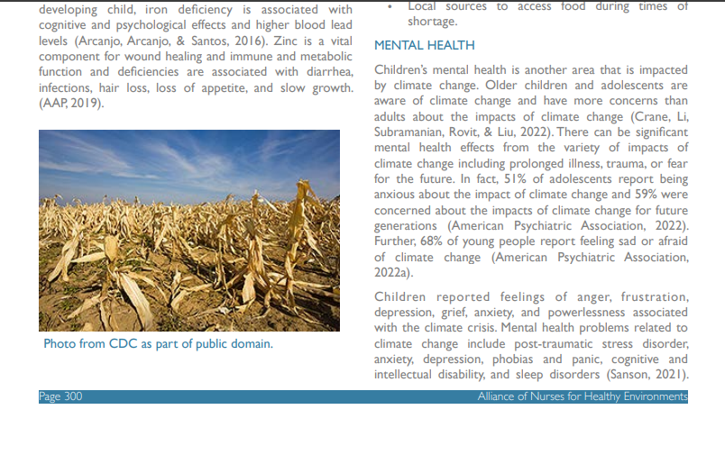
Lectures & Readings
Lecture 1: Social determinants of health; healthy eco-systems
Lecture 2: Kim Fox invited to guest lecture
Lecture 8: Lecture on Sustainability
Climate Health Textbook: “Environmental Health in Nursing, 3rd ed.” (Alliance of Nurses for Healthy Environments)
3 articles- mental health impacts of climate change; How to communicate with patients about climate change; disaster and eco-anxiety

Slide 9
Self-Care & Personal sustainability goal
Implemented over 14 weeks
Students pick a goal for Implementing personal Sustainability and track their progress
Present to their clinical groups at the end of the semester

Slide 10
Clinical Assignments and Post conference discussions
Students complete a mental status assessment that includes assessment of Social determinants of health and environmental assessment
Students assess for eco-anxiety
Perform an environmental assessment with a client; identify mental health consequences related to the environment; Complete a disaster plan with the client; students can go to the website below and print
https://www.americares.org/what-we-do/community-health/climate-resilient-health-clinics/#floods (contains education related to Heat, Floods, Hurricanes, Wildfires/Smoke)
Unit assessment (Psychiatric clinical site): does the site have any resources r/t sustainability? What are nurses' responsibilities? How could they implement sustainable goals/practice?

Slide 11
Reflective Journaling
Week 7
Journal #7 Activity/Prompt:
1) Take a walk outside this week and notice anything that speaks to you about resilience. For example, you might see a tree that has fallen, and new growth is sprouting from some of its’ branches. The new growth might symbolize resilience to you.
2) Reflect on your experience. Explain why this represents resilience to you. Then, think about yourself and describe a time where you have felt resilient or demonstrated resilience in your own life.
"Seeing butterflies around reminded me of transformation and growth because of how much they change after being a caterpillar. This makes me think of how much personal growth I've had since being in college and how far I've made it through nursing school and learned so much."
"I noticed all the daffodils blooming after winter. They still managed to push through after a cold winter. This reminded me of resilience because they overcame the cold and still showed up their vibrant yellow. They rose even in challenges. This made me related to a time I overcame the challenge of losing my father. In a dark season of my life, I still managed to blossom."

Slide 12
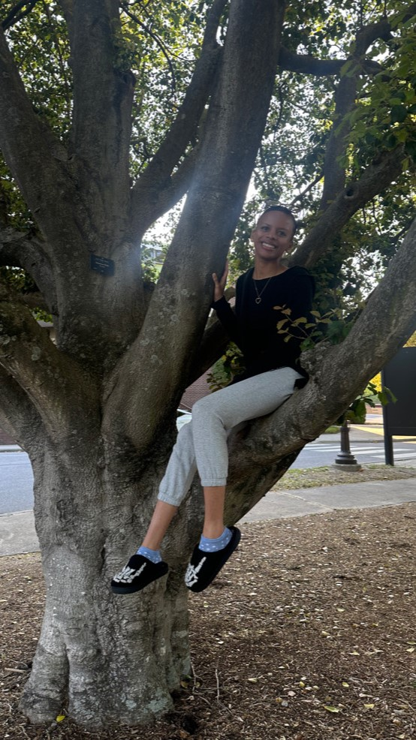
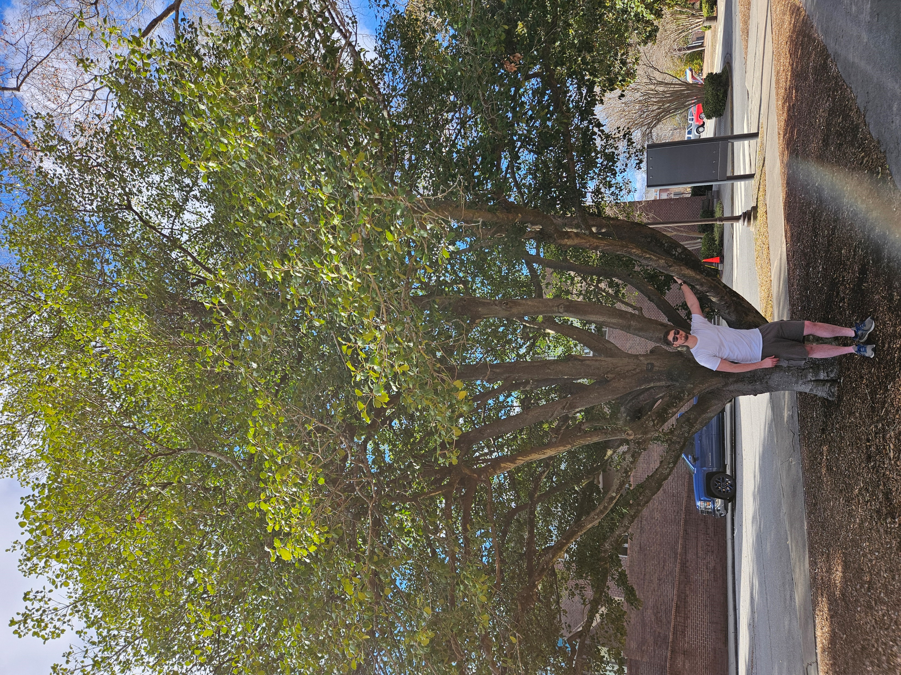
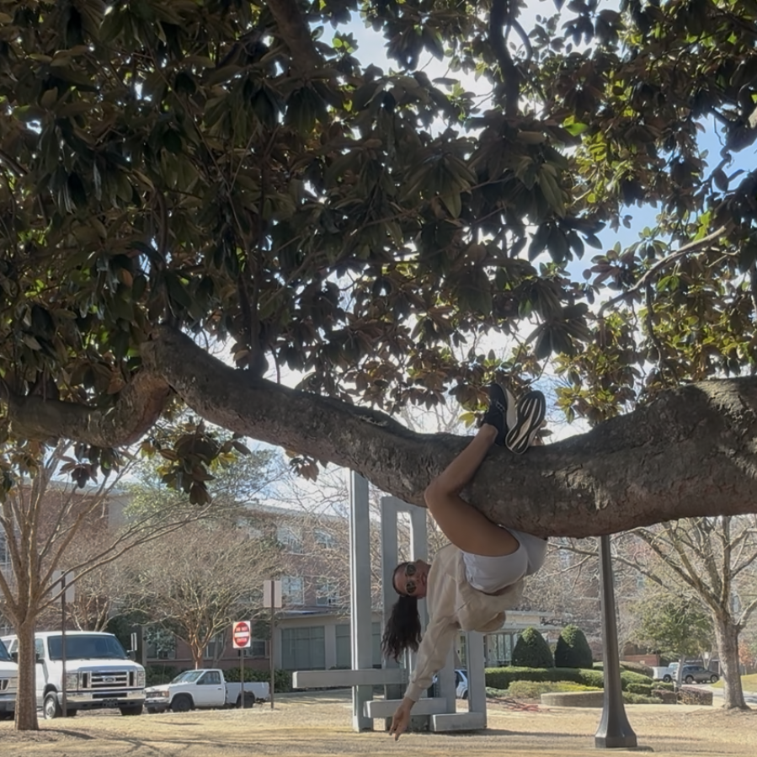
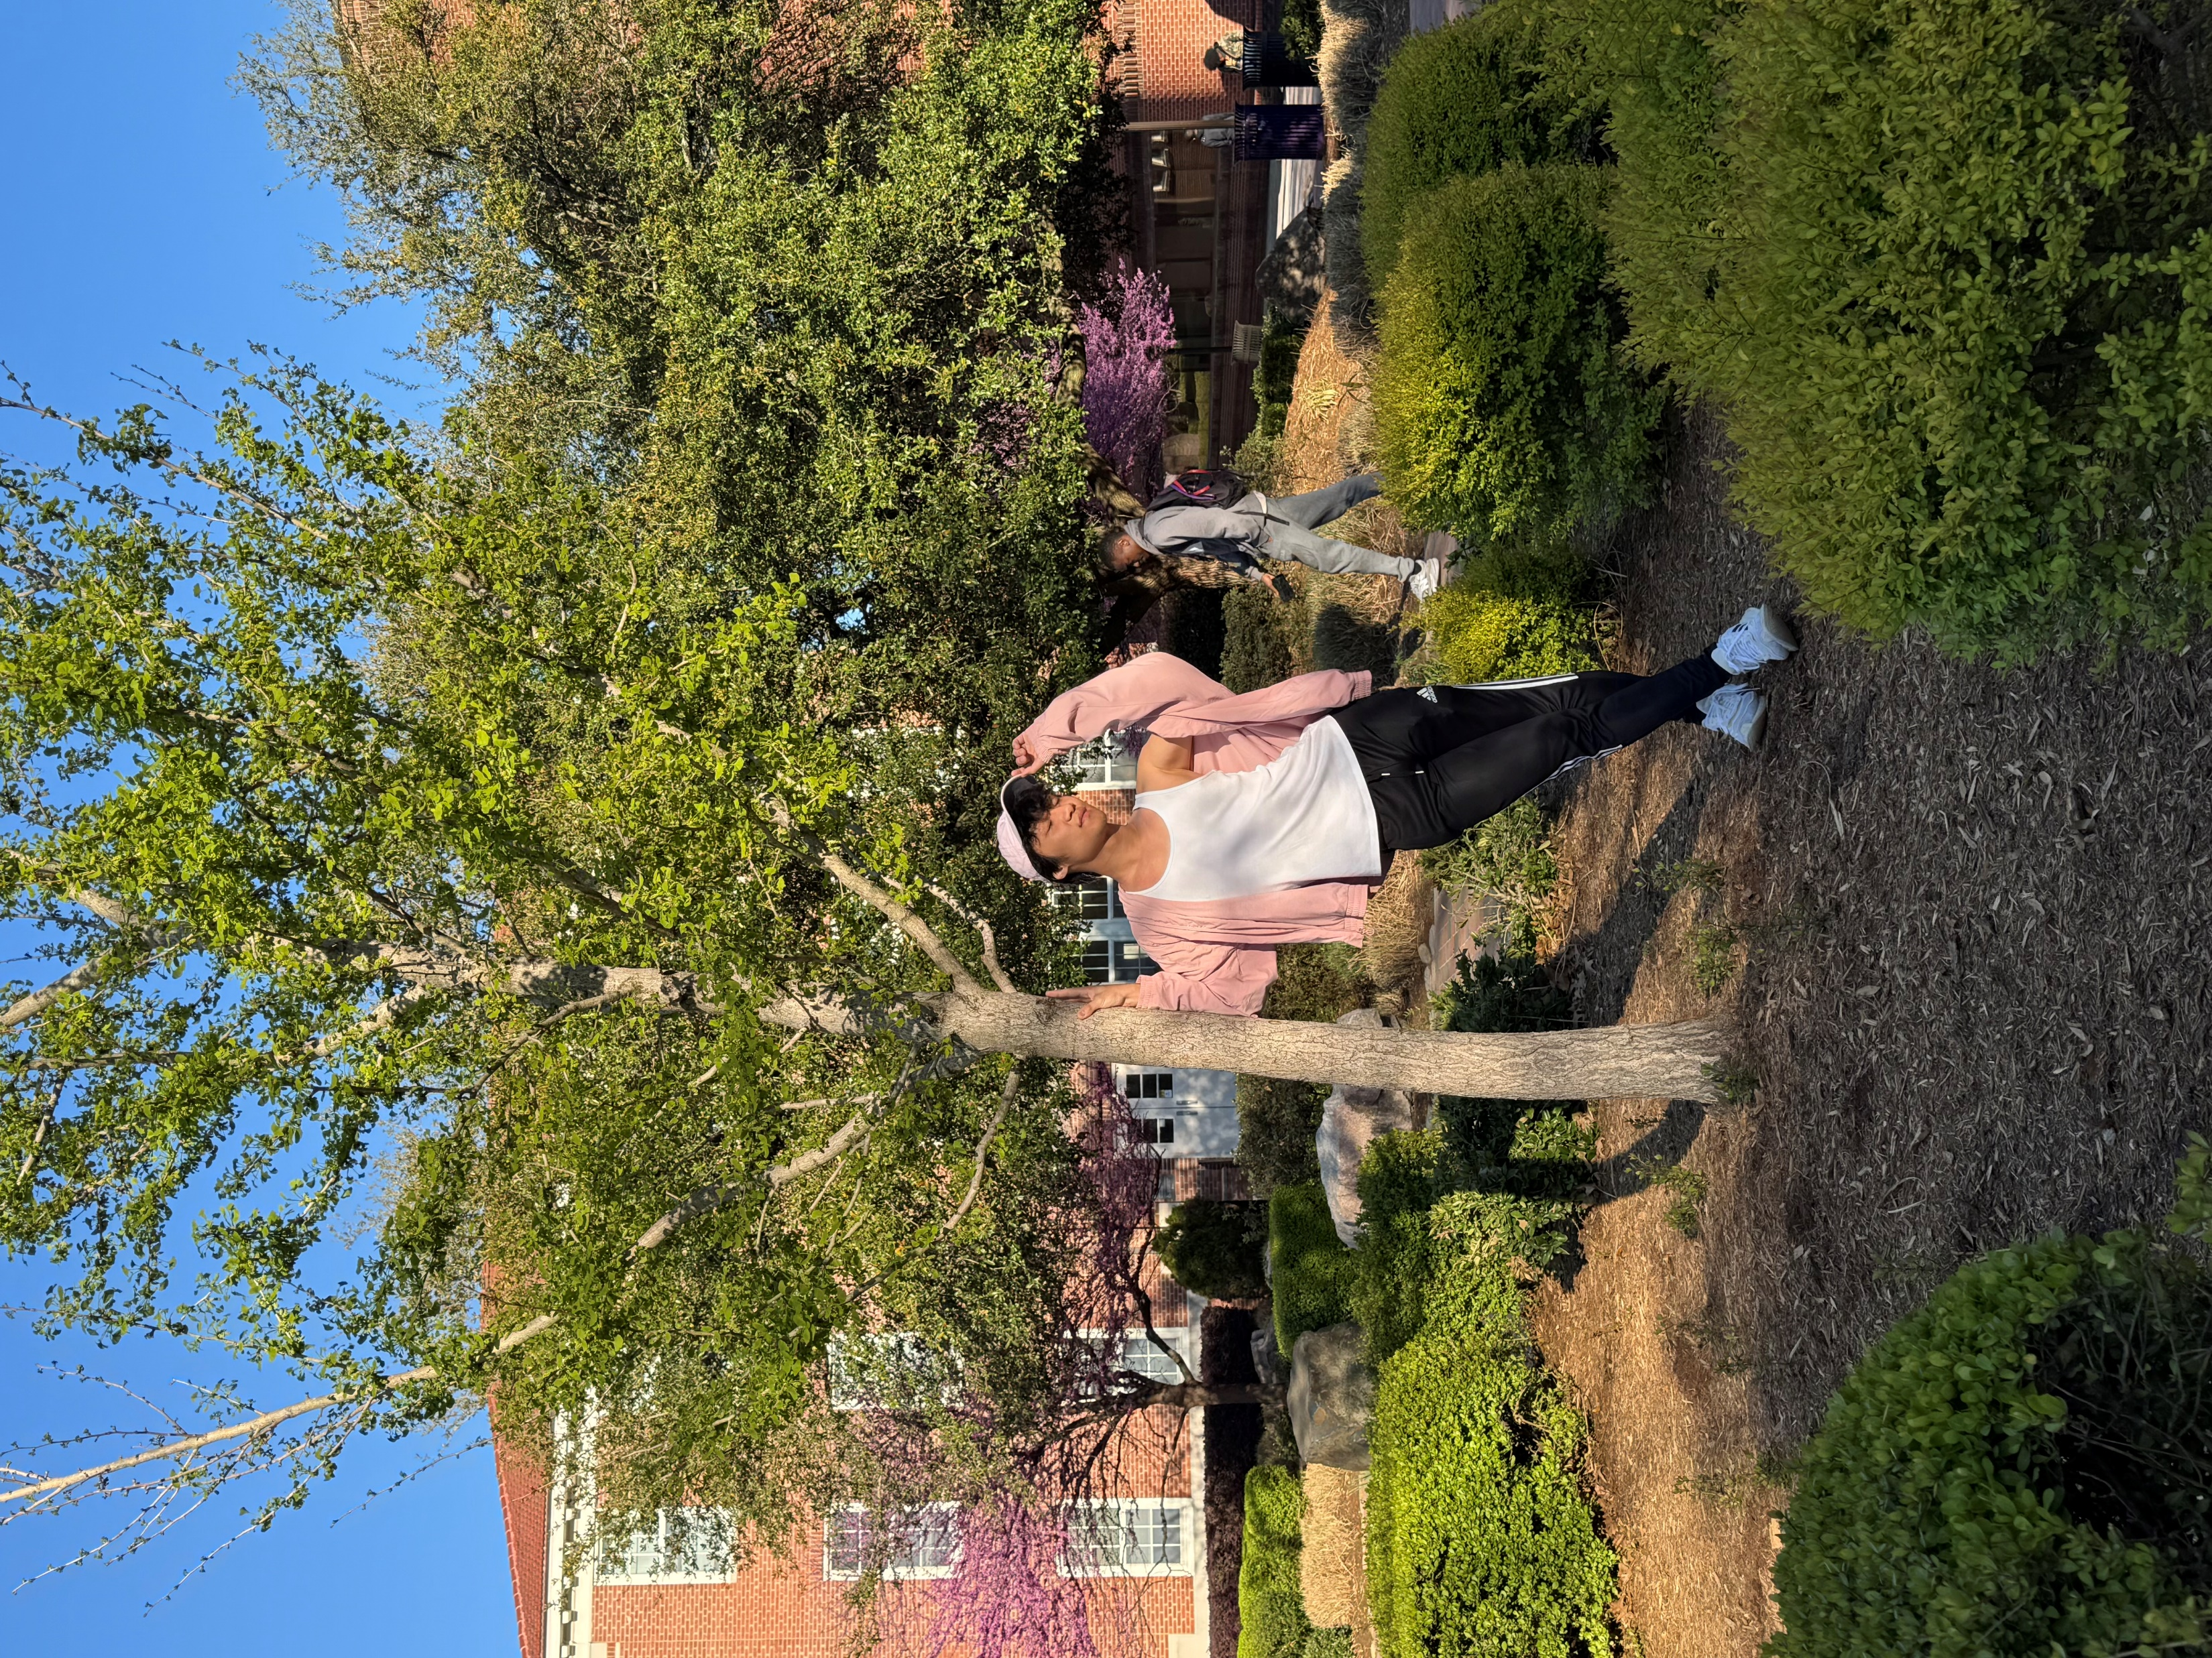
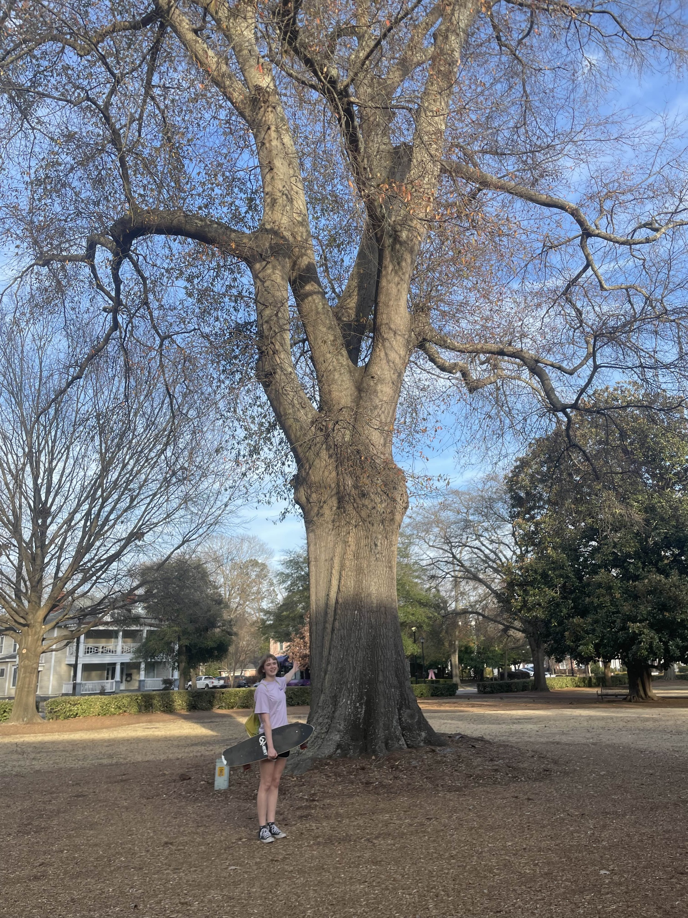
Tree Trail Assignment –Extra Credit
“The American Holly tree was my favorite because it reminds me of the one my mom had planted in our front yard as a kid.”
“This is the southern magnolia, and I love it cause it’s massive and it has the most beautiful flowers!!!
I will be planting one when I become a homeowner”
“My favorite tree is the Gingko, and a fun fact about this tree is that they are living fossils, being dated to around 270 million years ago! (It also can cause bleeding as an herbal supplement 🤭 shout out pharm)”
“The first tree along the the trail which is the American Holly topped all trees for me along the trail. This tree reminded me of a tree outside of the house I grew up in. I would climb that tree for hours and this just brought back a lot of memories! Who would've thought I'd be climbing a tree again haha. “
“This white oak tree was my favorite because I liked its height and size. White oaks live for hundreds of years and are a keystone species. I used to have a white oak of similar size in my front yard. Unfortunately, the tree had to be removed after Hurricane Florence”

Slide 13
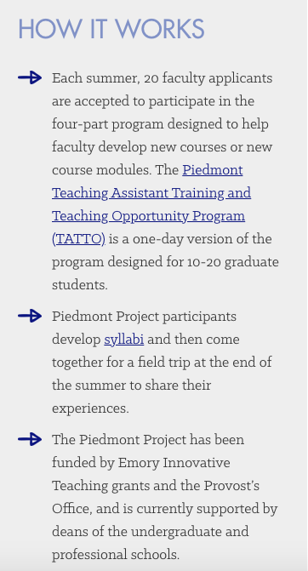
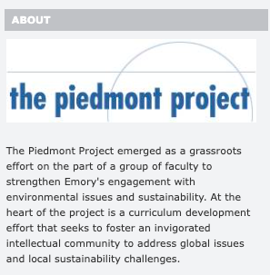
https://piedmont.emory.edu/syllabi/index.html

Slide 14
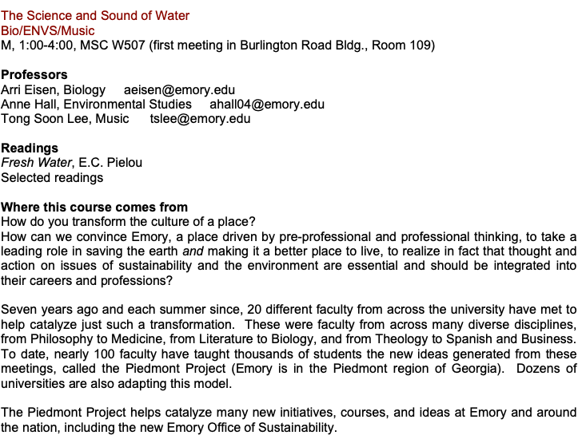
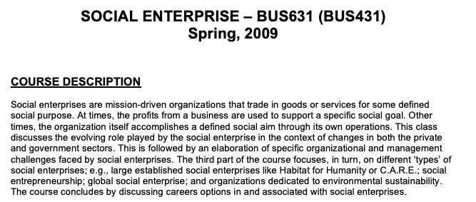

Slide 15
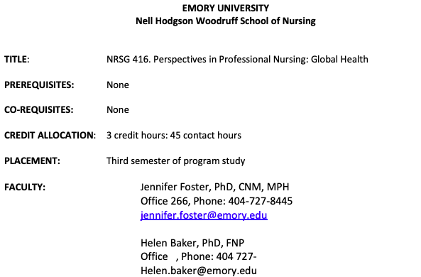
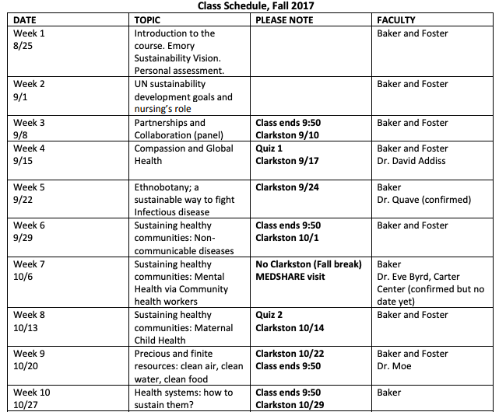
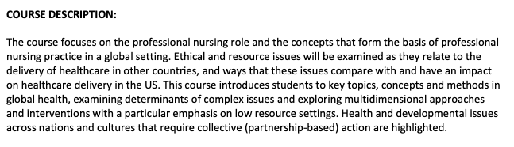

Slide 16



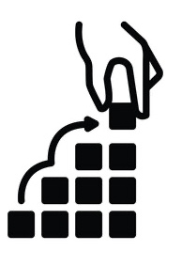

Sustainability Course Designation Justification
  Courses focused on sustainability help students understand a systems-thinking approach to problem solving along the continuum from local to global
  Sustainability course designation signals the importance of sustainability to students, faculty, staff, & university stakeholders
  Students who complete sustainability-focused courses will be prepared to understand & apply sustainability principles & practices as they enter the workforce & continue in civic life
  Sustainability-designated courses must provide foundational exposure to sustainability as a concept and a set of practices
  Sustainability course designation allows students to find & understand sustainability course offerings, which can assist them in planning their academic studies

Slide 17
Sustainability Course Designation Learning Outcomes
Define sustainability and identify major sustainability challenges
Articulate how healthy ecosystems function
Identify and evaluate interconnections between the environment, the economy, and society
Apply critical thinking skills in assessing the effects of human actions on planet Earth

Slide 18
Sustainability Education and ECU Strategic Plan Alignment
Mission Priority 1: Student Success
We offer transformative experiences for all students during their time at ECU and beyond.
Objective M1.1: Strengthen graduation and retention strategies while closing equity gaps to advance opportunity for all.
Objective M1.2: Expand access to and participation in transformative experiences and experiential learning.
Objective M1.3: Align university programs to meet the demands of a dynamic, innovative economy and an evolving workforce.
Mission Priority 2: Public Service
We focus our efforts with the community in mind and to achieve goals that enable us to be more engaged citizens.
Objective M2.1: Increase public engagement with and access to educational and cultural offerings.
Objective M2.2: Grow external sponsorship to support community engagement activities
Mission Priority 3: Regional Transformation
We evaluate our success by the development of our region, informed by local and global perspectives.
Objective M3.1: Strengthen the regional workforce.
Objective M3.2: Expand and enrich external partnerships.
Objective M3.3: Advance regional economic prosperity and sustainability.

Slide 19
Sustainability Education and ECU Strategic Plan Alignment
Vision Priority 1: Social and Economic Mobility
We will be an engine of access and advancement for all learners through innovative teaching, research and creative activities.
Objective V1.1: Increase enrollment and completion rates of underserved populations through a lens of affordability and accessibility.
Objective V1.2: Bolster online course and program offerings.
Objective V1.3: Expand curricular and noncurricular workforce development programs aimed at workforce upskilling and reskilling.
Vision Priority 2: Workforce Success
We cultivate a culture of care, belonging and opportunity for our faculty, staff and learners and all stakeholders.
Objective V2.1: Increase support and utilization of faculty and staff well-being resources.
Objective V2.2: Commit to sustaining an inclusive environment that welcomes a broad representation of persons and perspectives.
Objective V2.3: Prepare university employees with the knowledge and competencies required for successful career journeys.
Vision Priority 3: Rural Health and Well-Being
We will improve health access, sustainability and outcomes for rural communities.
Objective V3.1: Strengthen educational opportunities and academic programs to meet the needs of a rural population.
Objective V3.2: Expand access to health care and wellness options.
Objective V3.3: Collaborate with community and university partners to foster comprehensive well-being.

Slide 20
8 Ways to change your course
Sustainability Component | Department | Example
1. Hidden curriculum | Health Education and Promotion | Assign readings, modules, or assignments focusing on OneHealth approaches that incorporate human, animal, and environmental health
2. New readings | Women's Studies | Assigned reading: Earthcare: Women and the Environment (collection of essays) & reflection paper
3. New assignment | Public Health | Assignment(s) that focus on the social and environmental frameworks of human health. Identify variables and create sustaining models to improve human health
4. New unit/module | Marketing and Supply Chain Management | Create module or unit that examines “Green Logistics” that includes an investigation of this approach and specific application (e.g., biodegradable packaging, electric vehicles)

Slide 21
Sustainability Component | Department | Example
5. New student project | Engineering | Senior thesis/internship/final project that incorporates theory and method with ”hands-on” solutions to employ sustainable approaches
6. Guest speaker | Interior Design and Merchandising | Host a botanist/ecologist to discuss the life cycles of cotton clothing: water and fertilizer requirements, carrying capacities, environmental impacts of dyes
7. New course | Foreign Language and Literature | Study abroad program with course(s) addressing environmental/urban sustainability to gain another society’s perspective
8. Engaged learning | Nutrition | community experience: Students in a food/nutrition class go to work for a couple hours on a local farm a few times throughout the semester

Slide 22
Sustainability Pedagogical Approaches:
Inquiry-Based Learning: Students learn through investigation of a research problem and scholarly discussions related to the investigation (Kalsoom & Khanam, 2017)
Service Learning: Students learn through meeting the needs of a specific community or setting, supplemented by reflexive exercises (Hernández-Barco et al., 2020)
Experiential Learning: Students learn through translating knowledge into action by working to engage with real-world situations (Savage et al., 2015)
Project-Based Learning: Students learn through self-directed, collaborative learning that focuses on addressing place-based issues, often through stakeholder engagement (Wiek et al., 2014)
Transdisciplinary Learning: Students learn through generating knowledge in the form of novel solution options to sustainability problems in collaboration with stakeholders within and beyond higher education settings (Brundiers & Wiek, 2013)

Slide 23
Sustainability Key Competencies:
Systems-Thinking Competency: The ability to collectively analyze sustainability problems cutting across different domains and scales
Futures-Thinking Competency: The ability to collectively analyze, evaluate, and craft rich ‘pictures’ of the future related to sustainability issues
Values-Thinking Competency: The ability to collectively map, specify, apply, reconcile, and negotiate sustainability values, principles, goals, targets, and trade-offs
Strategic-Thinking Competency: The ability to collectively design and implement interventions, transitions, and transformative governance strategies toward sustainability
Interpersonal Competency: The ability to motivate, enable, and facilitate collaborative and participatory sustainability research and problem solving
Intrapersonal Competency: The ability to consciously and proactively engage as a change agent for sustainability, by reflecting on, regulating, motivating, and continually evaluating one’s emotions, desires, thoughts, and behaviors
Implementation Competency: The ability to realize a planned solution on the ground, particularly through addressing emerging challenges in an iterative process between planning, realization, and evaluation
Integrated Problem-Solving Competency: The ability to integrate problem analysis, sustainability assessment, visioning and strategy building in order to develop viable solution options and apply appropriate problem-solving frameworks

Slide 24
Teamwork skills, communication abilities, understanding your community – no one in the room needs to work on this… establishing and maintaining communication, regular reporting
Successful Sustainability Curriculum
Systems thinking
Anticipatory competence
Normative competence
Strategic competence
Interpersonal competence
Understanding challenges and how they are situated in the world
Envisioning and constructing possible and desirable results for the system – developing assignments, readings, units
Formulating strategies to implement sustainable initiatives that are effective on the ground – connecting to the community (face to face, video stream)
Thinking of alternative futures and the desires of local stakeholders – course discussions, internships
Wick et al. 2011 Sus, Sci. 6:203-218

Slide 25





Some resources

Slide 26


Acknowledgments
Thanks to Chad Carwein and Kim Fox for organizing this symposium! And thanks to all the attendees of the symposium.

